Slide 1
Choufli Taxi
Portail Mobile Application – Choufli Taxi
www.Chouflitaxi.net

Slide 2
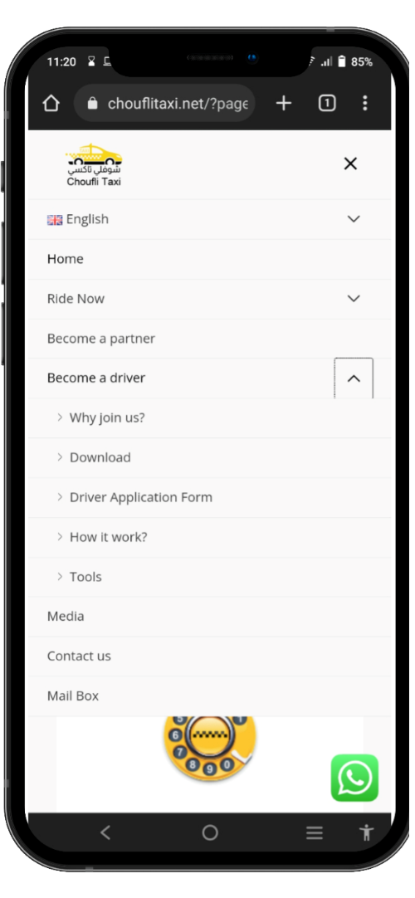
SlideSalad- COPYRIGHT NOTICE
Visitez le site Web
SlideSalad is #1 online marketplace of premium presentations templates for all needs
Things you can do with the template
Use the free templates for your own presentations and projects without limitations.
Please link back to our website if you like our free designs or write a comment to this template on our website.
All copyright and intellectual property rights, without limitation, are retained by SlideSalad.com. By downloading and using this template, you agree to this statement.
Please contact us if you have any questions about usage: support@slidesalad.com
Things you can’t do with the template
Resell or distribute the templates or backgrounds.
Make these templates available on a website or social network for download.
Edit or modify the downloaded templates and claim / pass off as your own work.
Visitez le site Chouflitaxi.net
Veuillez visiter le site Web www.chouflitaxi.net et cliquez sur le menu "Devenir chauffeur" puis cliquez sur le sous-menu "Outils".
More PowerPoint, Google Slides and Keynote templates are available at www.SlideSalad.com

Slide 3
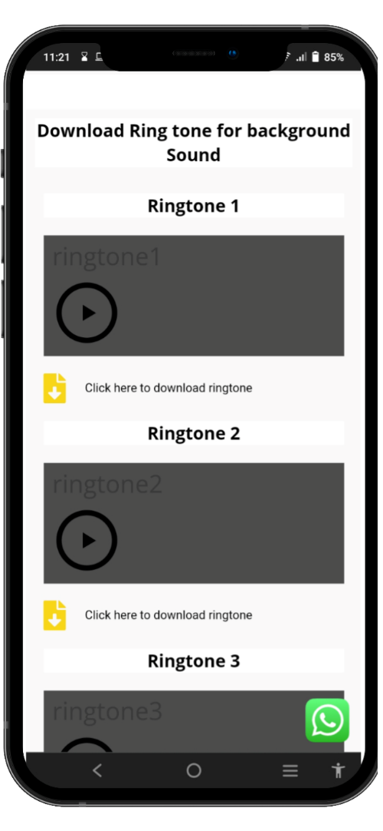
SlideSalad- COPYRIGHT NOTICE
Page Outils
SlideSalad is #1 online marketplace of premium presentations templates for all needs
Things you can do with the template
Use the free templates for your own presentations and projects without limitations.
Please link back to our website if you like our free designs or write a comment to this template on our website.
All copyright and intellectual property rights, without limitation, are retained by SlideSalad.com. By downloading and using this template, you agree to this statement.
Please contact us if you have any questions about usage: support@slidesalad.com
Things you can’t do with the template
Resell or distribute the templates or backgrounds.
Make these templates available on a website or social network for download.
Edit or modify the downloaded templates and claim / pass off as your own work.
Page Outils
Sur la page Outils, veuillez vous rendre dans la section télécharger la sonnerie. Il existe trois types de sonneries disponibles. Ainsi, vous pouvez jouer chaque sonnerie et sélectionner une sonnerie et cliquer sur l'option de téléchargement pour la télécharger sur votre appareil mobile.
More PowerPoint, Google Slides and Keynote templates are available at www.SlideSalad.com

Slide 4
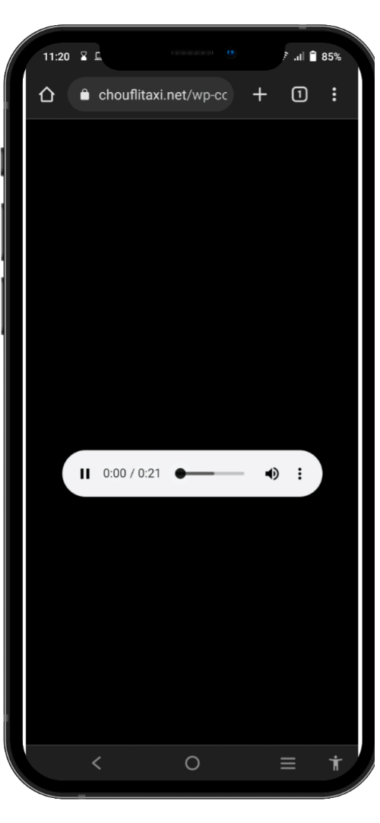
SlideSalad- COPYRIGHT NOTICE
Télécharger la sonnerie
SlideSalad is #1 online marketplace of premium presentations templates for all needs
Things you can do with the template
Use the free templates for your own presentations and projects without limitations.
Please link back to our website if you like our free designs or write a comment to this template on our website.
All copyright and intellectual property rights, without limitation, are retained by SlideSalad.com. By downloading and using this template, you agree to this statement.
Please contact us if you have any questions about usage: support@slidesalad.com
Things you can’t do with the template
Resell or distribute the templates or backgrounds.
Make these templates available on a website or social network for download.
Edit or modify the downloaded templates and claim / pass off as your own work.
Télécharger la sonnerie
Une fois le bouton de téléchargement cliqué. Automatiquement, le pilote sera redirigé vers la page de téléchargement. Il faut cliquer sur l'icône last : pour afficher l'option de téléchargement.
More PowerPoint, Google Slides and Keynote templates are available at www.SlideSalad.com

Slide 5
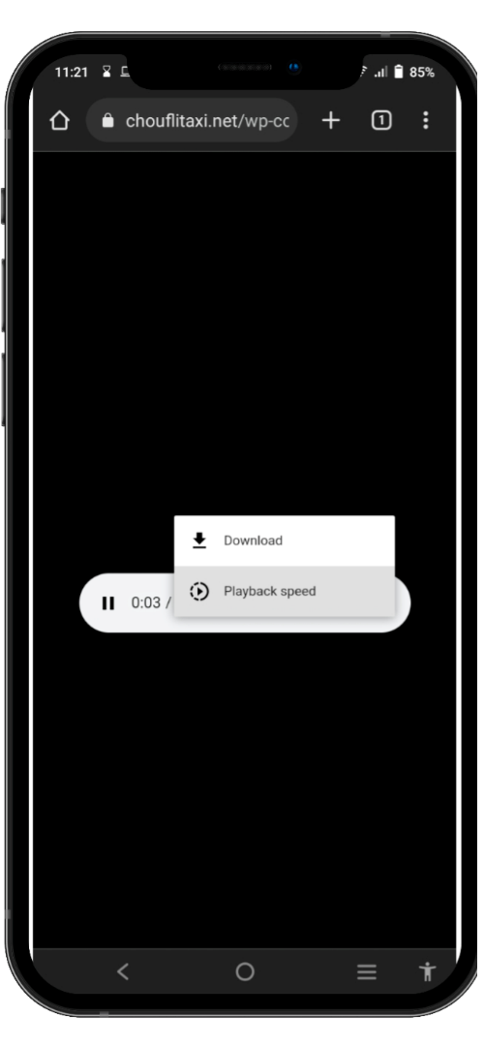
SlideSalad- COPYRIGHT NOTICE
Télécharger la sonnerie
SlideSalad is #1 online marketplace of premium presentations templates for all needs
Things you can do with the template
Use the free templates for your own presentations and projects without limitations.
Please link back to our website if you like our free designs or write a comment to this template on our website.
All copyright and intellectual property rights, without limitation, are retained by SlideSalad.com. By downloading and using this template, you agree to this statement.
Please contact us if you have any questions about usage: support@slidesalad.com
Things you can’t do with the template
Resell or distribute the templates or backgrounds.
Make these templates available on a website or social network for download.
Edit or modify the downloaded templates and claim / pass off as your own work.
Télécharger la sonnerie
Cliquez sur l'option Télécharger pour télécharger la sonnerie sur votre appareil mobile.
More PowerPoint, Google Slides and Keynote templates are available at www.SlideSalad.com

Slide 6
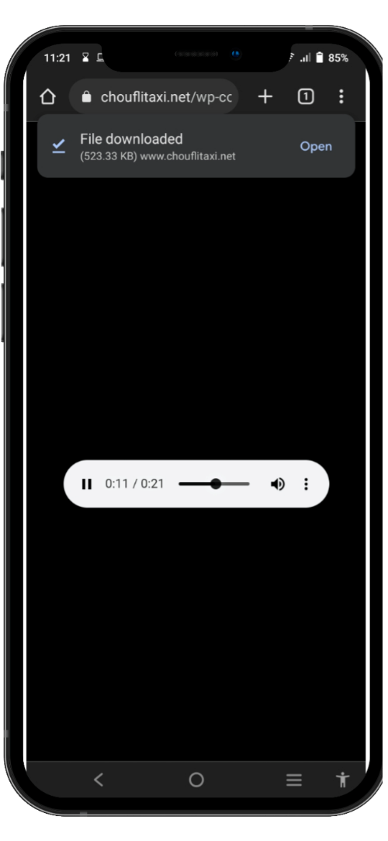
SlideSalad- COPYRIGHT NOTICE
Téléchargement terminé
SlideSalad is #1 online marketplace of premium presentations templates for all needs
Things you can do with the template
Use the free templates for your own presentations and projects without limitations.
Please link back to our website if you like our free designs or write a comment to this template on our website.
All copyright and intellectual property rights, without limitation, are retained by SlideSalad.com. By downloading and using this template, you agree to this statement.
Please contact us if you have any questions about usage: support@slidesalad.com
Things you can’t do with the template
Resell or distribute the templates or backgrounds.
Make these templates available on a website or social network for download.
Edit or modify the downloaded templates and claim / pass off as your own work.
Téléchargé avec succès
La sonnerie sera téléchargée avec succès sur votre appareil. Vous pouvez trouver un lien court pour ouvrir la sonnerie téléchargée sur votre appareil.
More PowerPoint, Google Slides and Keynote templates are available at www.SlideSalad.com

Slide 7
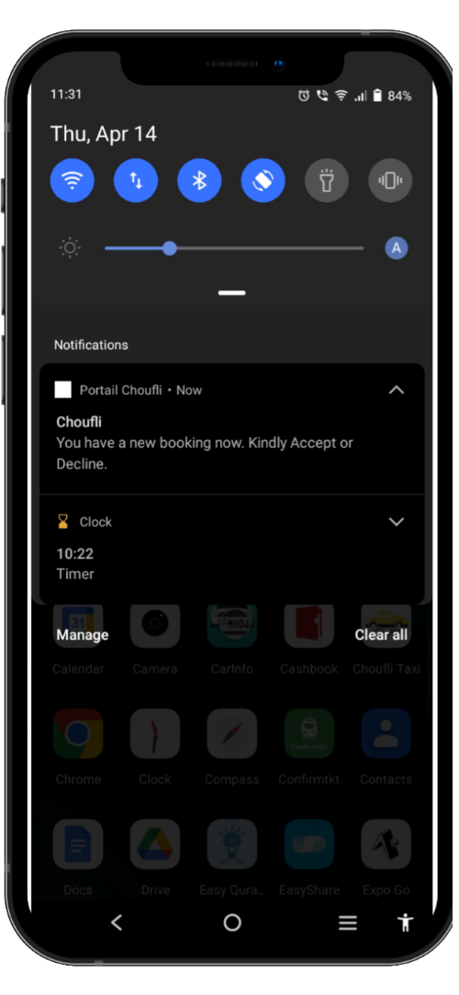
SlideSalad- COPYRIGHT NOTICE
Mettre sonnerie
SlideSalad is #1 online marketplace of premium presentations templates for all needs
Things you can do with the template
Use the free templates for your own presentations and projects without limitations.
Please link back to our website if you like our free designs or write a comment to this template on our website.
All copyright and intellectual property rights, without limitation, are retained by SlideSalad.com. By downloading and using this template, you agree to this statement.
Please contact us if you have any questions about usage: support@slidesalad.com
Things you can’t do with the template
Resell or distribute the templates or backgrounds.
Make these templates available on a website or social network for download.
Edit or modify the downloaded templates and claim / pass off as your own work.
Nouvelle sonnerie personnalisée
Appuyez longuement sur la notification d'alerte de réservation pour définir la sonnerie téléchargée comme son de notification pour l'application Portail Choufli.
More PowerPoint, Google Slides and Keynote templates are available at www.SlideSalad.com

Slide 8
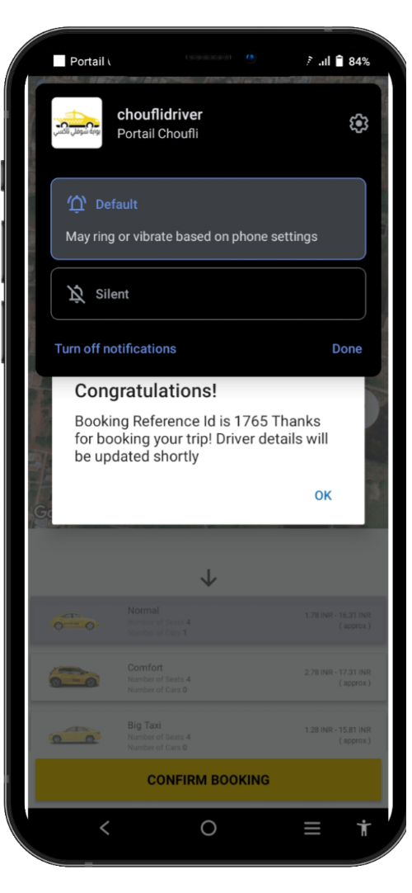
SlideSalad- COPYRIGHT NOTICE
Mettre sonnerie
SlideSalad is #1 online marketplace of premium presentations templates for all needs
Things you can do with the template
Use the free templates for your own presentations and projects without limitations.
Please link back to our website if you like our free designs or write a comment to this template on our website.
All copyright and intellectual property rights, without limitation, are retained by SlideSalad.com. By downloading and using this template, you agree to this statement.
Please contact us if you have any questions about usage: support@slidesalad.com
Things you can’t do with the template
Resell or distribute the templates or backgrounds.
Make these templates available on a website or social network for download.
Edit or modify the downloaded templates and claim / pass off as your own work.
Nouvelle sonnerie personnalisée
Vous trouverez l'option appelée "Par défaut", sélectionnez cette option et elle sera redirigée vers la section suivante.
More PowerPoint, Google Slides and Keynote templates are available at www.SlideSalad.com

Slide 9
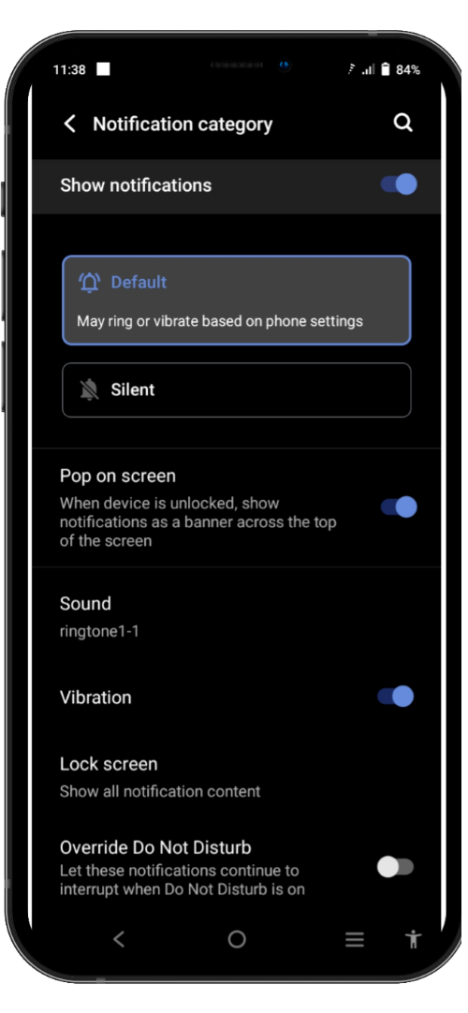
SlideSalad- COPYRIGHT NOTICE
Mettre sonnerie
SlideSalad is #1 online marketplace of premium presentations templates for all needs
Things you can do with the template
Use the free templates for your own presentations and projects without limitations.
Please link back to our website if you like our free designs or write a comment to this template on our website.
All copyright and intellectual property rights, without limitation, are retained by SlideSalad.com. By downloading and using this template, you agree to this statement.
Please contact us if you have any questions about usage: support@slidesalad.com
Things you can’t do with the template
Resell or distribute the templates or backgrounds.
Make these templates available on a website or social network for download.
Edit or modify the downloaded templates and claim / pass off as your own work.
Nouvelle sonnerie personnalisée
Cette page sera ouverte et vous pourrez trouver l'option "Son". Par défaut, le son de notification sera défini comme son mobile par défaut. Nous devons donc le changer pour le son de la sonnerie téléchargée. Alors sélectionnez l'option "Son"
More PowerPoint, Google Slides and Keynote templates are available at www.SlideSalad.com

Slide 10
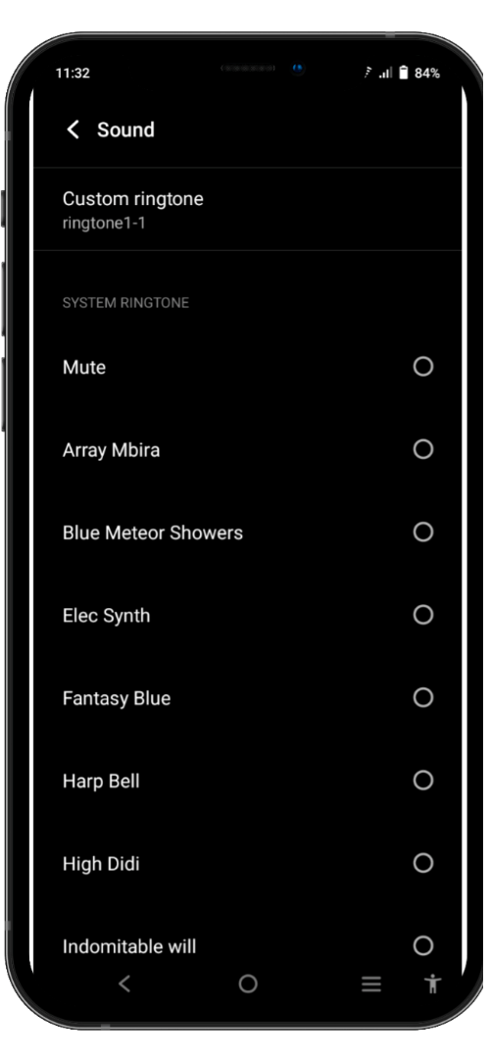
SlideSalad- COPYRIGHT NOTICE
Mettre sonnerie
SlideSalad is #1 online marketplace of premium presentations templates for all needs
Things you can do with the template
Use the free templates for your own presentations and projects without limitations.
Please link back to our website if you like our free designs or write a comment to this template on our website.
All copyright and intellectual property rights, without limitation, are retained by SlideSalad.com. By downloading and using this template, you agree to this statement.
Please contact us if you have any questions about usage: support@slidesalad.com
Things you can’t do with the template
Resell or distribute the templates or backgrounds.
Make these templates available on a website or social network for download.
Edit or modify the downloaded templates and claim / pass off as your own work.
Nouvelle sonnerie personnalisée
Cliquez sur l'option "Sonnerie personnalisée"
More PowerPoint, Google Slides and Keynote templates are available at www.SlideSalad.com

Slide 11
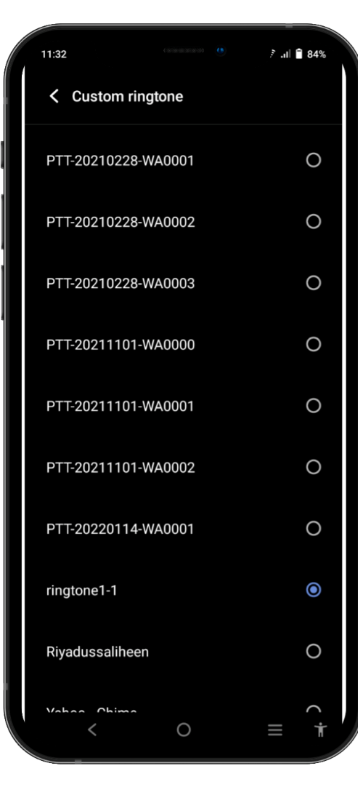
SlideSalad- COPYRIGHT NOTICE
Mettre sonnerie
SlideSalad is #1 online marketplace of premium presentations templates for all needs
Things you can do with the template
Use the free templates for your own presentations and projects without limitations.
Please link back to our website if you like our free designs or write a comment to this tem
Plate on our website.
All copyright and intellectual property rights, without limitation, are retained by SlideSalad.com. By downloading and using this template, you agree to this statement.
Please contact us if you have any questions about usage: support@slidesalad.com`
Things you can’t do with the template
Resell or distribute the templates or backgrounds.
Make these templates available on a website or social network for download.
Edit or modify the downloaded templates and claim / pass off as your own work.
Nouvelle sonnerie personnalisée
Vous trouverez toutes les sonneries disponibles dans l'appareil mobile. Vous devez sélectionner la sonnerie que vous venez de télécharger. Appuyez simplement sur la sonnerie pour la sélectionner. Ensuite, automatiquement, cette sonnerie sera définie comme sonnerie par défaut pour le son de notification portial Choufli. Ainsi, toutes les réceptions d'alertes de réservation à venir joueront ce son automatiquement.
More PowerPoint, Google Slides and Keynote templates are available at www.SlideSalad.com

