Slide 1
Choufli Taxi
Portail Mobile Application – Choufli Taxi
www.Chouflitaxi.net

Slide 2
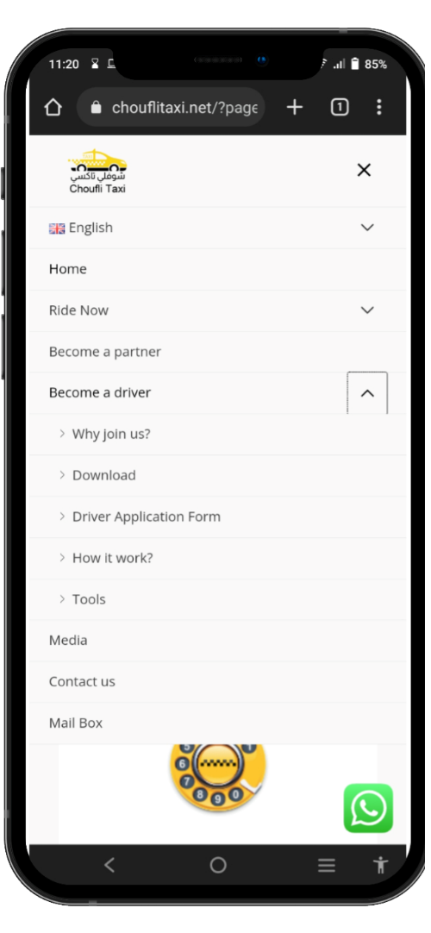
SlideSalad- COPYRIGHT NOTICE
Visit Website
SlideSalad is #1 online marketplace of premium presentations templates for all needs
Things you can do with the template
Use the free templates for your own presentations and projects without limitations.
Please link back to our website if you like our free designs or write a comment to this template on our website.
All copyright and intellectual property rights, without limitation, are retained by SlideSalad.com. By downloading and using this template, you agree to this statement.
Please contact us if you have any questions about usage: support@slidesalad.com
Things you can’t do with the template
Resell or distribute the templates or backgrounds.
Make these templates available on a website or social network for download.
Edit or modify the downloaded templates and claim / pass off as your own work.
Visit Chouflitaxi.net website
Kindly visit website www.chouflitaxi.net and click menu “Become a Driver” and then click Sub Menu “Tools”.
More PowerPoint, Google Slides and Keynote templates are available at www.SlideSalad.com

Slide 3
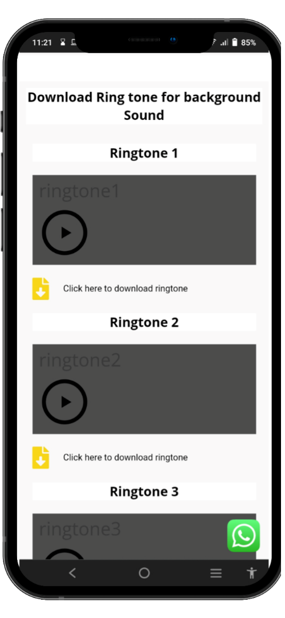
SlideSalad- COPYRIGHT NOTICE
Tools Page
SlideSalad is #1 online marketplace of premium presentations templates for all needs
Things you can do with the template
Use the free templates for your own presentations and projects without limitations.
Please link back to our website if you like our free designs or write a comment to this template on our website.
All copyright and intellectual property rights, without limitation, are retained by SlideSalad.com. By downloading and using this template, you agree to this statement.
Please contact us if you have any questions about usage: support@slidesalad.com
Things you can’t do with the template
Resell or distribute the templates or backgrounds.
Make these templates available on a website or social network for download.
Edit or modify the downloaded templates and claim / pass off as your own work.
Tools Page
At Tools Page, please go the section download ringtone. There are three types of ringtones available. So you can play each ringtone and select any one ringtone and click download option to download it in your mobile device.
More PowerPoint, Google Slides and Keynote templates are available at www.SlideSalad.com

Slide 4
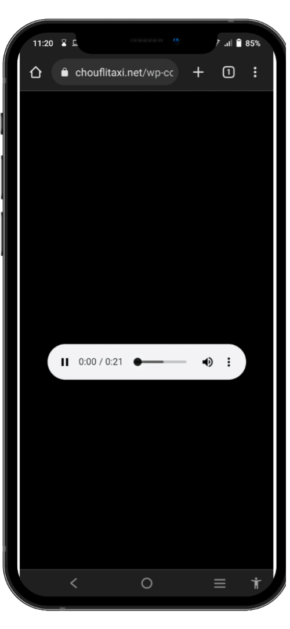
SlideSalad- COPYRIGHT NOTICE
Download Ringtone
SlideSalad is #1 online marketplace of premium presentations templates for all needs
Things you can do with the template
Use the free templates for your own presentations and projects without limitations.
Please link back to our website if you like our free designs or write a comment to this template on our website.
All copyright and intellectual property rights, without limitation, are retained by SlideSalad.com. By downloading and using this template, you agree to this statement.
Please contact us if you have any questions about usage: support@slidesalad.com
Things you can’t do with the template
Resell or distribute the templates or backgrounds.
Make these templates available on a website or social network for download.
Edit or modify the downloaded templates and claim / pass off as your own work.
Download Ringtone
Once the download button is clicked. Automatically, driver will be redirected to download page. Need to click last : icon to view the download option.
More PowerPoint, Google Slides and Keynote templates are available at www.SlideSalad.com

Slide 5
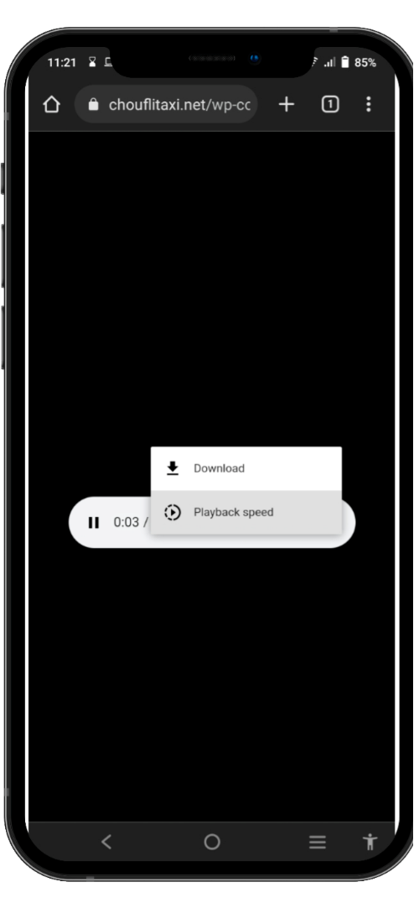
SlideSalad- COPYRIGHT NOTICE
Download Ringtone
SlideSalad is #1 online marketplace of premium presentations templates for all needs
Things you can do with the template
Use the free templates for your own presentations and projects without limitations.
Please link back to our website if you like our free designs or write a comment to this template on our website.
All copyright and intellectual property rights, without limitation, are retained by SlideSalad.com. By downloading and using this template, you agree to this statement.
Please contact us if you have any questions about usage: support@slidesalad.com
Things you can’t do with the template
Resell or distribute the templates or backgrounds.
Make these templates available on a website or social network for download.
Edit or modify the downloaded templates and claim / pass off as your own work.
Download Ringtone
Click Download option to download ringtone in your mobile device.
More PowerPoint, Google Slides and Keynote templates are available at www.SlideSalad.com

Slide 6
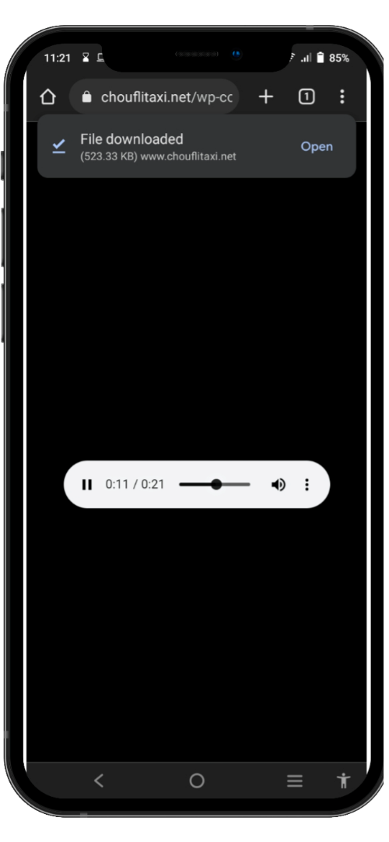
SlideSalad- COPYRIGHT NOTICE
Download Completed
SlideSalad is #1 online marketplace of premium presentations templates for all needs
Things you can do with the template
Use the free templates for your own presentations and projects without limitations.
Please link back to our website if you like our free designs or write a comment to this template on our website.
All copyright and intellectual property rights, without limitation, are retained by SlideSalad.com. By downloading and using this template, you agree to this statement.
Please contact us if you have any questions about usage: support@slidesalad.com
Things you can’t do with the template
Resell or distribute the templates or backgrounds.
Make these templates available on a website or social network for download.
Edit or modify the downloaded templates and claim / pass off as your own work.
Successfully Downloaded
Ringtone will be downloaded successfully in your device. You can find it a short link to open the downloaded ringtone in your device.
More PowerPoint, Google Slides and Keynote templates are available at www.SlideSalad.com

Slide 7
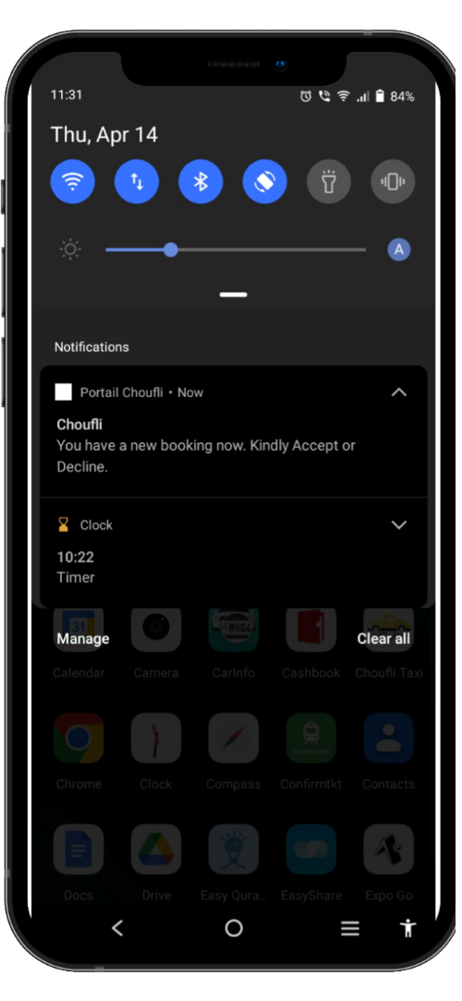
SlideSalad- COPYRIGHT NOTICE
Set Ringtone
SlideSalad is #1 online marketplace of premium presentations templates for all needs
Things you can do with the template
Use the free templates for your own presentations and projects without limitations.
Please link back to our website if you like our free designs or write a comment to this template on our website.
All copyright and intellectual property rights, without limitation, are retained by SlideSalad.com. By downloading and using this template, you agree to this statement.
Please contact us if you have any questions about usage: support@slidesalad.com
Things you can’t do with the template
Resell or distribute the templates or backgrounds.
Make these templates available on a website or social network for download.
Edit or modify the downloaded templates and claim / pass off as your own work.
New Customized Ringtone
Long Press the booking alert notification to set the downloaded ringtone as your notification sound for Portail Choufli app.
More PowerPoint, Google Slides and Keynote templates are available at www.SlideSalad.com

Slide 8
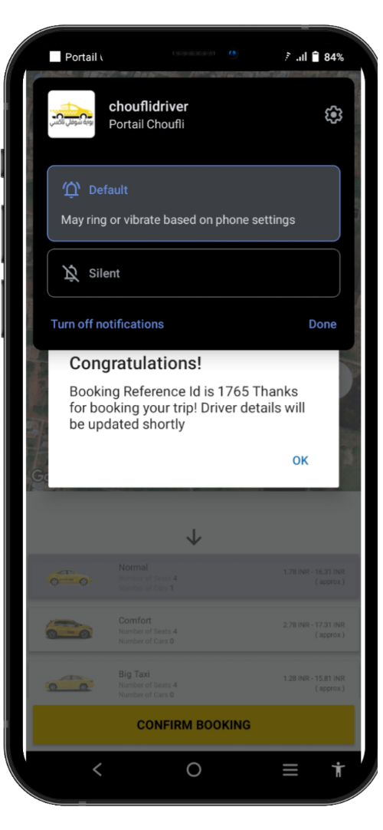
SlideSalad- COPYRIGHT NOTICE
Set Ringtone
SlideSalad is #1 online marketplace of premium presentations templates for all needs
Things you can do with the template
Use the free templates for your own presentations and projects without limitations.
Please link back to our website if you like our free designs or write a comment to this template on our website.
All copyright and intellectual property rights, without limitation, are retained by SlideSalad.com. By downloading and using this template, you agree to this statement.
Please contact us if you have any questions about usage: support@slidesalad.com
Things you can’t do with the template
Resell or distribute the templates or backgrounds.
Make these templates available on a website or social network for download.
Edit or modify the downloaded templates and claim / pass off as your own work.
New Customized Ringtone
You will find option called “Default”, select this option and it will be redirected to next section.
More PowerPoint, Google Slides and Keynote templates are available at www.SlideSalad.com

Slide 9
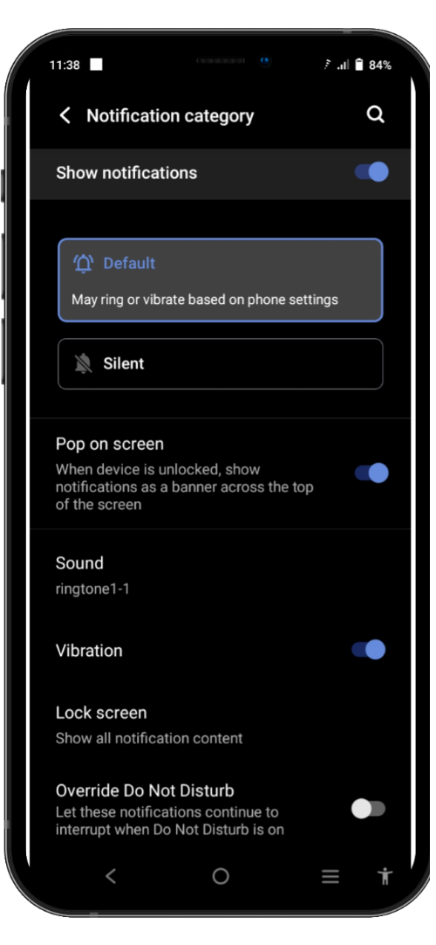
SlideSalad- COPYRIGHT NOTICE
Set Ringtone
SlideSalad is #1 online marketplace of premium presentations templates for all needs
Things you can do with the template
Use the free templates for your own presentations and projects without limitations.
Please link back to our website if you like our free designs or write a comment to this template on our website.
All copyright and intellectual property rights, without limitation, are retained by SlideSalad.com. By downloading and using this template, you agree to this statement.
Please contact us if you have any questions about usage: support@slidesalad.com
Things you can’t do with the template
Resell or distribute the templates or backgrounds.
Make these templates available on a website or social network for download.
Edit or modify the downloaded templates and claim / pass off as your own work.
New Customized Ringtone
This page will be open and you can find option “Sound”. By default notification sound will be set as mobile default sound. So we need to change it to downloaded ringtone sound. So select option “Sound”
More PowerPoint, Google Slides and Keynote templates are available at www.SlideSalad.com

Slide 10
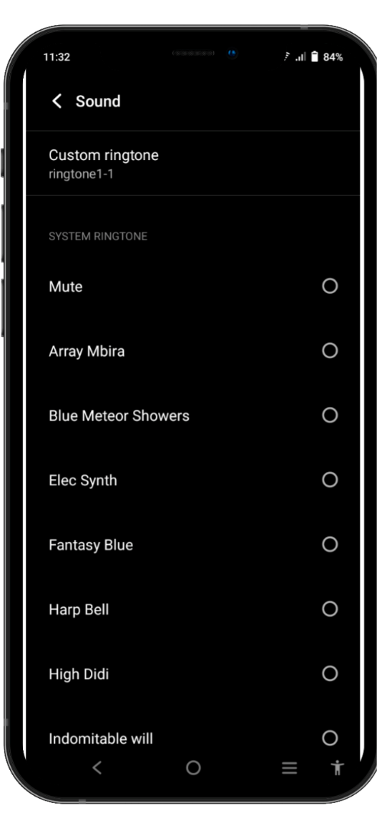
SlideSalad- COPYRIGHT NOTICE
Set Ringtone
SlideSalad is #1 online marketplace of premium presentations templates for all needs
Things you can do with the template
Use the free templates for your own presentations and projects without limitations.
Please link back to our website if you like our free designs or write a comment to this template on our website.
All copyright and intellectual property rights, without limitation, are retained by SlideSalad.com. By downloading and using this template, you agree to this statement.
Please contact us if you have any questions about usage: support@slidesalad.com
Things you can’t do with the template
Resell or distribute the templates or backgrounds.
Make these templates available on a website or social network for download.
Edit or modify the downloaded templates and claim / pass off as your own work.
New Customized Ringtone
Click the option “Custom Ringtone”
More PowerPoint, Google Slides and Keynote templates are available at www.SlideSalad.com

Slide 11
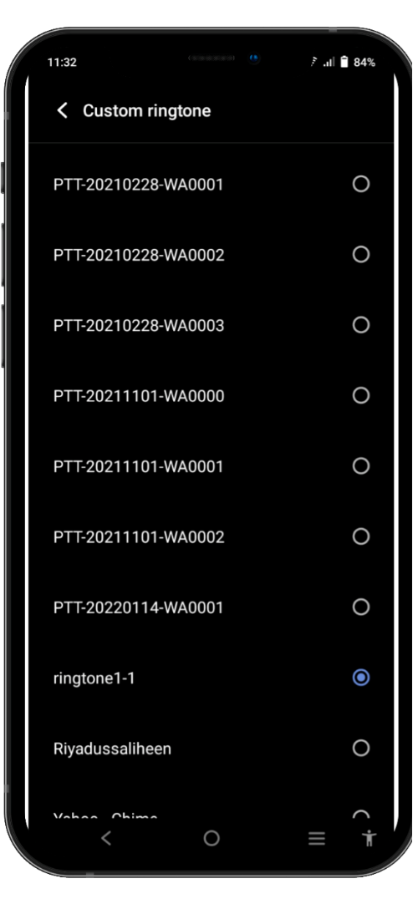
SlideSalad- COPYRIGHT NOTICE
Set Ringtone
SlideSalad is #1 online marketplace of premium presentations templates for all needs
Things you can do with the template
Use the free templates for your own presentations and projects without limitations.
Please link back to our website if you like our free designs or write a comment to this template on our website.
All copyright and intellectual property rights, without limitation, are retained by SlideSalad.com. By downloading and using this template, you agree to this statement.
Please contact us if you have any questions about usage: support@slidesalad.com
Things you can’t do with the template
Resell or distribute the templates or backgrounds.
Make these templates available on a website or social network for download.
Edit or modify the downloaded templates and claim / pass off as your own work.
New Customized Ringtone
You will find the all ringtones available in the mobile device. You need to select the ringtone just downloaded. Just tap the ringtone to make it selected. Then automatically, this ringtone will be set as default ringtone for portial Choufli notification sound. So all the booking alert upcoming receiving will play this sound automatically.
More PowerPoint, Google Slides and Keynote templates are available at www.SlideSalad.com

