Slide 1

Choufli Taxi
Portail Mobile Application – Choufli Taxi
www.Chouflitaxi.net

Slide 2
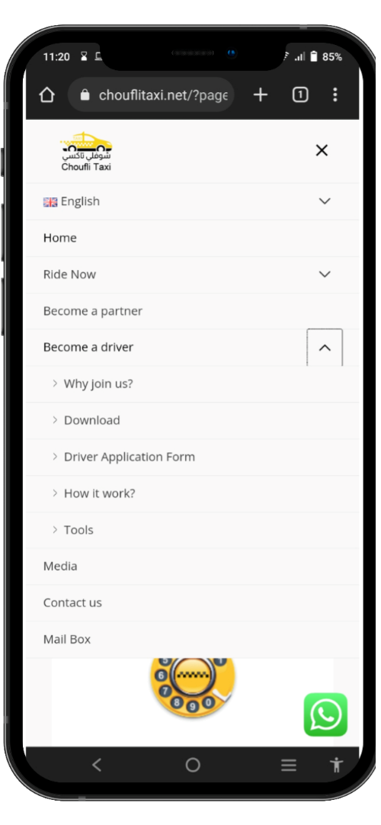
SlideSalad- COPYRIGHT NOTICE
قم بزيارة الموقع
SlideSalad is #1 online marketplace of premium presentations templates for all needs
Things you can do with the template
Use the free templates for your own presentations and projects without limitations.
Please link back to our website if you like our free designs
or write a comment to this template on our website.
All copyright and intellectual property rights, without limitation, are retained by SlideSalad.com.
By downloading and using this template, you agree
to this statement.
Please contact us if you have any questions
about usage: support@slidesalad.com
Things you can’t do with the template
Resell or distribute the templates or backgrounds.
Make these templates available on a website or social network for download.
Edit or modify the downloaded templates and claim /
pass off as your own work.
قم بزيارة Chouflitaxi.net
يرجى زيارة موقع الويب www.chouflitaxi.net والنقر فوق قائمة "كن سائقًا" ثم النقر فوق القائمة الفرعية "أدوات".
More PowerPoint, Google Slides and Keynote templates are available at www.SlideSalad.com

Slide 3
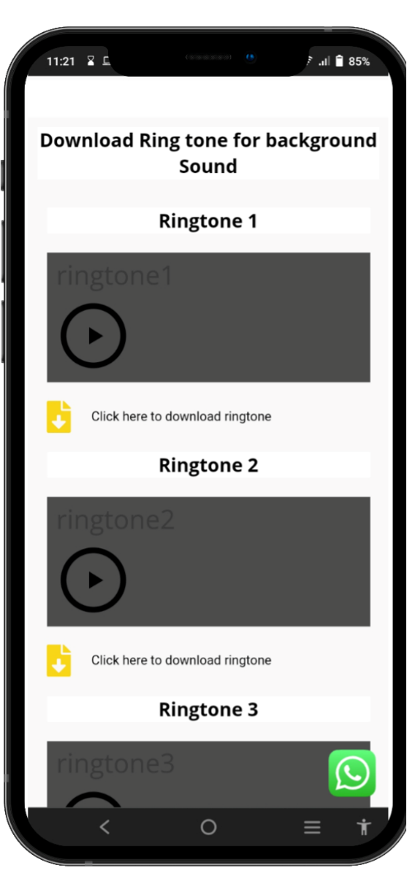
SlideSalad- COPYRIGHT NOTICE
صفحة الأدوات
SlideSalad is #1 online marketplace of premium presentations templates for all needs
Things you can do with the template
Use the free templates for your own presentations and projects without limitations.
Please link back to our website if you like our free designs
or write a comment to this template on our website.
All copyright and intellectual property rights, without limitation, are retained by SlideSalad.com.
By downloading and using this template, you agree
to this statement.
Please contact us if you have any questions
about usage: support@slidesalad.com
Things you can’t do with the template
Resell or distribute the templates or backgrounds.
Make these templates available on a website or social network for download.
Edit or modify the downloaded templates and claim /
pass off as your own work.
صفحة الأدوات
في صفحة الأدوات ، يرجى الانتقال إلى قسم نغمات التنزيل. هناك ثلاثة أنواع متوفرة من نغمات الرنين. حتى تتمكن من تشغيل كل نغمة رنين وتحديد نغمة رنين والنقر فوق خيار التنزيل لتنزيلها على جهازك المحمول.
More PowerPoint, Google Slides and Keynote templates are available at www.SlideSalad.com

Slide 4
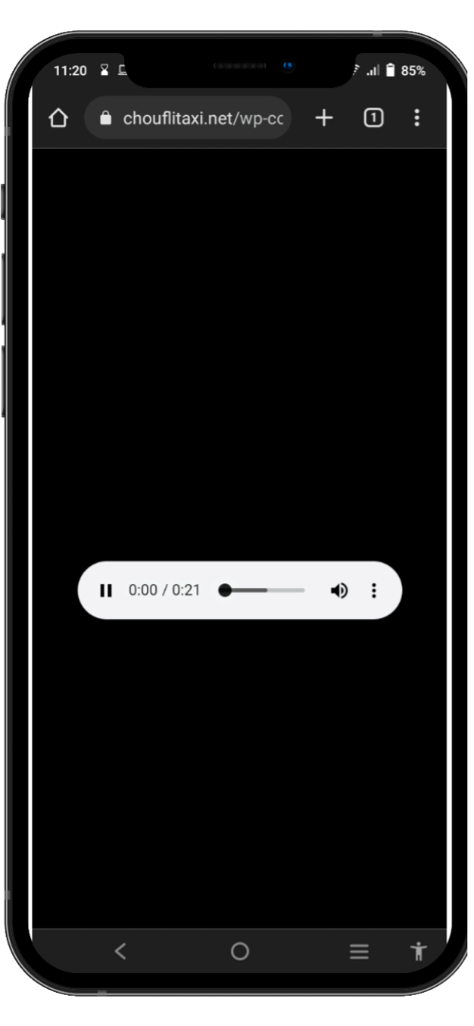
SlideSalad- COPYRIGHT NOTICE
تحميل نغمة
SlideSalad is #1 online marketplace of premium presentations templates for all needs
Things you can do with the template
Use the free templates for your own presentations and projects without limitations.
Please link back to our website if you like our free designs
or write a comment to this template on our website.
All copyright and intellectual property rights, without limitation, are retained by SlideSalad.com.
By downloading and using this template, you agree
to this statement.
Please contact us if you have any questions
about usage: support@slidesalad.com
Things you can’t do with the template
Resell or distribute the templates or backgrounds.
Make these templates available on a website or social network for download.
Edit or modify the downloaded templates and claim /
pass off as your own work.
تحميل نغمة
بمجرد النقر فوق زر التنزيل. تلقائيًا ، ستتم إعادة توجيه برنامج التشغيل إلى صفحة التنزيل. انقر فوق الرمز الأخير: لعرض خيار التنزيل.
More PowerPoint, Google Slides and Keynote templates are available at www.SlideSalad.com

Slide 5
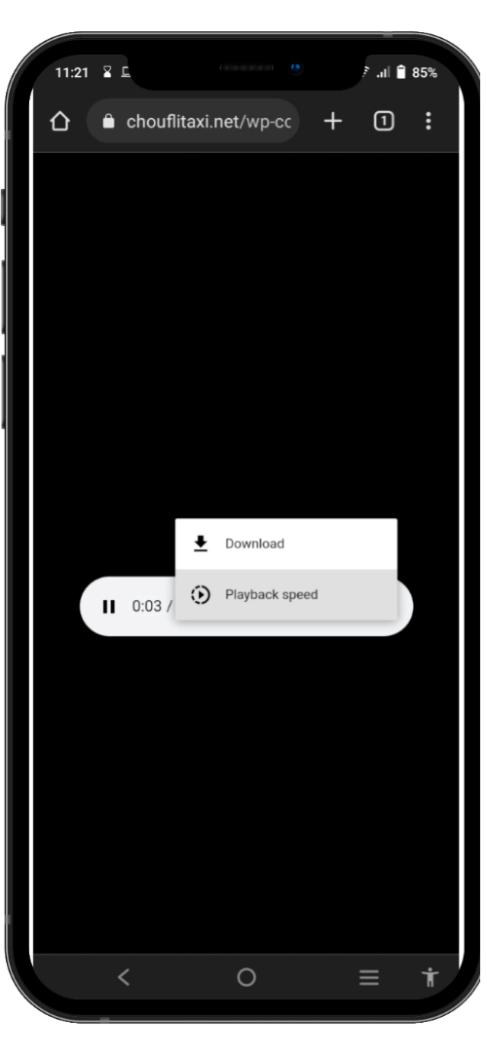
SlideSalad- COPYRIGHT NOTICE
تحميل نغمة
SlideSalad is #1 online marketplace of premium presentations templates for all needs
Things you can do with the template
Use the free templates for your own presentations and projects without limitations.
Please link back to our website if you like our free designs
or write a comment to this template on our website.
All copyright and intellectual property rights, without limitation, are retained by SlideSalad.com.
By downloading and using this template, you agree
to this statement.
Please contact us if you have any questions
about usage: support@slidesalad.com
Things you can’t do with the template
Resell or distribute the templates or backgrounds.
Make these templates available on a website or social network for download.
Edit or modify the downloaded templates and claim /
pass off as your own work.
تحميل نغمة
انقر فوق خيار التنزيل لتنزيل نغمة الرنين على جهازك المحمول.
More PowerPoint, Google Slides and Keynote templates are available at www.SlideSalad.com

Slide 6
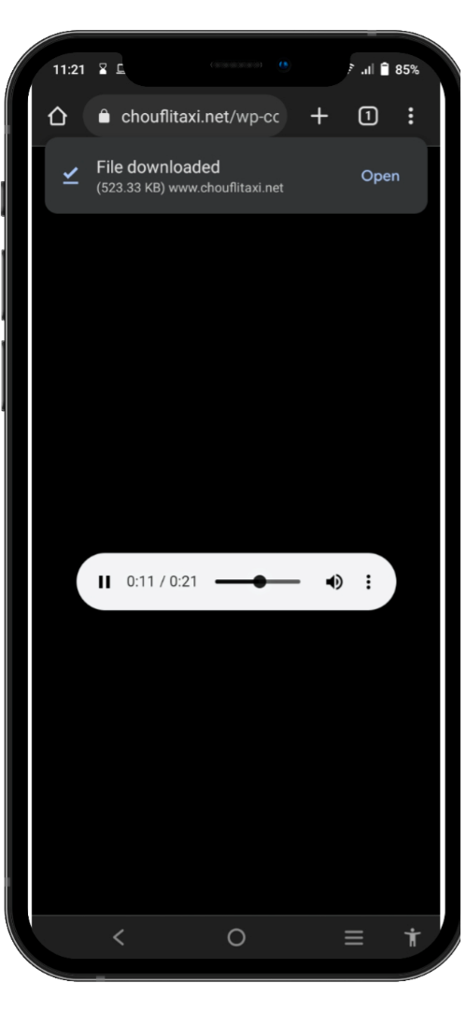
SlideSalad- COPYRIGHT NOTICE
تم التحميل
SlideSalad is #1 online marketplace of premium presentations templates for all needs
Things you can do with the template
Use the free templates for your own presentations and projects without limitations.
Please link back to our website if you like our free designs
or write a comment to this template on our website.
All copyright and intellectual property rights, without limitation, are retained by SlideSalad.com.
By downloading and using this template, you agree
to this statement.
Please contact us if you have any questions
about usage: support@slidesalad.com
Things you can’t do with the template
Resell or distribute the templates or backgrounds.
Make these templates available on a website or social network for download.
Edit or modify the downloaded templates and claim /
pass off as your own work.
تم التنزيل بنجاح
سيتم تنزيل نغمة الرنين بنجاح على جهازك. يمكنك العثور على رابط قصير لفتح نغمة الرنين التي تم تنزيلها على جهازك.
More PowerPoint, Google Slides and Keynote templates are available at www.SlideSalad.com

Slide 7
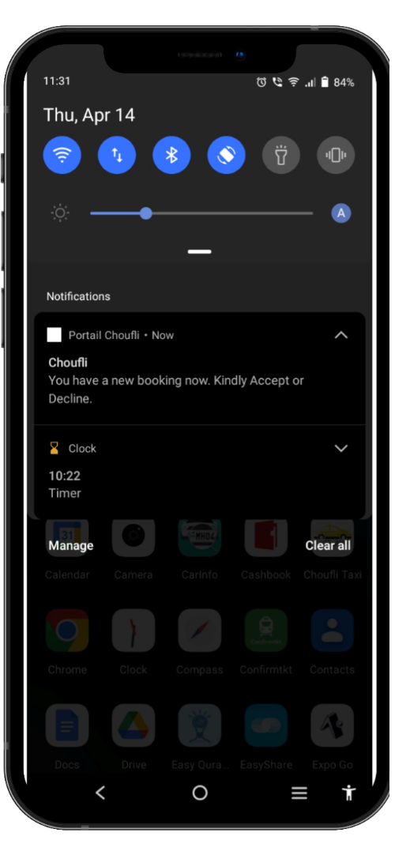
SlideSalad- COPYRIGHT NOTICE
الرنة تعيين
SlideSalad is #1 online marketplace of premium presentations templates for all needs
Things you can do with the template
Use the free templates for your own presentations and projects without limitations.
Please link back to our website if you like our free designs
or write a comment to this template on our website.
All copyright and intellectual property rights, without limitation, are retained by SlideSalad.com.
By downloading and using this template, you agree
to this statement.
Please contact us if you have any questions
about usage: support@slidesalad.com
Things you can’t do with the template
Resell or distribute the templates or backgrounds.
Make these templates available on a website or social network for download.
Edit or modify the downloaded templates and claim /
pass off as your own work.
نغمة رنين مخصصة جديدة
اضغط لفترة طويلة على إشعار تنبيه الحجز لتعيين نغمة الرنين التي تم تنزيلها كصوت إخطار لتطبيق Choufli Portal.
More PowerPoint, Google Slides and Keynote templates are available at www.SlideSalad.com

Slide 8
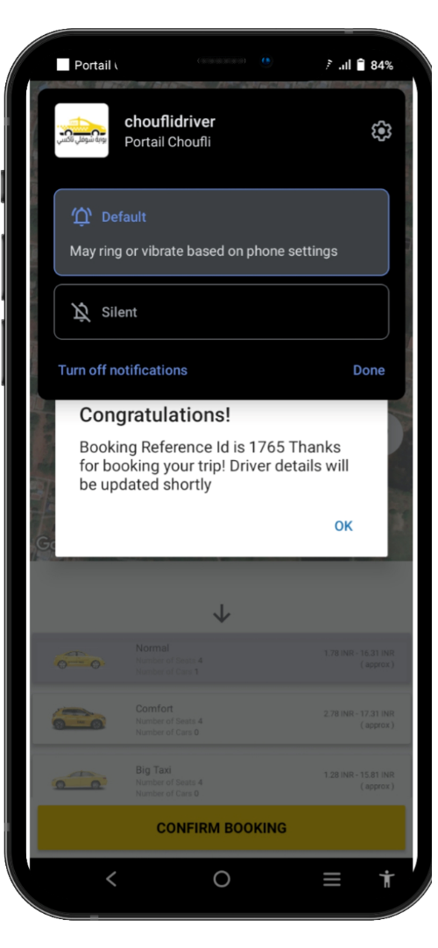
SlideSalad- COPYRIGHT NOTICE
الرنة تعيين
SlideSalad is #1 online marketplace of premium presentations templates for all needs
Things you can do with the template
Use the free templates for your own presentations and projects without limitations.
Please link back to our website if you like our free designs
or write a comment to this template on our website.
All copyright and intellectual property rights, without limitation, are retained by SlideSalad.com.
By downloading and using this template, you agree
to this statement.
Please contact us if you have any questions
about usage: support@slidesalad.com
Things you can’t do with the template
Resell or distribute the templates or backgrounds.
Make these templates available on a website or social network for download.
Edit or modify the downloaded templates and claim /
pass off as your own work.
نغمة رنين مخصصة جديدة
سوف تجد الخيار "افتراضي" ، حدد هذا الخيار وسيتم إعادة توجيهه إلى القسم التالي.
More PowerPoint, Google Slides and Keynote templates are available at www.SlideSalad.com

Slide 9
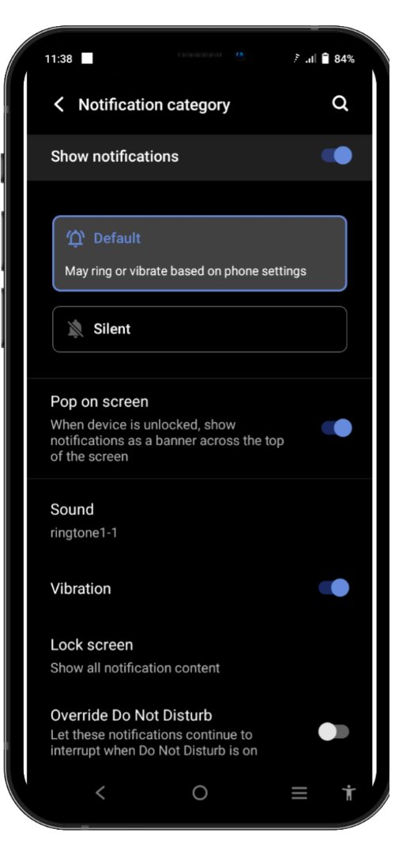
SlideSalad- COPYRIGHT NOTICE
الرنة تعيين
SlideSalad is #1 online marketplace of premium presentations templates for all needs
Things you can do with the template
Use the free templates for your own presentations and projects without limitations.
Please link back to our website if you like our free designs
or write a comment to this template on our website.
All copyright and intellectual property rights, without limitation, are retained by SlideSalad.com.
By downloading and using this template, you agree
to this statement.
Please contact us if you have any questions
about usage: support@slidesalad.com
Things you can’t do with the template
Resell or distribute the templates or backgrounds.
Make these templates available on a website or social network for download.
Edit or modify the downloaded templates and claim /
pass off as your own work.
نغمة رنين مخصصة جديدة
سيتم فتح هذه الصفحة ويمكنك العثور على خيار "الصوت". بشكل افتراضي ، سيتم تعيين صوت الإعلام كصوت افتراضي للجوّال. لذلك نحن بحاجة إلى تغييره إلى نغمة الرنين التي تم تنزيلها. لذا حدد خيار "الصوت"
More PowerPoint, Google Slides and Keynote templates are available at www.SlideSalad.com

Slide 10
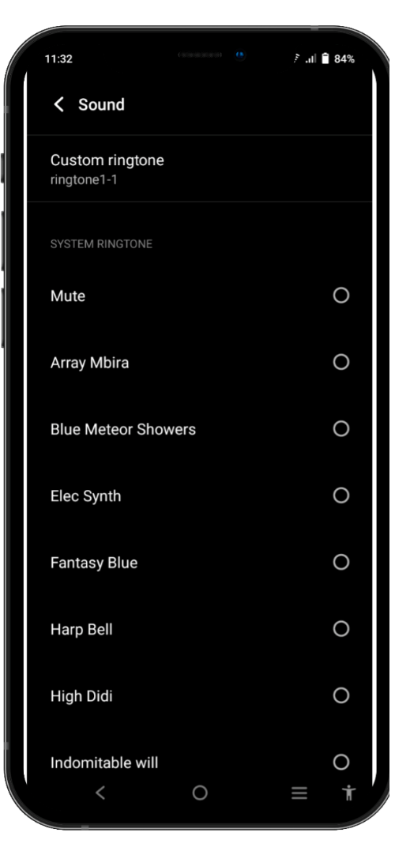
SlideSalad- COPYRIGHT NOTICE
الرنة تعيين
SlideSalad is #1 online marketplace of premium presentations templates for all needs
Things you can do with the template
Use the free templates for your own presentations and projects without limitations.
Please link back to our website if you like our free designs
or write a comment to this template on our website.
All copyright and intellectual property rights, without limitation, are retained by SlideSalad.com.
By downloading and using this template, you agree
to this statement.
Please contact us if you have any questions
about usage: support@slidesalad.com
Things you can’t do with the template
Resell or distribute the templates or backgrounds.
Make these templates available on a website or social network for download.
Edit or modify the downloaded templates and claim /
pass off as your own work.
نغمة رنين مخصصة جديدة
انقر فوق خيار "نغمة مخصصة"
More PowerPoint, Google Slides and Keynote templates are available at www.SlideSalad.com

Slide 11
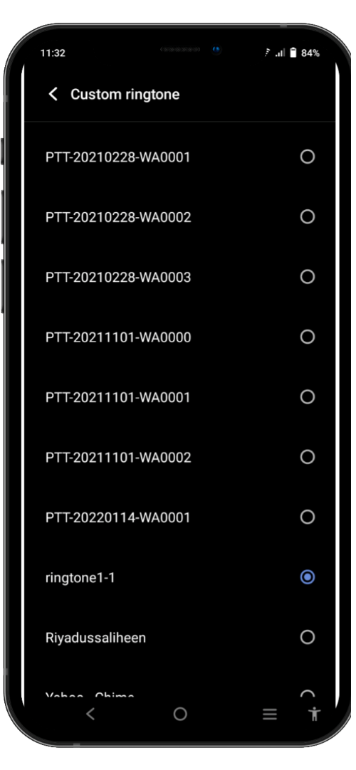
SlideSalad- COPYRIGHT NOTICE
الرنة تعيين
SlideSalad is #1 online marketplace of premium presentations templates for all needs
Things you can do with the template
Use the free templates for your own presentations and projects without limitations.
Please link back to our website if you like our free designs
or write a comment to this tem
Plate on our website.
All copyright and intellectual property rights, without limitation, are retained by SlideSalad.com.
By downloading and using this template, you agree
to this statement.
Please contact us if you have any questions
about usage: support@slidesalad.com`
Things you can’t do with the template
Resell or distribute the templates or backgrounds.
Make these templates available on a website or social network for download.
Edit or modify the downloaded templates and claim /
pass off as your own work.
نغمة رنين مخصصة جديدة
ستجد جميع نغمات الرنين المتوفرة في الجهاز المحمول. تحتاج إلى تحديد نغمة الرنين التي قمت بتنزيلها للتو. ما عليك سوى النقر فوق نغمة الرنين لتحديدها. ثم سيتم تعيين نغمة الرنين هذه تلقائيًا كنغمة رنين افتراضية لصوت إشعار بوابة الشوفلي. وبالتالي ، ستعمل جميع عمليات استقبال تنبيهات الحجز المستقبلية على تشغيل هذا الصوت تلقائيًا.
More PowerPoint, Google Slides and Keynote templates are available at www.SlideSalad.com

