Slide 1

Choufli Taxi
Portail Mobile Application – Choufli Taxi
www.Chouflitaxi.net

Slide 2


Portail Choufli Taxi
Register as a driver
Become a driver in Choufli Taxi through Portail Choufli App and earn while driving using your car. It is a best opportunity in Tunisia for Taxi Business.
Get Your Login Credentials
Become Online
Accept Booking

Slide 3
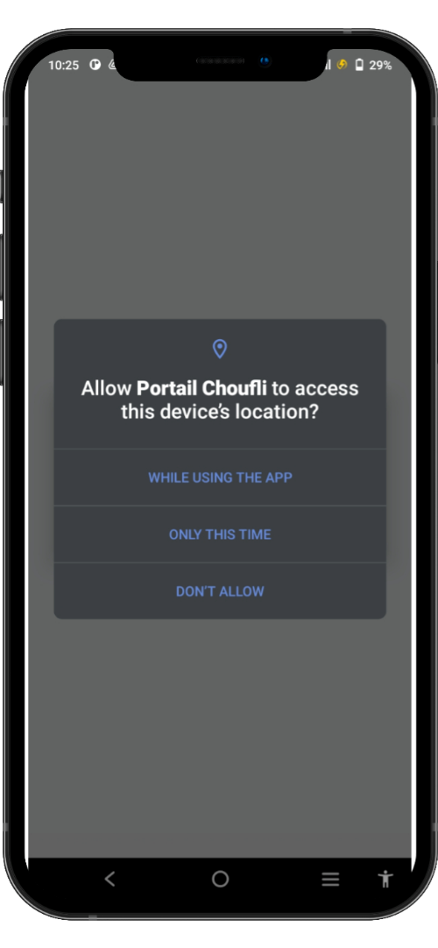
SlideSalad- COPYRIGHT NOTICE
Traffic authorizations
SlideSalad is #1 online marketplace of premium presentations templates for all needs
Things you can do with the template
Use the free templates for your own presentations and projects without limitations.
Please link back to our website if you like our free designs
or write a comment to this template on our website.
All copyright and intellectual property rights, without limitation, are retained by SlideSalad.com.
By downloading and using this template, you agree
to this statement.
Please contact us if you have any questions
about usage: support@slidesalad.com
Things you can’t do with the template
Resell or distribute the templates or backgrounds.
Make these templates available on a website or social network for download.
Edit or modify the downloaded templates and claim /
pass off as your own work.
Traffic authorizations
To protect user privacy and detect your current location, apps that use location services must request location permission.
Applications cannot grant permissions automatically, they must be confirmed by the user. The apps. Will ask you to accept each of their permissions the first time you launch them through a popup that asks you to allow or deny each request
More PowerPoint, Google Slides and Keynote templates are available at www.SlideSalad.com

Slide 4
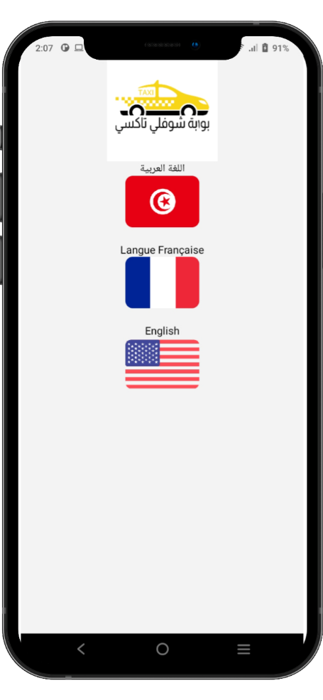



Choose your language
The app Choufli Taxi works in several languages
Arabic language
French language
English language

Slide 5
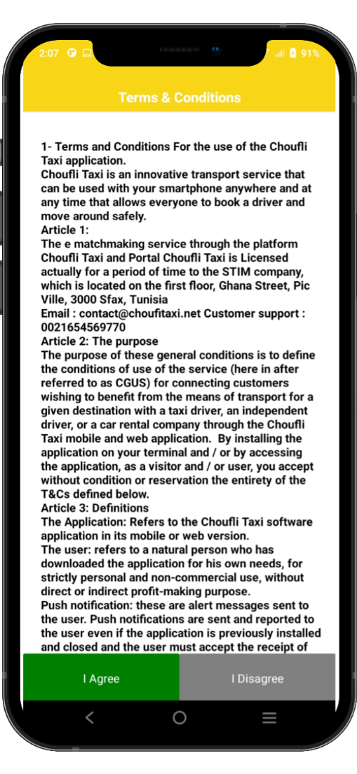
SlideSalad- COPYRIGHT NOTICE
Terms & Conditions
SlideSalad is #1 online marketplace of premium presentations templates for all needs
Things you can do with the template
Use the free templates for your own presentations and projects without limitations.
Please link back to our website if you like our free designs
or write a comment to this template on our website.
All copyright and intellectual property rights, without limitation, are retained by SlideSalad.com.
By downloading and using this template, you agree
to this statement.
Please contact us if you have any questions
about usage: support@slidesalad.com
Things you can’t do with the template
Resell or distribute the templates or backgrounds.
Make these templates available on a website or social network for download.
Edit or modify the downloaded templates and claim /
pass off as your own work.
Terms & Conditions
The following Terms & Conditions shall apply for Drivers / Passengers using the services offered by Choufli Taxi for the rental of the taxi service.
Every Driver should need to read Terms & Conditions carefully before clicking the agree button.
If a Driver is not satisfied with the terms & conditions Choufli Taxi. He may not agree.
If the Driver clicks the disapprove button, they cannot continue with the app. Choufli Taxi
More PowerPoint, Google Slides and Keynote templates are available at www.SlideSalad.com

Slide 6
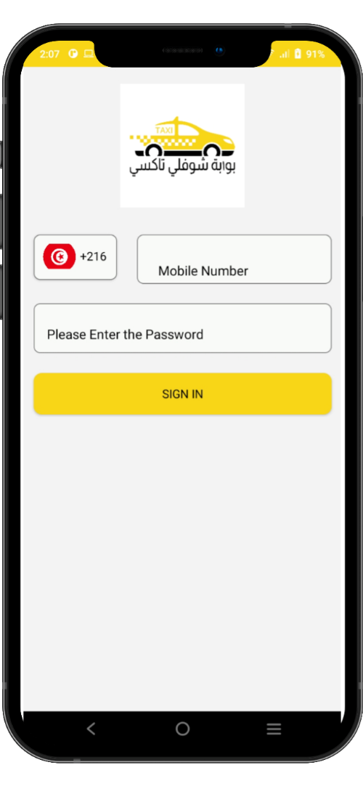

SlideSalad- COPYRIGHT NOTICE
Login Page
SlideSalad is #1 online marketplace of premium presentations templates for all needs
Things you can do with the template
Use the free templates for your own presentations and projects without limitations.
Please link back to our website if you like our free designs
or write a comment to this template on our website.
All copyright and intellectual property rights, without limitation, are retained by SlideSalad.com.
By downloading and using this template, you agree
to this statement.
Please contact us if you have any questions
about usage: support@slidesalad.com
Things you can’t do with the template
Resell or distribute the templates or backgrounds.
Make these templates aailable on a website or social network for download.
Edit or modify the downloaded templates and claim /
pass off as your own work.
Country code
Select your country as a Driver using their mobile number
Phone number
The Driver must need to enter their registered mobile number.
Password
The Driver must need to enter their password received from the Choufli admin.
To log in
After entering the correct mobile phone number and password, the driver must click the login button to access the Choufli application portal.
More PowerPoint, Google Slides and Keynote templates are available at www.SlideSalad.com

Slide 7
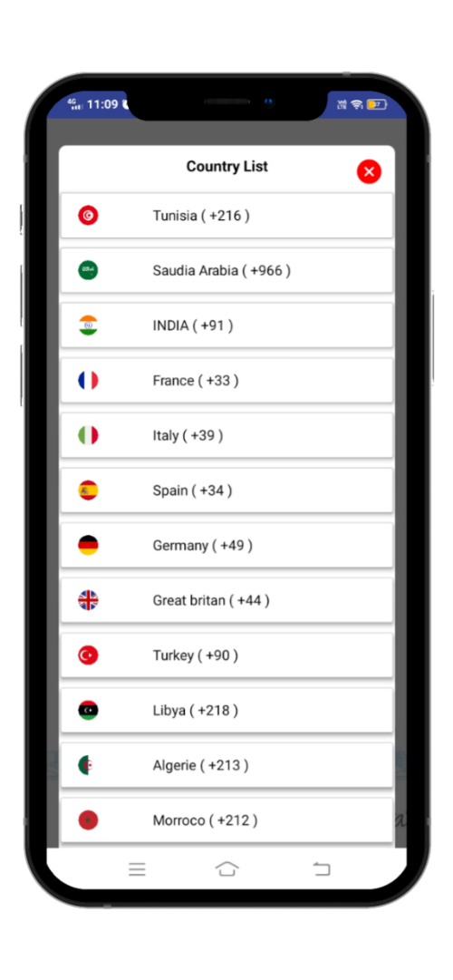
SlideSalad- COPYRIGHT NOTICE
Country List
SlideSalad is #1 online marketplace of premium presentations templates for all needs
Things you can do with the template
Use the free templates for your own presentations and projects without limitations.
Please link back to our website if you like our free designs
or write a comment to this template on our website.
All copyright and intellectual property rights, without limitation, are retained by SlideSalad.com.
By downloading and using this template, you agree
to this statement.
Please contact us if you have any questions
about usage: support@slidesalad.com
Things you can’t do with the template
Resell or distribute the templates or backgrounds.
Make these templates available on a website or social network for download.
Edit or modify the downloaded templates and claim /
pass off as your own work.
Country List
The Driver must need to select the country code for the current location and the network operator.
More PowerPoint, Google Slides and Keynote templates are available at www.SlideSalad.com

Slide 8
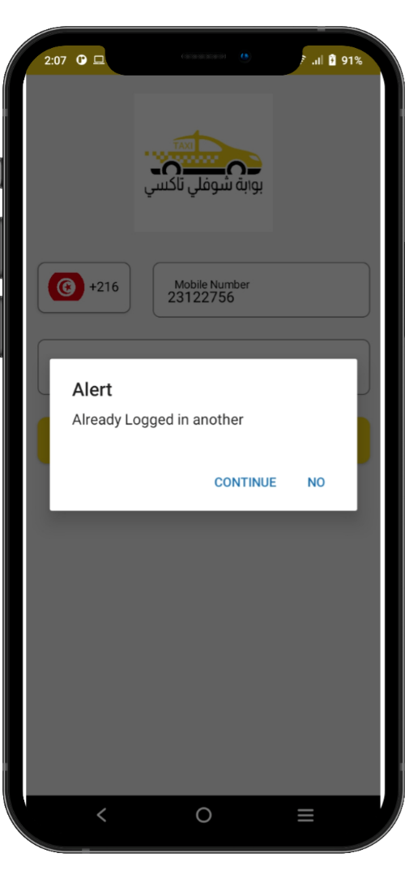
SlideSalad- COPYRIGHT NOTICE
Already Logged In
SlideSalad is #1 online marketplace of premium presentations templates for all needs
Things you can do with the template
Use the free templates for your own presentations and projects without limitations.
Please link back to our website if you like our free designs
or write a comment to this template on our website.
All copyright and intellectual property rights, without limitation, are retained by SlideSalad.com.
By downloading and using this template, you agree
to this statement.
Please contact us if you have any questions
about usage: support@slidesalad.com
Things you can’t do with the template
Resell or distribute the templates or backgrounds.
Make these templates available on a website or social network for download.
Edit or modify the downloaded templates and claim /
pass off as your own work.
Already Logged In
If driver is already logged in another device means, this alert will be displayed. So driver can decide to continue or not with his current device.
More PowerPoint, Google Slides and Keynote templates are available at www.SlideSalad.com

Slide 9
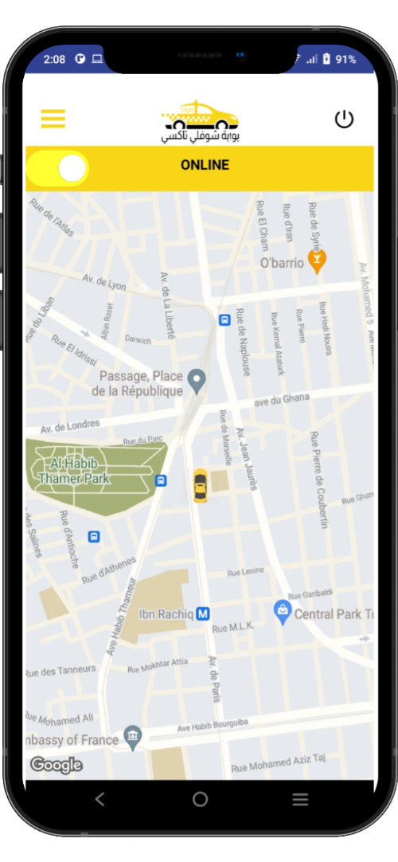
SlideSalad- COPYRIGHT NOTICE
Home Page
SlideSalad is #1 online marketplace of premium presentations templates for all needs
Logout
Driver can logout using this button. So when driver is not in service. He can directly logout using this button. So no more new bookings will be received to him.
Home Button
Home Button will display the list of menu’s available in the driver app.
Things you can do with the template
Use the free templates for your own presentations and projects without limitations.
Please link back to our website if you like our free designs
or write a comment to this template on our website.
All copyright and intellectual property rights, without limitation, are retained by SlideSalad.com.
By downloading and using this template, you agree
to this statement.
Please contact us if you have any questions
about usage: support@slidesalad.com
Things you can’t do with the template
Resell or distribute the templates or backgrounds.
Make these templates available on a website or social network for download.
Edit or modify the downloaded templates and claim /
pass off as your own work.
ONLINE / OFFLINE Button
Driver can switch between Online to Offline, when don’t want to receive new bookings. Same, driver can switch between Offline to Online, when want to receive new bookings.
More PowerPoint, Google Slides and Keynote templates are available at www.SlideSalad.com

Slide 10
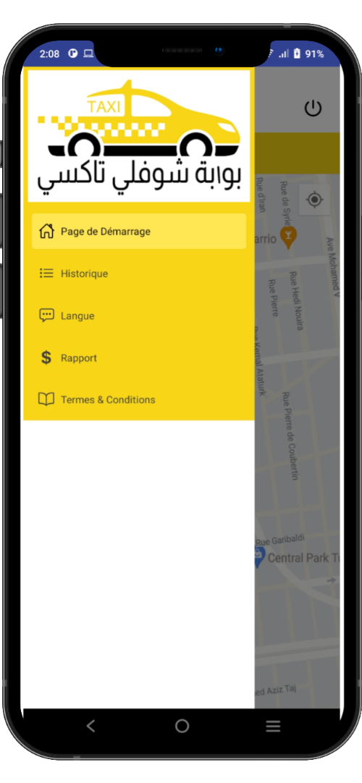
SlideSalad- COPYRIGHT NOTICE
MENU’S LIST
SlideSalad is #1 online marketplace of premium presentations templates for all needs
Things you can do with the template
Use the free templates for your own presentations and projects without limitations.
Please link back to our website if you like our free designs
or write a comment to this template on our website.
All copyright and intellectual property rights, without limitation, are retained by SlideSalad.com.
By downloading and using this template, you agree
to this statement.
Please contact us if you have any questions
about usage: support@slidesalad.com
Things you can’t do with the template
Resell or distribute the templates or backgrounds.
Make these templates available on a website or social network for download.
Edit or modify the downloaded templates and claim /
pass off as your own work.
Menu List
The List of menu’s like Home page, History, Language, Reports and Terms/Conditions will be displayed.
More PowerPoint, Google Slides and Keynote templates are available at www.SlideSalad.com

Slide 11
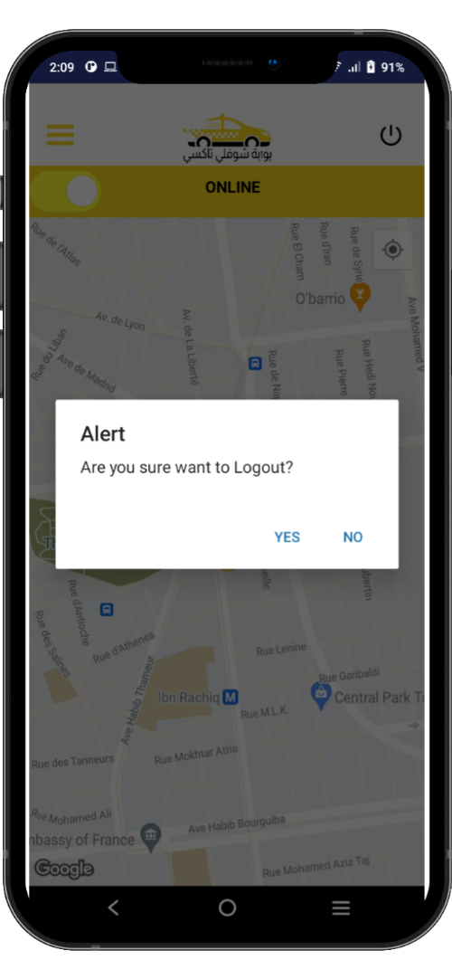
SlideSalad- COPYRIGHT NOTICE
Logout
SlideSalad is #1 online marketplace of premium presentations templates for all needs
Logout
Click this button to logout from driver app
Things you can do with the template
Use the free templates for your own presentations and projects without limitations.
Please link back to our website if you like our free designs
or write a comment to this template on our website.
All copyright and intellectual property rights, without limitation, are retained by SlideSalad.com.
By downloading and using this template, you agree
to this statement.
Please contact us if you have any questions
about usage: support@slidesalad.com
Things you can’t do with the template
Resell or distribute the templates or backgrounds.
Make these templates available on a website or social network for download.
Edit or modify the downloaded templates and claim /
pass off as your own work.
CONFIRM LOGOUT
Alert will be displayed to make sure logout or not.
More PowerPoint, Google Slides and Keynote templates are available at www.SlideSalad.com

Slide 12
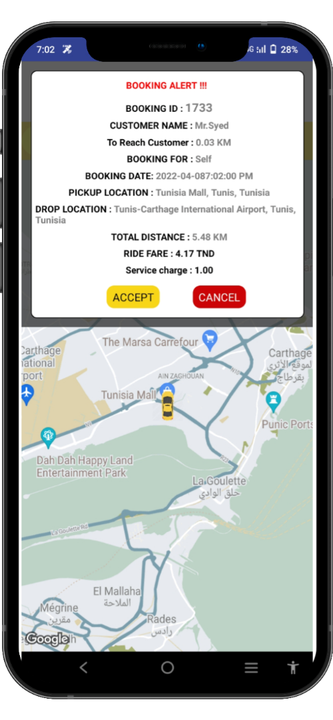
SlideSalad- COPYRIGHT NOTICE
Booking Alert
SlideSalad is #1 online marketplace of premium presentations templates for all needs
BOOKING ALERT
Booking Alert will be received to nearest available drivers. The following details will be displayed in the booking alert. They are:
Booking Id, Customer Name, KM to reach customer, booking for, booking date, pickup location, drop location, total distance, fare and service charge.
Things you can do with the template
Use the free templates for your own presentations and projects without limitations.
Please link back to our website if you like our free designs
or write a comment to this template on our website.
All copyright and intellectual property rights, without limitation, are retained by SlideSalad.com.
By downloading and using this template, you agree
to this statement.
Please contact us if you have any questions
about usage: support@slidesalad.com
Things you can’t do with the template
Resell or distribute the templates or backgrounds.
Make these templates available on a website or social network for download.
Edit or modify the downloaded templates and claim /
pass off as your own work.
More PowerPoint, Google Slides and Keynote templates are available at www.SlideSalad.com

Slide 13
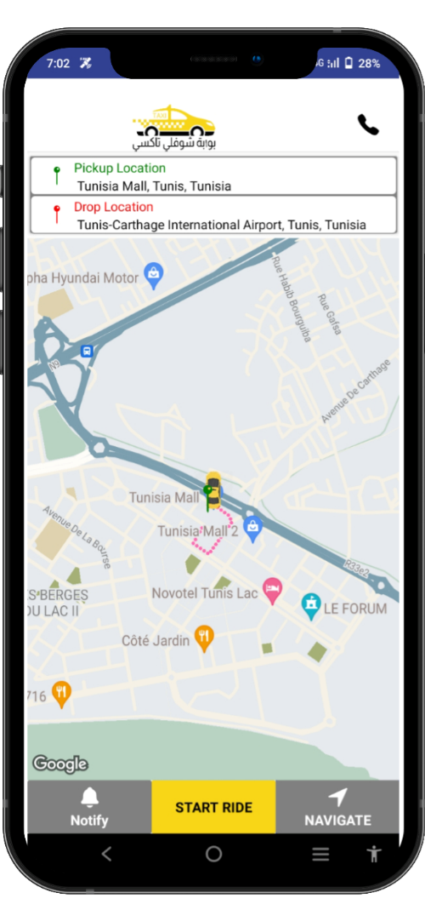
SlideSalad- COPYRIGHT NOTICE
ON THE WAY
Pickup Location
Driver can see the pickup location
SlideSalad is #1 online marketplace of premium presentations templates for all needs
Drop Location
Driver can see the drop location of the passenger
Things you can’t do with the template
Resell or distribute the templates or backgrounds.
Make these templates available on a website or social network for download.
Edit or modify the downloaded templates and claim /
pass off as your own work.
Call Button
Driver can call the passenger using the call button
Car Location
Driver can see the current location of the car in the map.
On the way
Current Pickup Location Pin
Driver can also see the pickup location of the passenger in the map through pin.
Navigate
Driver can click “Navigate” button to open Google Maps Navigation to navigate to go customer pickup location.
Start Ride
Driver can click Start Ride button to start the ride upon reaching passenger location
More PowerPoint, Google Slides and Keynote templates are available at www.SlideSalad.com
Notify
Driver can send notification to passenger upon reaching their location and waiting for pickup.

Slide 14
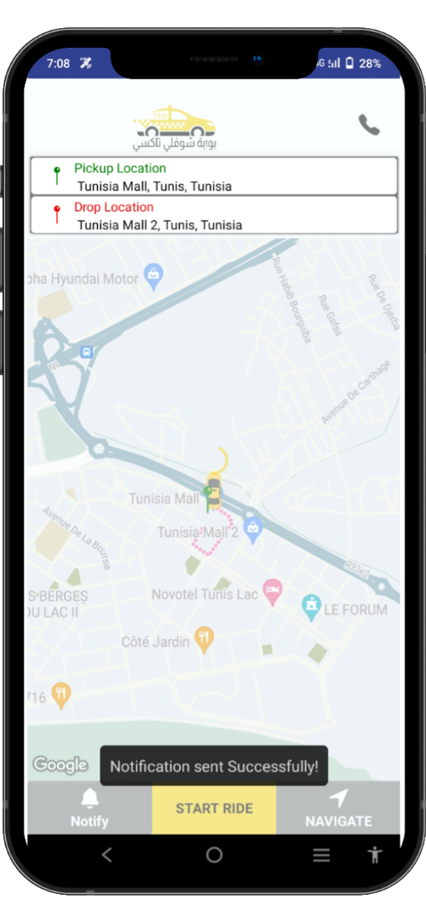
SlideSalad- COPYRIGHT NOTICE
Sending Notification
SlideSalad is #1 online marketplace of premium presentations templates for all needs
Things you can do with the template
Use the free templates for your own presentations and projects without limitations.
Please link back to our website if you like our free designs
or write a comment to this template on our website.
All copyright and intellectual property rights, without limitation, are retained by SlideSalad.com.
By downloading and using this template, you agree
to this statement.
Please contact us if you have any questions
about usage: support@slidesalad.com
Things you can’t do with the template
Resell or distribute the templates or backgrounds.
Make these templates available on a website or social network for download.
Edit or modify the downloaded templates and claim /
pass off as your own work.
Notification
Driver can send Notification to passenger upon reaching their location for pickup.
More PowerPoint, Google Slides and Keynote templates are available at www.SlideSalad.com

Slide 15
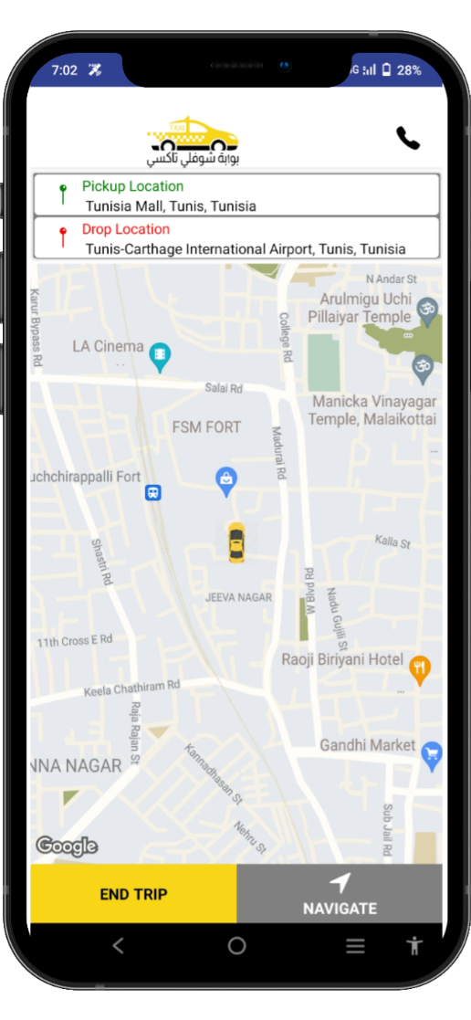
SlideSalad- COPYRIGHT NOTICE
RIDE STARTED
SlideSalad is #1 online marketplace of premium presentations templates for all needs
Things you can do with the template
Use the free templates for your own presentations and projects without limitations.
Please link back to our website if you like our free designs
or write a comment to this template on our website.
All copyright and intellectual property rights, without limitation, are retained by SlideSalad.com.
By downloading and using this template, you agree
to this statement.
Please contact us if you have any questions
about usage: support@slidesalad.com
Things you can’t do with the template
Resell or distribute the templates or backgrounds.
Make these templates available on a website or social network for download.
Edit or modify the downloaded templates and claim /
pass off as your own work.
Ride Started
One ride is started. Driver will be landed to this page.
End Trip
End Trip button will be displayed to compete the trip upon reaching drop location by driver.
Navigate
Navigate button is used to open google maps and then automatically will be displayed the location of drop
More PowerPoint, Google Slides and Keynote templates are available at www.SlideSalad.com

Slide 16
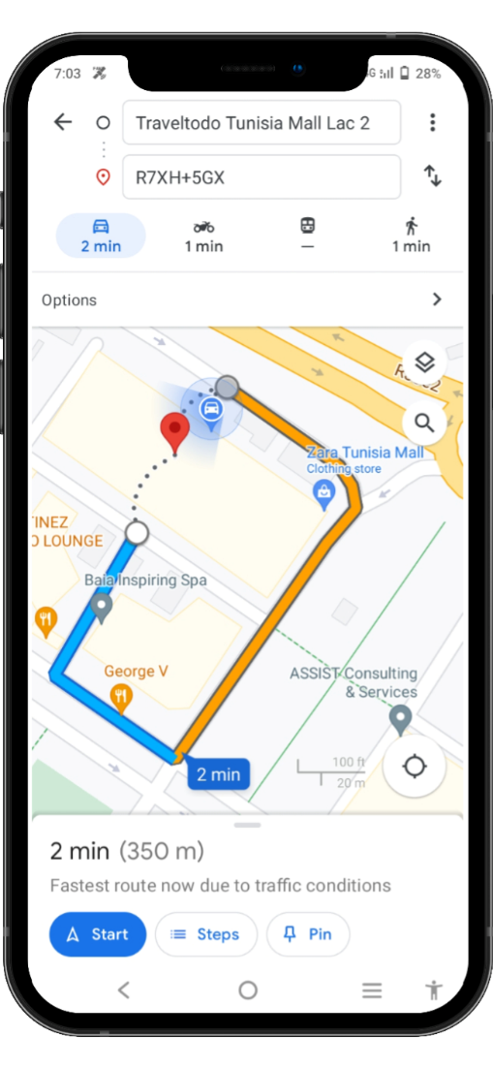
SlideSalad- COPYRIGHT NOTICE
Navigate button
SlideSalad is #1 online marketplace of premium presentations templates for all needs
Things you can do with the template
Use the free templates for your own presentations and projects without limitations.
Please link back to our website if you like our free designs
or write a comment to this template on our website.
All copyright and intellectual property rights, without limitation, are retained by SlideSalad.com.
By downloading and using this template, you agree
to this statement.
Please contact us if you have any questions
about usage: support@slidesalad.com
Things you can’t do with the template
Resell or distribute the templates or backgrounds.
Make these templates available on a website or social network for download.
Edit or modify the downloaded templates and claim /
pass off as your own work.
Start point and end point location search bar
search results
More PowerPoint, Google Slides and Keynote templates are available at www.SlideSalad.com

Slide 17
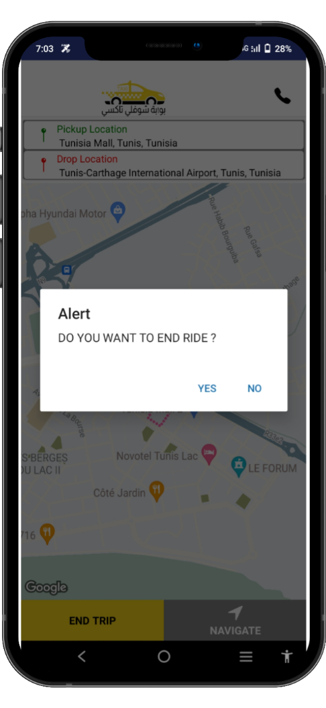
SlideSalad- COPYRIGHT NOTICE
End of the trip
SlideSalad is #1 online marketplace of premium presentations templates for all needs
Alert -> Arrive at destination the driver must end his race to be able to accept another reservation.
Things you can do with the template
Use the free templates for your own presentations and projects without limitations.
Please link back to our website if you like our free designs
or write a comment to this template on our website.
All copyright and intellectual property rights, without limitation, are retained by SlideSalad.com.
By downloading and using this template, you agree
to this statement.
Please contact us if you have any questions
about usage: support@slidesalad.com
Things you can’t do with the template
Resell or distribute the templates or backgrounds.
Make these templates available on a website or social network for download.
Edit or modify the downloaded templates and claim /
pass off as your own work.
More PowerPoint, Google Slides and Keynote templates are available at www.SlideSalad.com

Slide 18
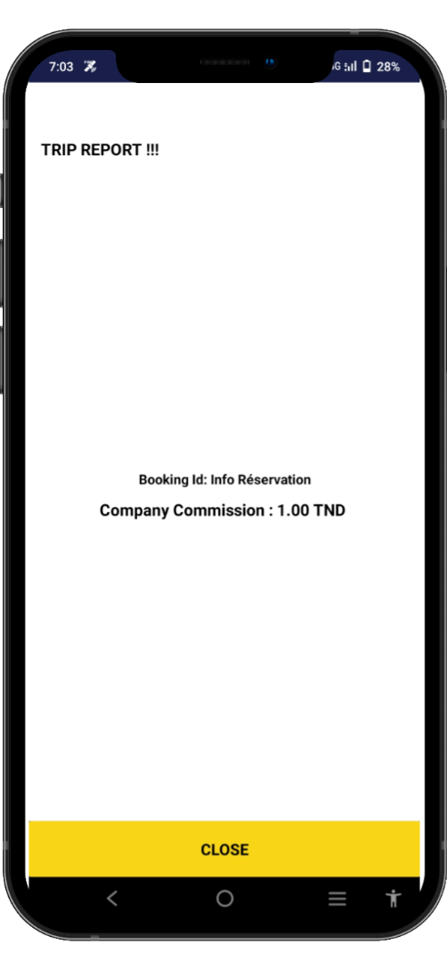
SlideSalad- COPYRIGHT NOTICE
Trip Report
SlideSalad is #1 online marketplace of premium presentations templates for all needs
Things you can do with the template
Use the free templates for your own presentations and projects without limitations.
Please link back to our website if you like our free designs
or write a comment to this template on our website.
All copyright and intellectual property rights, without limitation, are retained by SlideSalad.com.
By downloading and using this template, you agree
to this statement.
Please contact us if you have any questions
about usage: support@slidesalad.com
Things you can’t do with the template
Resell or distribute the templates or backgrounds.
Make these templates available on a website or social network for download.
Edit or modify the downloaded templates and claim /
pass off as your own work.
Trip Report
If the Driver clicks "no" the journey cannot begin
Report -> If the Driver clicks on the end of run button a window opens to indicate the amount to be paid for the service in addition to the amount shown in the taxi meter.
More PowerPoint, Google Slides and Keynote templates are available at www.SlideSalad.com

Slide 19
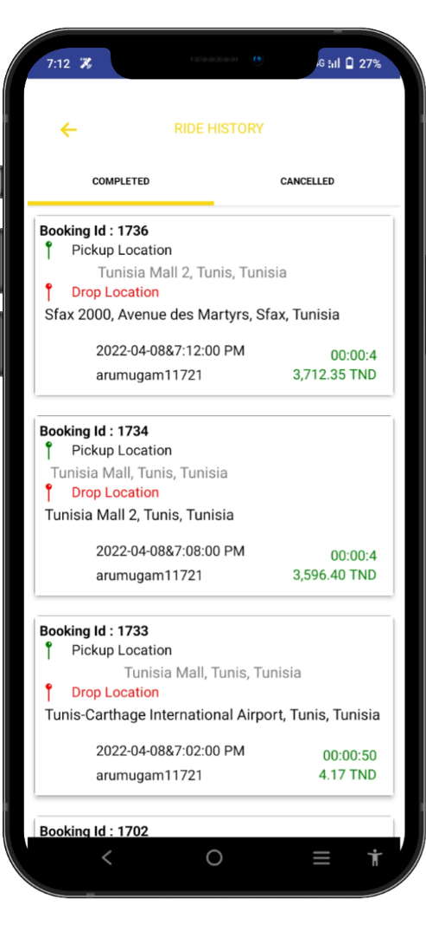
SlideSalad- COPYRIGHT NOTICE
List of reservations
SlideSalad is #1 online marketplace of premium presentations templates for all needs
Things you can do with the template
Use the free templates for your own presentations and projects without limitations.
Please link back to our website if you like our free designs
or write a comment to this template on our website.
All copyright and intellectual property rights, without limitation, are retained by SlideSalad.com.
By downloading and using this template, you agree
to this statement.
Please contact us if you have any questions
about usage: support@slidesalad.com
Things you can’t do with the template
Resell or distribute the templates or backgrounds.
Make these templates available on a website or social network for download.
Edit or modify the downloaded templates and claim /
pass off as your own work.
The Driver can access the list of reservations made and the one in progress.
More PowerPoint, Google Slides and Keynote templates are available at www.SlideSalad.com

Slide 20
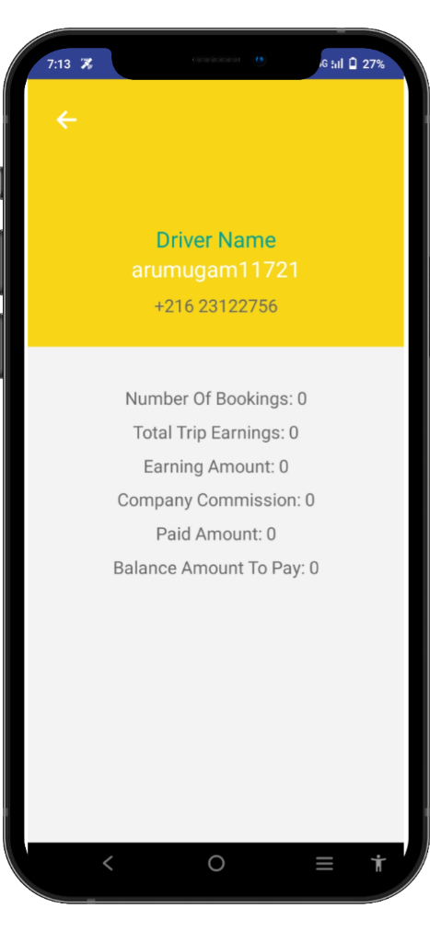
SlideSalad- COPYRIGHT NOTICE
Earnings Summary
SlideSalad is #1 online marketplace of premium presentations templates for all needs
Things you can do with the template
Use the free templates for your own presentations and projects without limitations.
Please link back to our website if you like our free designs
or write a comment to this template on our website.
All copyright and intellectual property rights, without limitation, are retained by SlideSalad.com.
By downloading and using this template, you agree
to this statement.
Please contact us if you have any questions
about usage: support@slidesalad.com
Things you can’t do with the template
Resell or distribute the templates or backgrounds.
Make these templates available on a website or social network for download.
Edit or modify the downloaded templates and claim /
pass off as your own work.
The driver can see a summary of all earnings collected by the app.
More PowerPoint, Google Slides and Keynote templates are available at www.SlideSalad.com

