Slide 1

بوابة شوفلي تاكسي
www.Chouflitaxi.net

Slide 2


بوابة شوفلي تاكسي
سجل كسائق
تحصل على مفاتيح العبور
تثبت من اتصالك بالإنترنات
اقبل الحجوزات

Slide 3
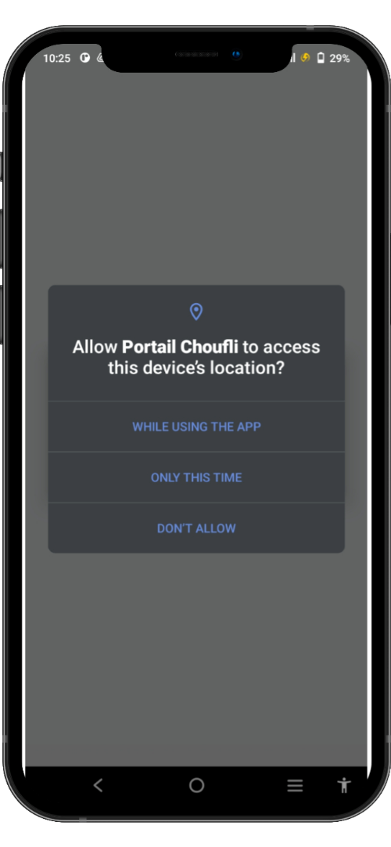
SlideSalad- COPYRIGHT NOTICE
أذونات تحديد الموقع
SlideSalad is #1 online marketplace of premium presentations templates for all needs
Things you can do with the template
Use the free templates for your own presentations and projects without limitations.
Please link back to our website if you like our free designs
or write a comment to this template on our website.
All copyright and intellectual property rights, without limitation, are retained by SlideSalad.com.
By downloading and using this template, you agree
to this statement.
Please contact us if you have any questions
about usage: support@slidesalad.com
Things you can’t do with the template
Resell or distribute the templates or backgrounds.
Make these templates available on a website or social network for download.
Edit or modify the downloaded templates and claim /
pass off as your own work.
لحماية خصوصية المستخدم و تحديد موقعك الحالي, يجب على التطبيق الذي يستعمل خدمات تحديد الموقع أن يطلب إذن تحديد الموقع.
التطبيقات لا يمكنها منح نفسها أذونات تحديد الموقع بصفة تلقائية, يجب أن تكون مؤكدة من طرف المستخدم. سوف يطلب منك التطبيق إعطاء الأذونات كل على حذى في المرة الأولى
More PowerPoint, Google Slides and Keynote templates are available at www.SlideSalad.com

Slide 4
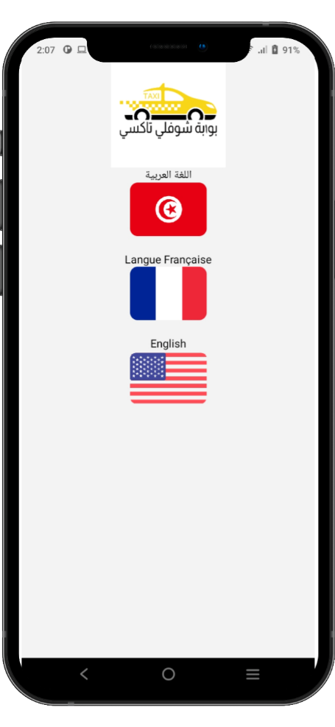



اختر لغتك
يعمل التطبيق بعدة لغات
اللغة العربية
اللغة الفرنسية
اللغة الإنجليزية

Slide 5
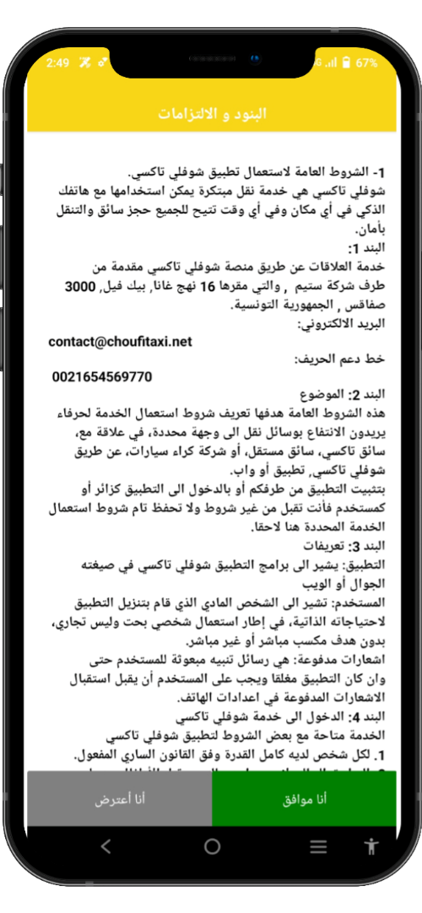
SlideSalad- COPYRIGHT NOTICE
البنود و الالتزامات
SlideSalad is #1 online marketplace of premium presentations templates for all needs
the free templates for your own presentations and projects without limitations.
Please link back to our website if you like our free designs
or write a comment to this template on our website.
All copyright and intellectual property rights, without limitation, are retained by SlideSalad.com.
By downloading and using this template, you agree
to this statement.
Please contact us if you have any questions
about usage: support@slidesalad.com
يجب على كل سائق قراءة الشروط والأحكام بعناية قبل النقر على زر الموافقة
More PowerPoint, Google Slides and Keynote templates are available at www.SlideSalad.com

Slide 6
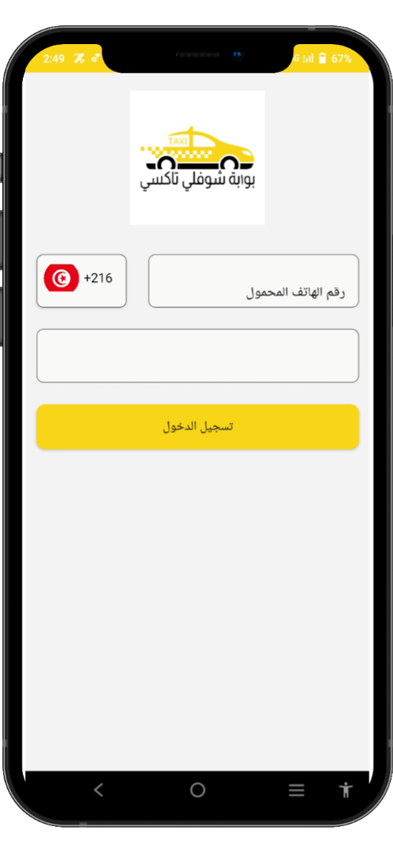

SlideSalad- COPYRIGHT NOTICE
تسجيل الدخول
SlideSalad is #1 online marketplace of premium presentations templates for all needs
Things you can do with the template
Use the free templates for your own presentations and projects without limitations.
Please link back to our website if you like our free designs
or write a comment to this template on our website.
All copyright and intellectual property rights, without limitation, are retained by SlideSalad.com.
By downloading and using this template, you agree
to this statement.
Please contact us if you have any questions
about usage: support@slidesalad.com
Things you can’t do with the template
Resell or distribute the templates or backgrounds.
Make these templates aailable on a website or social network for download.
Edit or modify the downloaded templates and claim /
pass off as your own work.
الرقم الدولي
رقم الهاتف
يجب على السائق إدخال رقم هاتفه المحمول المسجل.
كلمه السر
يجب على السائق إدخال كلمة المرور الخاصة به التي تم استلامها من فريق الدعم الفني.
تسجيل الدخول
بعد إدخال رقم الهاتف المحمول وكلمة المرور الصحيحين ، يجب على السائق النقر فوق زر تسجيل الدخول
More PowerPoint, Google Slides and Keynote templates are available at www.SlideSalad.com

Slide 7
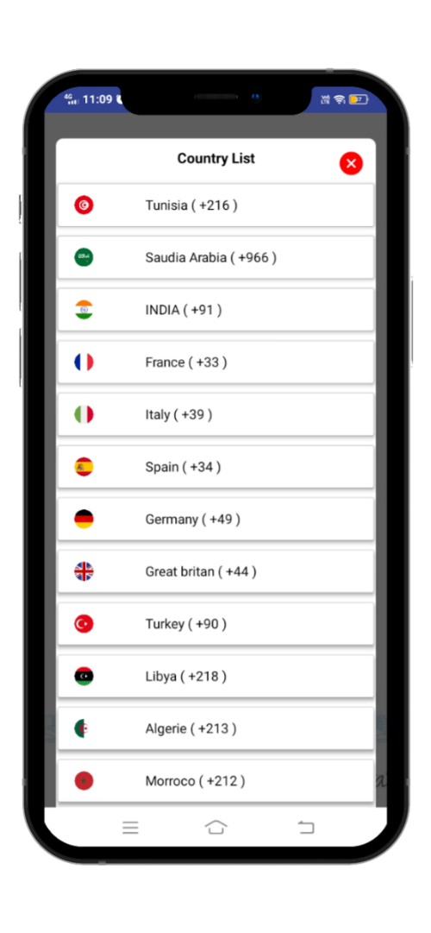
SlideSalad- COPYRIGHT NOTICE
قائمة الدول
SlideSalad is #1 online marketplace of premium presentations templates for all needs
Things you can do with the template
Use the free templates for your own presentations and projects without limitations.
Please link back to our website if you like our free designs
or write a comment to this template on our website.
All copyright and intellectual property rights, without limitation, are retained by SlideSalad.com.
By downloading and using this template, you agree
to this statement.
Please contact us if you have any questions
about usage: support@slidesalad.com
Things you can’t do with the template
Resell or distribute the templates or backgrounds.
Make these templates available on a website or social network for download.
Edit or modify the downloaded templates and claim /
pass off as your own work.
قائمة الدول

Slide 8
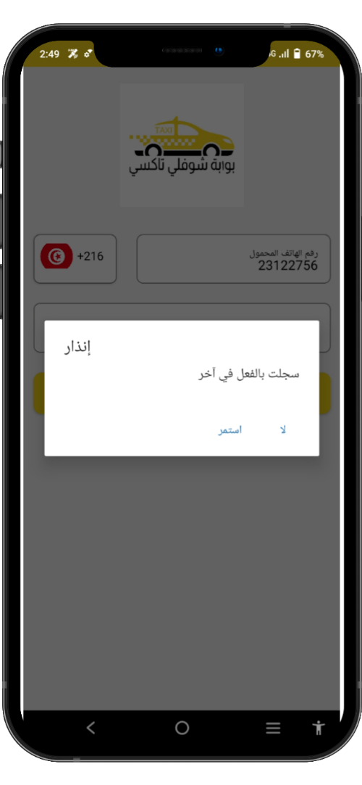
SlideSalad- COPYRIGHT NOTICE
تسجيل الدخول مرة ثانية
SlideSalad is #1 online marketplace of premium presentations templates for all needs
Things you can do with the template
Use the free templates for your own presentations and projects without limitations.
Please link back to our website if you like our free designs
or write a comment to this template on our website.
All copyright and intellectual property rights, without limitation, are retained by SlideSalad.com.
By downloading and using this template, you agree
to this statement.
Please contact us if you have any questions
about usage: support@slidesalad.com
Things you can’t do with the template
Resell or distribute the templates or backgrounds.
Make these templates available on a website or social network for download.
Edit or modify the downloaded templates and claim /
pass off as your own work.
إذا تم تسجيل دخول السائق بالفعل في جهاز آخر ، فسيتم عرض هذا التنبيه. لذلك يمكن للسائق أن يقرر الاستمرار أو عدم الاستمرار بجهازه الحالي.
More PowerPoint, Google Slides and Keynote templates are available at www.SlideSalad.com

Slide 9
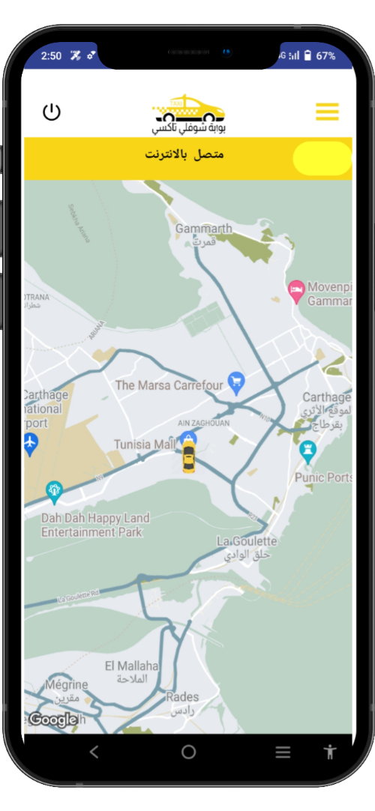
SlideSalad- COPYRIGHT NOTICE
الصفحة الرئيسة
SlideSalad is #1 online marketplace of premium presentations templates for all needs
تسجيل خروج
يمكن للسائق تسجيل الخروج باستخدام هذا الزر. يمكنه تسجيل الخروج مباشرة باستخدام هذا الزر و لن يتم تلقي اثر ذلك المزيد من الحجوزات.
القائمة الفرعية
يعرض زر الصفحة الرئيسية قائمة القوائم المتاحة.
زر متصل / غير متصل
يمكن للسائق التبديل بين متصل وغير متصل ، عندما لا يرغب في تلقي حجوزات جديدة.
More PowerPoint, Google Slides and Keynote templates are available at www.SlideSalad.com

Slide 10
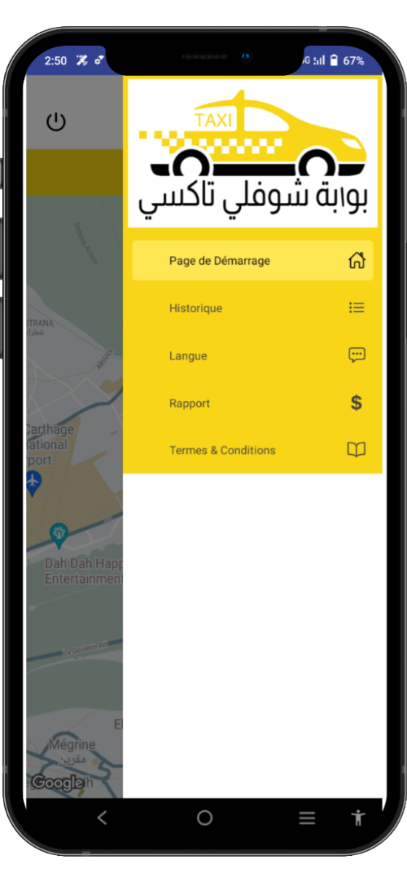
SlideSalad- COPYRIGHT NOTICE
القائمة الفرعية
SlideSalad is #1 online marketplace of premium presentations templates for all needs
Things you can do with the template
Use the free templates for your own presentations and projects without limitations.
Please link back to our website if you like our free designs
or write a comment to this template on our website.
All copyright and intellectual property rights, without limitation, are retained by SlideSalad.com.
By downloading and using this template, you agree
to this statement.
Please contact us if you have any questions
about usage: support@slidesalad.com
Things you can’t do with the template
Resell or distribute the templates or backgrounds.
Make these templates available on a website or social network for download.
Edit or modify the downloaded templates and claim /
pass off as your own work.
قائمة القائمة
عرض الصفحة الرئيسية , سجل الرحلات , تغيير اللغة, التقارير والشروط والإلتزامات.
More PowerPoint, Google Slides and Keynote templates are available at www.SlideSalad.com

Slide 11
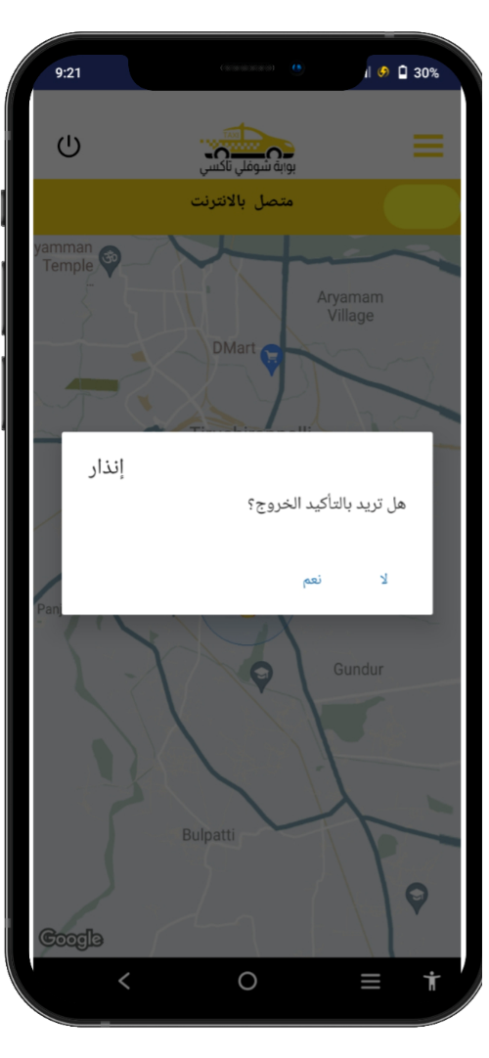
SlideSalad- COPYRIGHT NOTICE
تسجيل خروج
SlideSalad is #1 online marketplace of premium presentations templates for all needs
تسجيل خروج
انقر فوق هذا الزر لتسجيل الخروج من تطبيق السائق
Things you can do with the template
Use the free templates for your own presentations and projects without limitations.
Please link back to our website if you like our free designs
or write a comment to this template on our website.
All copyright and intellectual property rights, without limitation, are retained by SlideSalad.com.
By downloading and using this template, you agree
to this statement.
Please contact us if you have any questions
about usage: support@slidesalad.com
Things you can’t do with the template
Resell or distribute the templates or backgrounds.
Make these templates available on a website or social network for download.
Edit or modify the downloaded templates and claim /
pass off as your own work.
تأكيد الخروج
سيتم عرض التنبيه للتأكد من تسجيل الخروج أم لا.
More PowerPoint, Google Slides and Keynote templates are available at www.SlideSalad.com

Slide 12
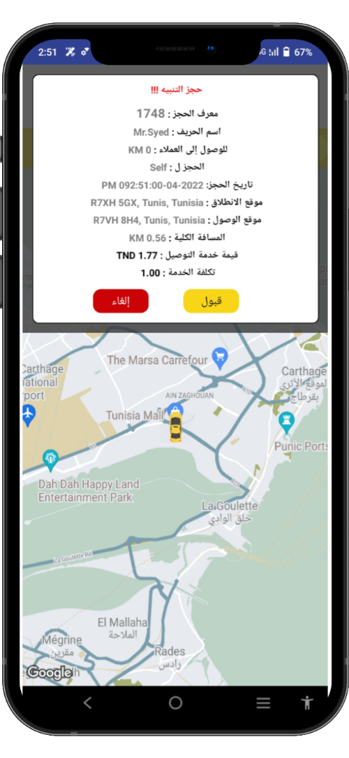
SlideSalad- COPYRIGHT NOTICE
تنبيه الحجز
Things you can do with the template
Use the free templates for your own presentations and projects without limitations.
Please link back to our website if you like our free designs
or write a comment to this template on our website.
All copyright and intellectual property rights, without limitation, are retained by SlideSalad.com.
By downloading and using this template, you agree
to this statement.
Please contact us if you have any questions
about usage: support@slidesalad.com
Things you can’t do with the template
Resell or distribute the templates or backgrounds.
Make these templates available on a website or social network for download.
Edit or modify the downloaded templates and claim /
pass off as your own work.
تنبيه الحجز
سيتم استلام تنبيه الحجز لأقرب السائقين المتاحين. سيتم عرض التفاصيل التالية في تنبيه الحجز:معرف الحجز, اسم الحريف, لمن الحجز, تاريخ الحجز, موقع الانطلاق والوصول, المسافة الكاملة, الأجرة ورسوم الخدمة.
More PowerPoint, Google Slides and Keynote templates are available at www.SlideSalad.com

Slide 13
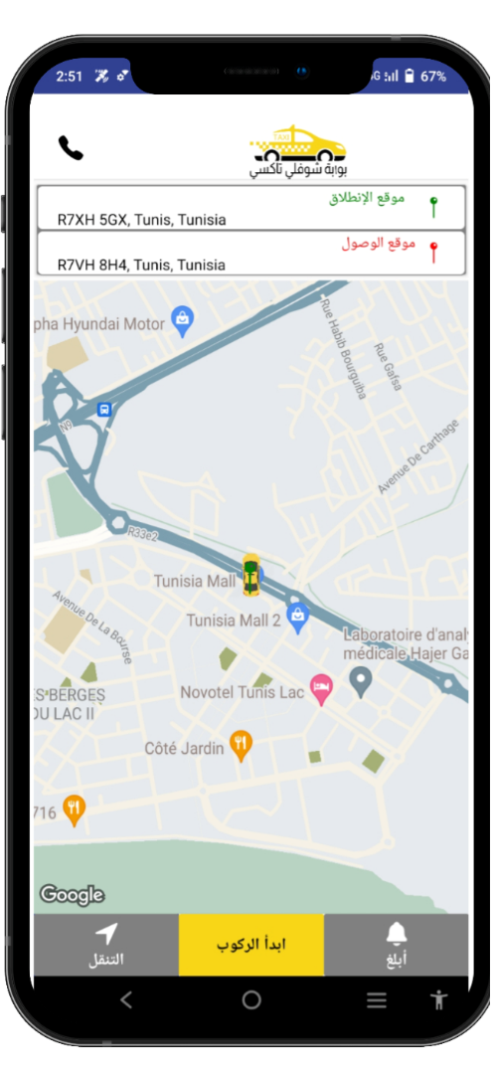
SlideSalad- COPYRIGHT NOTICE
في إتجاه الحريف
موقع الإنطلاق
يمكن للسائق رؤية موقع الانطلاق
SlideSalad is #1 online marketplace of m presentations templates for all needs
موقع الوصول
يمكن للسائق رؤية موقع الانطلاق
Things you can’t do with the template
Resell or distribute the templates or backgrounds.
Make these templates available on a website or social network for download.
Edit or modify the downloaded templates and claim /
pass off as your own work.
زر الإتصال
يمكن الاتصال هاتفيا بالحريف بإستعمال هذا الزر
مكان سيارة الأجرة
يمكن رؤية السيارة على الخريطة.
نحو الحريف
دبوس الإنطلاق
يمكن للسائق أيضًا رؤية موقع انطلاق الراكب في الخريطة من خلال الدبوس.
زر التنقل
يمكن للسائق النقر فوق الزر "تنقل" لفتح التنقل في خرائط قوقل.
ابدأ الركوب
يمكن للسائق النقر فوق زر بدء الركوب لبدء الرحلة عند الوصول إلى موقع الراكب
More PowerPoint, Google Slides and Keynote templates are available at www.SlideSalad.com
أبلغ يمكن للسائق إرسال إشعار إلى الراكب عند الوصول إلى موقعه بواسطة هذا الزر.

Slide 14
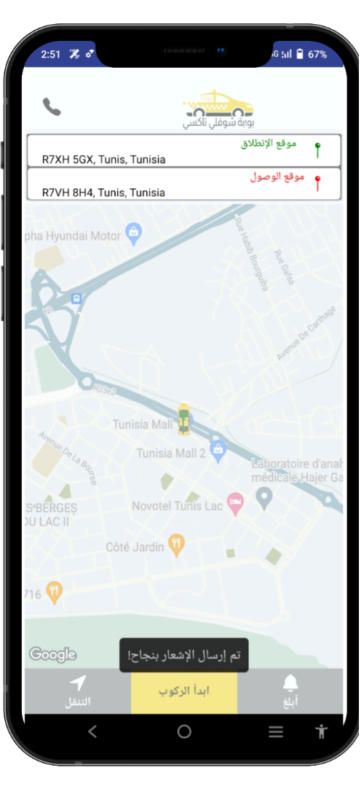
SlideSalad- COPYRIGHT NOTICE
إرسال إشعارالوصول
SlideSalad is #1 online marketplace of premium presentations templates for all needs
Things you can’t do with the template
Resell or distribute the templates or backgrounds.
Make these templates available on a website or social network for download.
Edit or modify the downloaded templates and claim /
pass off as your own work.
إشعار
يمكن للسائق إرسال إشعار إلى الراكب عند الوصول إلى موقعه.
More PowerPoint, Google Slides and Keynote templates are available at www.SlideSalad.com

Slide 15
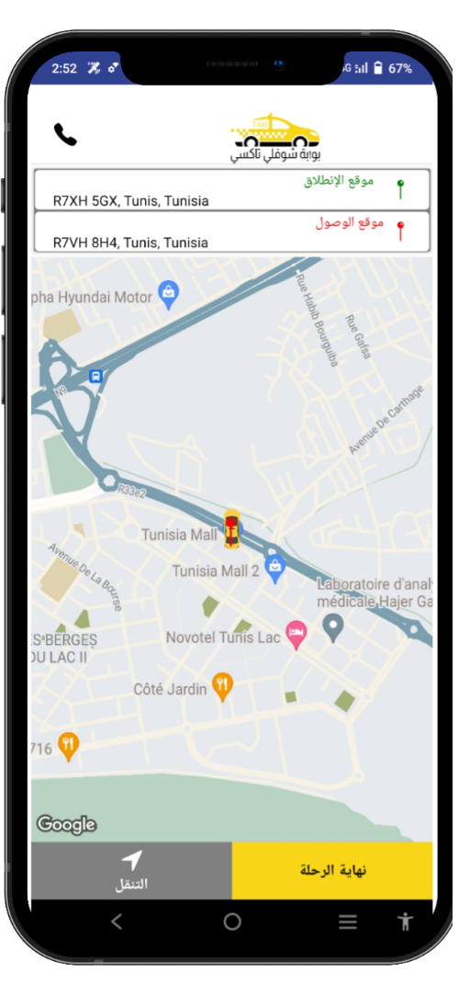
SlideSalad- COPYRIGHT NOTICE
في الطريق إلى الوجهة المطلوبة
SlideSalad is #1 online marketplace of premium presentations templates for all needs
Things you can do with the template
Use the free templates for your own presentations and projects without limitations.
Please link back to our website if you like our free designs
or write a comment to this template on our website.
All copyright and intellectual property rights, without limitation, are retained by SlideSalad.com.
By downloading and using this template, you agree
to this statement.
Please contact us if you have any questions
about usage: support@slidesalad.com
Things you can’t do with the template
Resell or distribute the templates or backgrounds.
Make these templates available on a website or social network for download.
Edit or modify the downloaded templates and claim /
pass off as your own work.
عند بداية الرحلة تفتح هذه الصفحة
More PowerPoint, Google Slides and Keynote templates are available at www.SlideSalad.com
يستخدم زر التنقل لفتح خرائط جوجل
يجب الضغط على هذا الزر عند الوصول إلى المكان المحدد

Slide 16
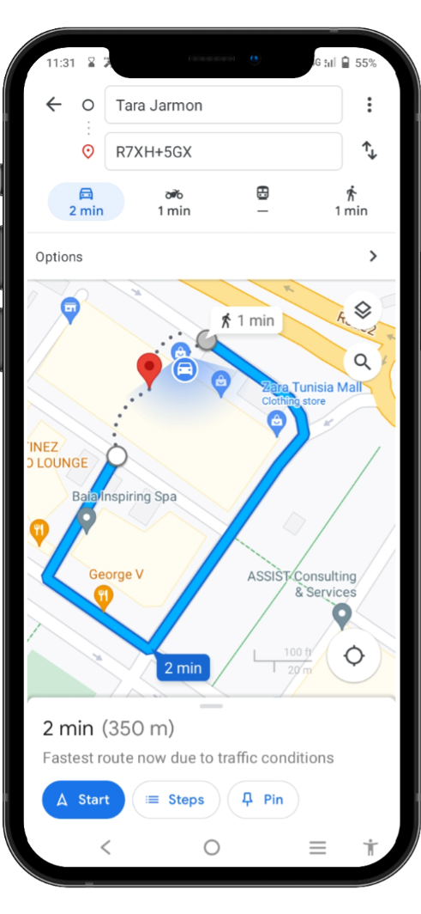
SlideSalad- COPYRIGHT NOTICE
استعمال خرائط قوقل
SlideSalad is #1 online marketplace of premium presentations templates for all needs
Things you can do with the template
Use the free templates for your own presentations and projects without limitations.
Please link back to our website if you like our free designs
or write a comment to this template on our website.
All copyright and intellectual property rights, without limitation, are retained by SlideSalad.com.
By downloading and using this template, you agree
to this statement.
Please contact us if you have any questions
about usage: support@slidesalad.com
Things you can’t do with the template
Resell or distribute the templates or backgrounds.
Make these templates available on a website or social network for download.
Edit or modify the downloaded templates and claim /
pass off as your own work.
More PowerPoint, Google Slides and Keynote templates are available at www.SlideSalad.com

Slide 17
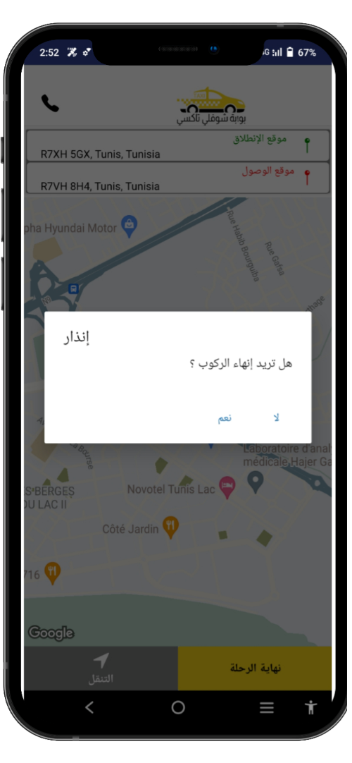
SlideSalad- COPYRIGHT NOTICE
تأكيد الوصول
SlideSalad is #1 online marketplace of premium presentations templates for all needs
Things you can do with the template
Use the free templates for your own presentations and projects without limitations.
Please link back to our website if you like our free designs
or write a comment to this template on our website.
All copyright and intellectual property rights, without limitation, are retained by SlideSalad.com.
By downloading and using this template, you agree
to this statement.
Please contact us if you have any questions
about usage: support@slidesalad.com
Things you can’t do with the template
Resell or distribute the templates or backgrounds.
Make these templates available on a website or social network for download.
Edit or modify the downloaded templates and claim /
pass off as your own work.
إنذار إنهاء الركوب
More PowerPoint, Google Slides and Keynote templates are available at www.SlideSalad.com

Slide 18
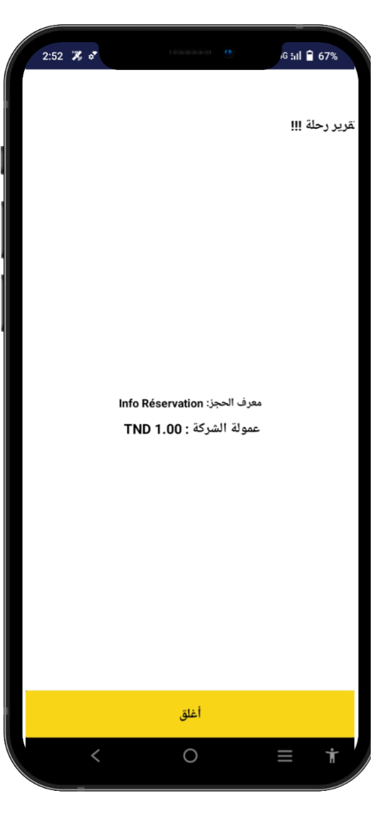
SlideSalad- COPYRIGHT NOTICE
Alert confirm booking
SlideSalad is #1 online marketplace of premium presentations templates for all needs
Things you can do with the template
Use the free templates for your own presentations and projects without limitations.
Please link back to our website if you like our free designs
or write a comment to this template on our website.
All copyright and intellectual property rights, without limitation, are retained by SlideSalad.com.
By downloading and using this template, you agree
to this statement.
Please contact us if you have any questions
about usage: support@slidesalad.com
Things you can’t do with the template
Resell or distribute the templates or backgrounds.
Make these templates available on a website or social network for download.
Edit or modify the downloaded templates and claim /
pass off as your own work.
تقرير الرحلة
More PowerPoint, Google Slides and Keynote templates are available at www.SlideSalad.com

Slide 19
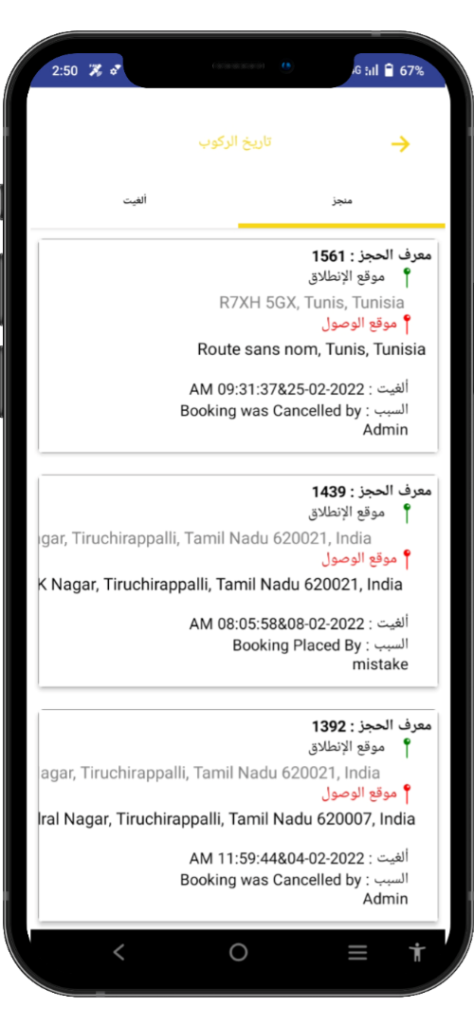
SlideSalad- COPYRIGHT NOTICE
تواريخ الركوب
SlideSalad is #1 online marketplace of premium presentations templates for all needs
Things you can do with the template
Use the free templates for your own presentations and projects without limitations.
Please link back to our website if you like our free designs
or write a comment to this template on our website.
All copyright and intellectual property rights, without limitation, are retained by SlideSalad.com.
By downloading and using this template, you agree
to this statement.
Please contact us if you have any questions
about usage: support@slidesalad.com
Things you can’t do with the template
Resell or distribute the templates or backgrounds.
Make these templates available on a website or social network for download.
Edit or modify the downloaded templates and claim /
pass off as your own work.
استعراض الحجوزات المنجزة
More PowerPoint, Google Slides and Keynote templates are available at www.SlideSalad.com

Slide 20
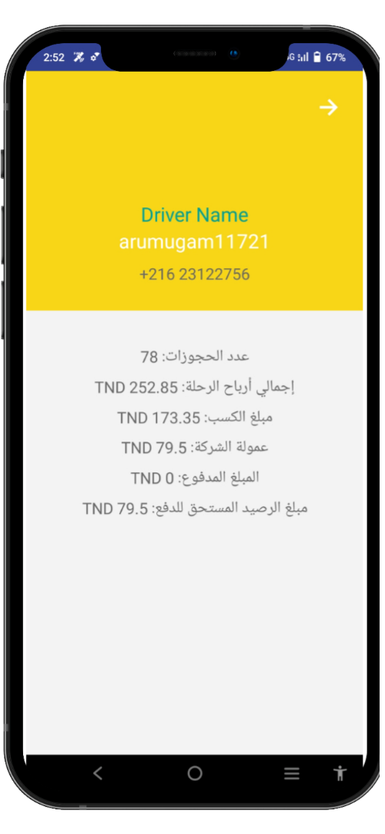
SlideSalad- COPYRIGHT NOTICE
حوصلة الحجوزات
SlideSalad is #1 online marketplace of premium presentations templates for all needs
Things you can do with the template
Use the free templates for your own presentations and projects without limitations.
Please link back to our website if you like our free designs
or write a comment to this template on our website.
All copyright and intellectual property rights, without limitation, are retained by SlideSalad.com.
By downloading and using this template, you agree
to this statement.
Please contact us if you have any questions
about usage: support@slidesalad.com
Things you can’t do with the template
Resell or distribute the templates or backgrounds.
Make these templates available on a website or social network for download.
Edit or modify the downloaded templates and claim /
pass off as your own work.
الحوصلة
More PowerPoint, Google Slides and Keynote templates are available at www.SlideSalad.com
Cancel button
During the search for a driver, there is a possibility for the Driver to cancel the reservation using the cancel button.

