Slide 1
Choufli Taxi
Customer Mobile Application – Choufli Taxi
www.Chouflitaxi.net

Slide 2
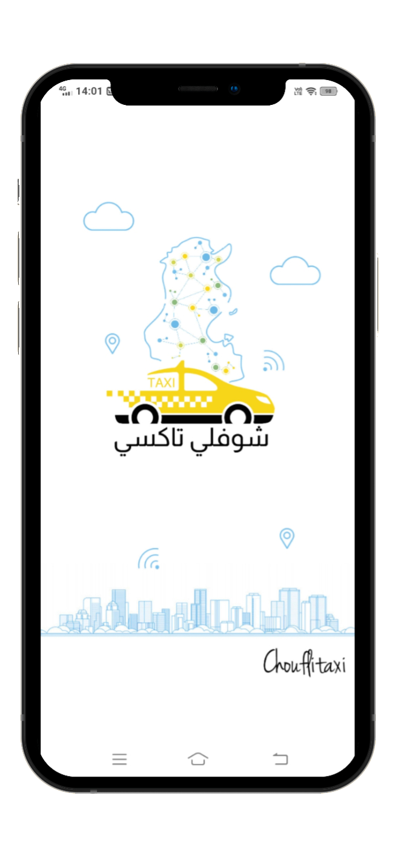
Choufli Taxi
Book a trip
A mission to deliver a world-class Taxi service experience.
Book a city taxi to your destination in town.
Choose from a range of categories and prices.
Track Your Taxi
Arrive Safely
Have an e-invoice

Slide 3
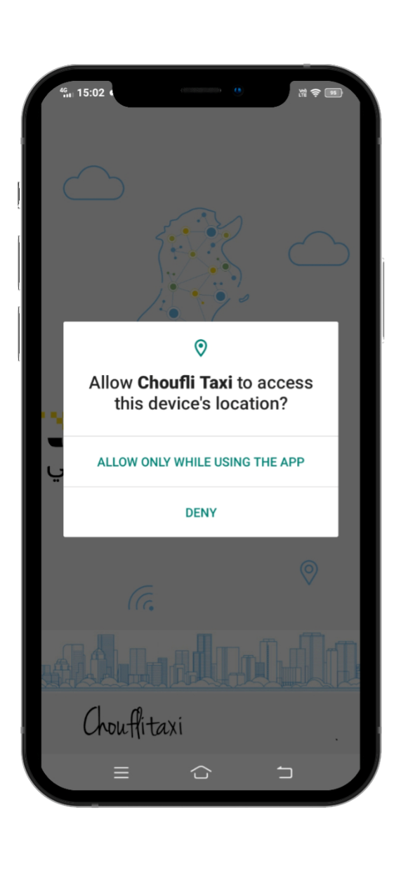
SlideSalad- COPYRIGHT NOTICE
Traffic authorizations
SlideSalad is #1 online marketplace of premium presentations templates for all needs
Things you can do with the template
Use the free templates for your own presentations and projects without limitations.
Please link back to our website if you like our free designs or write a comment to this template on our website.
All copyright and intellectual property rights, without limitation, are retained by SlideSalad.com. By downloading and using this template, you agree to this statement.
Please contact us if you have any questions about usage: support@slidesalad.com
Things you can’t do with the template
Resell or distribute the templates or backgrounds.
Make these templates available on a website or social network for download.
Edit or modify the downloaded templates and claim / pass off as your own work.
Traffic authorizations
To protect user privacy and detect your current location, apps that use location services must request location permission.
Applications cannot grant permissions automatically, they must be confirmed by the user. The apps. Will ask you to accept each of their permissions the first time you launch them through a popup that asks you to allow or deny each request
More PowerPoint, Google Slides and Keynote templates are available at www.SlideSalad.com

Slide 4
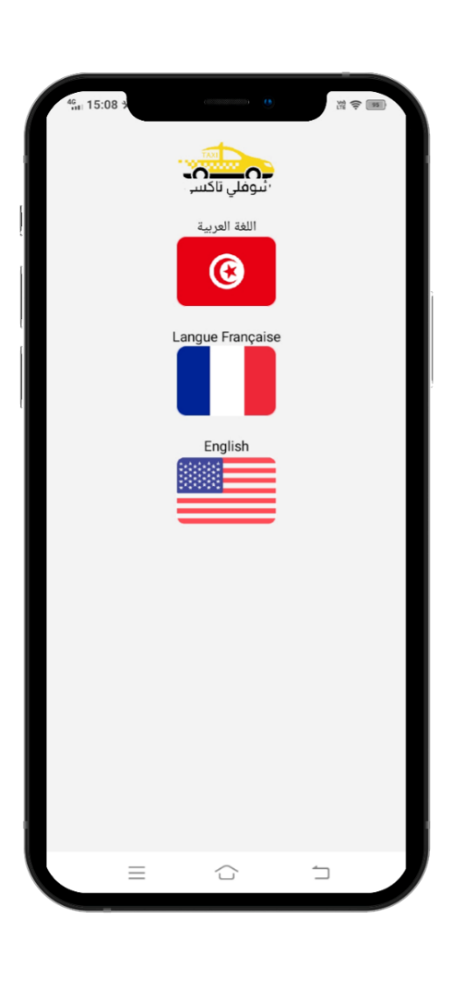
Choose your language
The app Choufli Taxi works in several languages
Arabic language
French language
English language

Slide 5
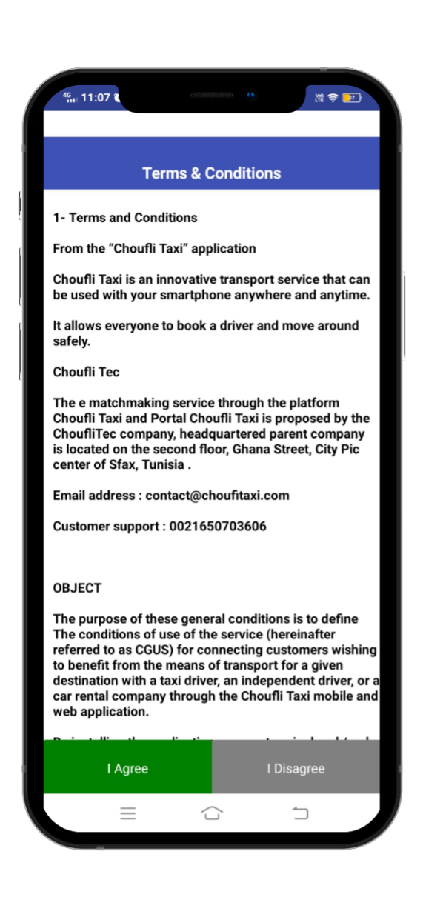
SlideSalad- COPYRIGHT NOTICE
Terms & Conditions
SlideSalad is #1 online marketplace of premium presentations templates for all needs
Things you can do with the template
Use the free templates for your own presentations and projects without limitations.
Please link back to our website if you like our free designs or write a comment to this template on our website.
All copyright and intellectual property rights, without limitation, are retained by SlideSalad.com. By downloading and using this template, you agree to this statement.
Please contact us if you have any questions about usage: support@slidesalad.com
Things you can’t do with the template
Resell or distribute the templates or backgrounds.
Make these templates available on a website or social network for download.
Edit or modify the downloaded templates and claim / pass off as your own work.
Terms & Conditions
The following Terms & Conditions shall apply for Customers / Passengers using the services offered by Choufli Taxi for the rental of the taxi service.
Every customer should need to read Terms & Conditions carefully before clicking the agree button.
If a customer is not satisfied with the terms & conditions Choufli Taxi. He may not agree.
If the customer clicks the disapprove button, they cannot continue with the app. Choufli Taxi
More PowerPoint, Google Slides and Keynote templates are available at www.SlideSalad.com

Slide 6
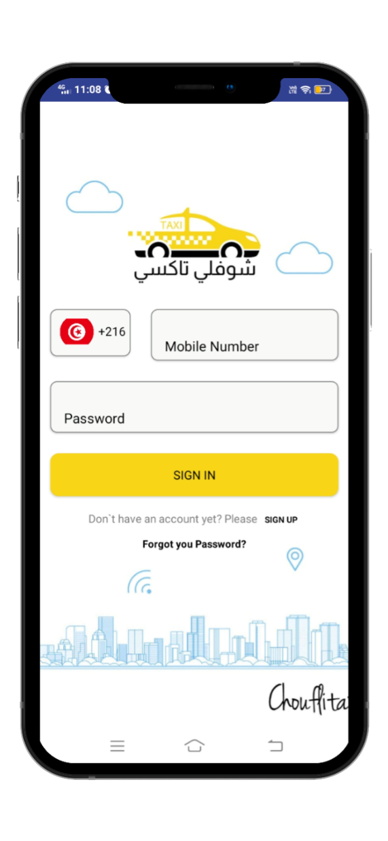
SlideSalad- COPYRIGHT NOTICE
Login Page
SlideSalad is #1 online marketplace of premium presentations templates for all needs
Things you can do with the template
Use the free templates for your own presentations and projects without limitations.
Please link back to our website if you like our free designs or write a comment to this template on our website.
All copyright and intellectual property rights, without limitation, are retained by SlideSalad.com. By downloading and using this template, you agree to this statement.
Please contact us if you have any questions about usage: support@slidesalad.com
Things you can’t do with the template
Resell or distribute the templates or backgrounds.
Make these templates aailable on a website or social network for download.
Edit or modify the downloaded templates and claim / pass off as your own work.
Country code
Select your country as a customer using their mobile number
Phone number
The customer must need to enter their registered mobile number.
Password
The customer must need to enter their password received from the Choufli admin.
To log in
After entering the correct mobile phone number and password, the customer must click the login button to access the Choufli application portal.
More PowerPoint, Google Slides and Keynote templates are available at www.SlideSalad.com

Slide 7
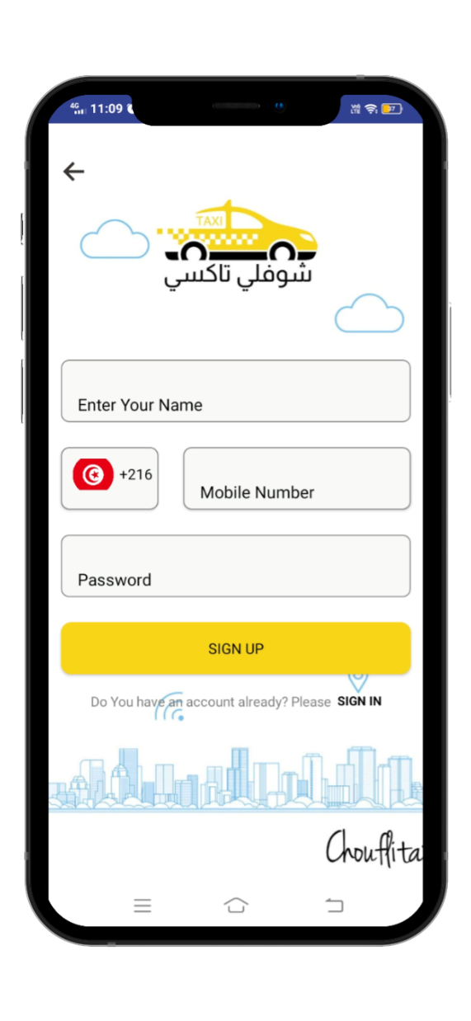
SlideSalad- COPYRIGHT NOTICE
Registration Page
SlideSalad is #1 online marketplace of premium presentations templates for all needs
Things you can do with the template
Use the free templates for your own presentations and projects without limitations.
Please link back to our website if you like our free designs or write a comment to this template on our website.
All copyright and intellectual property rights, without limitation, are retained by SlideSalad.com. By downloading and using this template, you agree to this statement.
Please contact us if you have any questions about usage: support@slidesalad.com
Things you can’t do with the template
Resell or distribute the templates or backgrounds.
Make these templates available on a website or social network for download.
Edit or modify the downloaded templates and claim / pass off as your own work.
Last Name
The customer needs to enter their name.
Phone Number
The customer needs to enter their real mobile phone number to register with the app. Choufli.
Password
Customer should need to enter their Password which received from Choufli admin.
Register
After entering the correct mobile number and password, the customer must need to click the register button to enter the Choufli application.
More PowerPoint, Google Slides and Keynote templates are available at www.SlideSalad.com

Slide 8
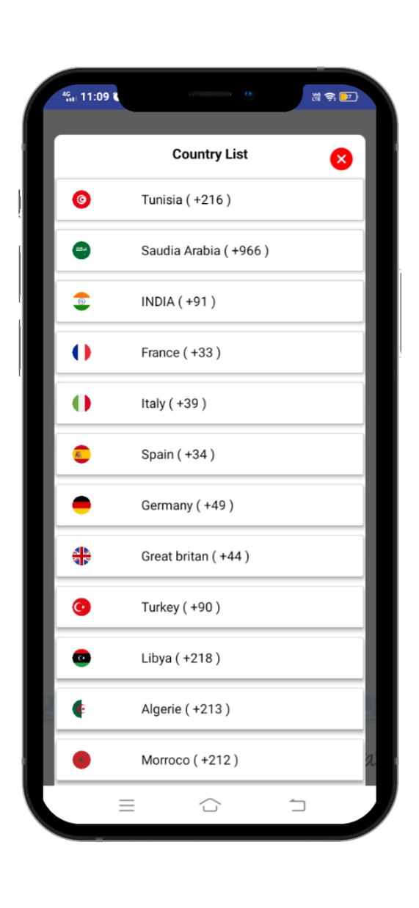
SlideSalad- COPYRIGHT NOTICE
Country List
SlideSalad is #1 online marketplace of premium presentations templates for all needs
Things you can do with the template
Use the free templates for your own presentations and projects without limitations.
Please link back to our website if you like our free designs or write a comment to this template on our website.
All copyright and intellectual property rights, without limitation, are retained by SlideSalad.com. By downloading and using this template, you agree to this statement.
Please contact us if you have any questions about usage: support@slidesalad.com
Things you can’t do with the template
Resell or distribute the templates or backgrounds.
Make these templates available on a website or social network for download.
Edit or modify the downloaded templates and claim / pass off as your own work.
Country List
The customer must need to select the country code for the current location and the network operator.
More PowerPoint, Google Slides and Keynote templates are available at www.SlideSalad.com

Slide 9
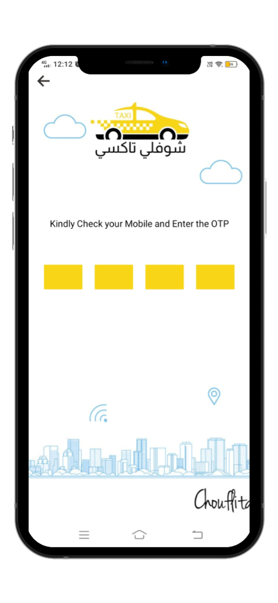
SlideSalad- COPYRIGHT NOTICE
OTP receipt
SlideSalad is #1 online marketplace of premium presentations templates for all needs
Back button
If the customer cannot receive OTP, that means, the customer can click the back button to navigate the previous page to check their corrections.
Things you can do with the template
Use the free templates for your own presentations and projects without limitations.
Please link back to our website if you like our free designs or write a comment to this template on our website.
All copyright and intellectual property rights, without limitation, are retained by SlideSalad.com. By downloading and using this template, you agree to this statement.
Please contact us if you have any questions about usage: support@slidesalad.com
Things you can’t do with the template
Resell or distribute the templates or backgrounds.
Make these templates available on a website or social network for download.
Edit or modify the downloaded templates and claim / pass off as your own work.
Enter OTP
After clicking the register button, the app. Navigate to the next page to enter the OTP received on your mobile phone.
More PowerPoint, Google Slides and Keynote templates are available at www.SlideSalad.com

Slide 10
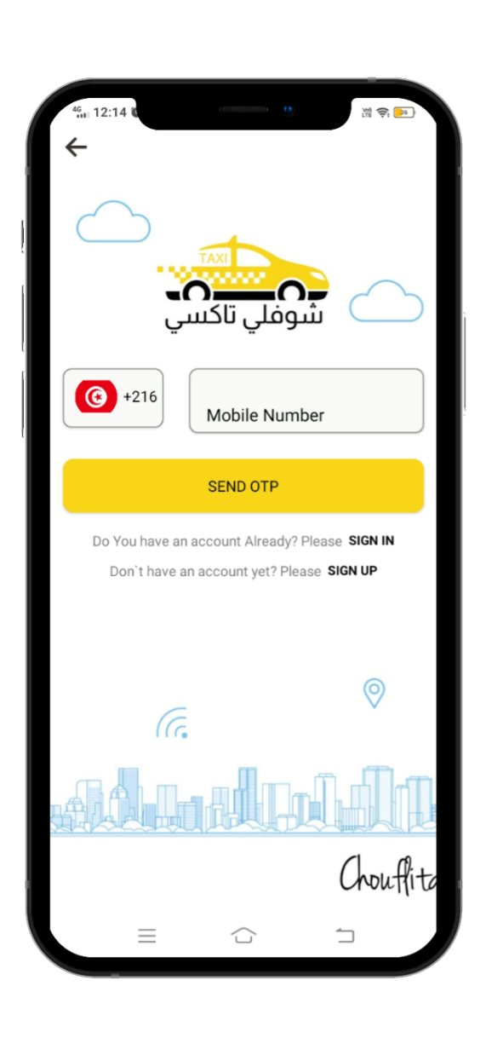
SlideSalad- COPYRIGHT NOTICE
Forgot your password ?
SlideSalad is #1 online marketplace of premium presentations templates for all needs
Things you can do with the template
Use the free templates for your own presentations and projects without limitations.
Please link back to our website if you like our free designs or write a comment to this template on our website.
All copyright and intellectual property rights, without limitation, are retained by SlideSalad.com. By downloading and using this template, you agree to this statement.
Please contact us if you have any questions about usage: support@slidesalad.com
Things you can’t do with the template
Resell or distribute the templates or backgrounds.
Make these templates available on a website or social network for download.
Edit or modify the downloaded templates and claim / pass off as your own work.
Registered mobile phone number
The customer should need to enter their mobile number already registered with the app. Choufli to receive OTP (one-time password)
Send OTP
After the customer has entered the registered mobile number correctly, he needs to click the send OTP button to receive OTP to create a new password for the existing used mobile number.
More PowerPoint, Google Slides and Keynote templates are available at www.SlideSalad.com

Slide 11
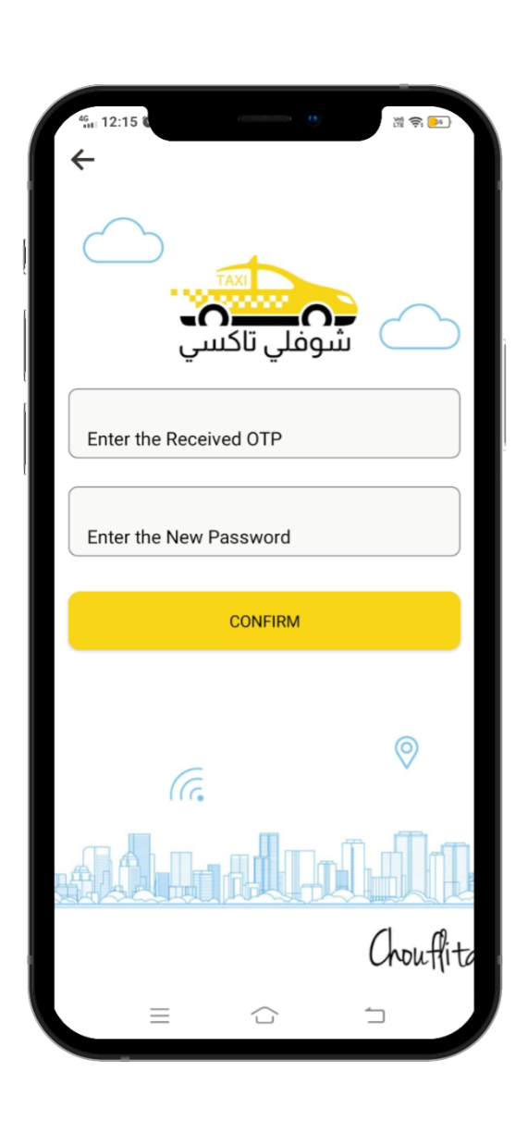
SlideSalad- COPYRIGHT NOTICE
Receive OTP
SlideSalad is #1 online marketplace of premium presentations templates for all needs
Back button
If the customer cannot receive OTP that means, the customer can click the back button to navigate to the previous page and check their corrections.
Things you can do with the template
Use the free templates for your own presentations and projects without limitations.
Please link back to our website if you like our free designs or write a comment to this template on our website.
All copyright and intellectual property rights, without limitation, are retained by SlideSalad.com. By downloading and using this template, you agree to this statement.
Please contact us if you have any questions about usage: support@slidesalad.com
Things you can’t do with the template
Resell or distribute the templates or backgrounds.
Make these templates available on a website or social network for download.
Edit or modify the downloaded templates and claim / pass off as your own work.
Enter OTP
After clicking send OTP the app. Navigate to the next page to enter the OTP received on the mobile phone.
Enter new password
After entering the OTP, the customer must need to enter their new password to update in the app. Choufli.
To confirm
After entering the OTP & password, the customer may need to click the confirm button to save the new password and update.
More PowerPoint, Google Slides and Keynote templates are available at www.SlideSalad.com

Slide 12
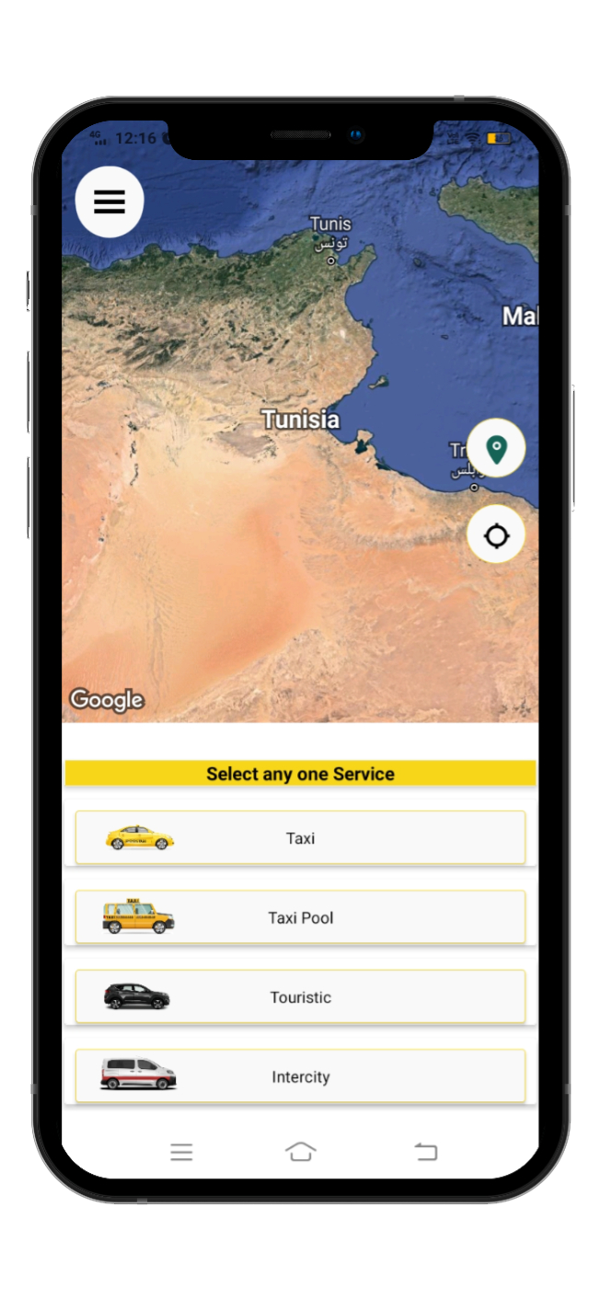
SlideSalad- COPYRIGHT NOTICE
Home page
SlideSalad is #1 online marketplace of premium presentations templates for all needs
Things you can do with the template
Use the free templates for your own presentations and projects without limitations.
Please link back to our website if you like our free designs or write a comment to this template on our website.
All copyright and intellectual property rights, without limitation, are retained by SlideSalad.com. By downloading and using this template, you agree to this statement.
Please contact us if you have any questions about usage: support@slidesalad.com
Google Map
Google Map shows the current location of the customer.
Submenu button
The submenu button is useful for customers to have additional features in the app. Choufli.
Things you can’t do with the template
Resell or distribute the templates or backgrounds.
Make these templates available on a website or social network for download.
Edit or modify the downloaded templates and claim / pass off as your own work.
Current location
Google Map shows the current location of the customer, if the customer needs to refresh the location of his current location or get his current location, he needs to click this current location icon.
Select a service
The customer can choose a service from the list depending on what the Choufli Taxi company provides for the customer.
More PowerPoint, Google Slides and Keynote templates are available at www.SlideSalad.com

Slide 13
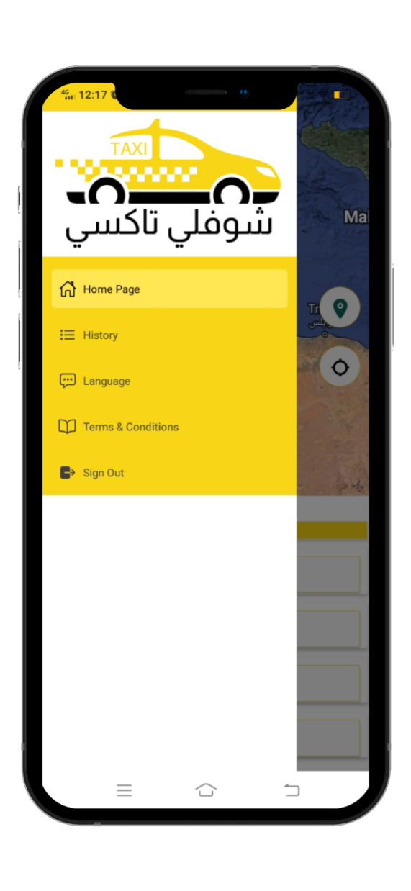
SlideSalad- COPYRIGHT NOTICE
Submenu
SlideSalad is #1 online marketplace of premium presentations templates for all needs
Book your Trip The customer can book his trip after clicking the button book your trip
Things you can’t do with the template
Resell or distribute the templates or backgrounds.
Make these templates available on a website or social network for download.
Edit or modify the downloaded templates and claim / pass off as your own work.
Trip history If the customer clicks the trip history button it means the customer can see his trip history as current reservation, reservation completed, reservation canceled
Support (support) Customer must need support or have any issues & requests, they can contact customer service using the support button
Main menu
Language The customer can change his language at any time using the language option button
Terms & Conditions Terms & Conditions for Customer can read at any time from the app. Choufli.
More PowerPoint, Google Slides and Keynote templates are available at www.SlideSalad.com
Sign out Log out option for customer when he needs a long break or other personal issues, he can log out from the application at any time.

Slide 14
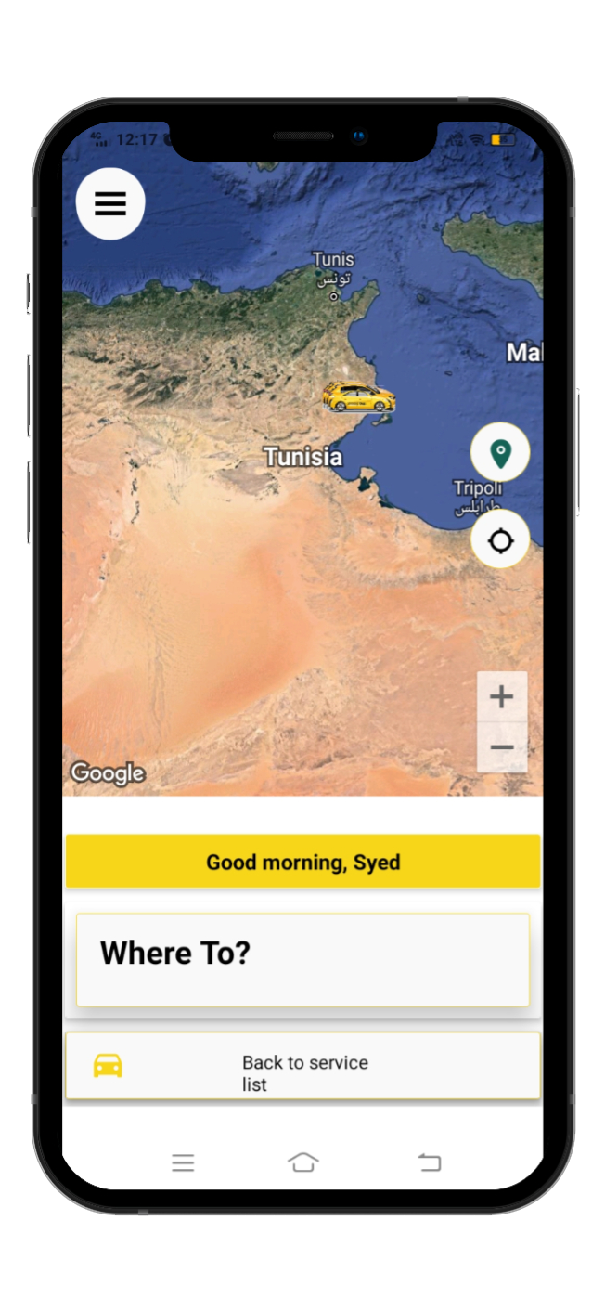
SlideSalad- COPYRIGHT NOTICE
Service page
SlideSalad is #1 online marketplace of premium presentations templates for all needs
Submenu button
The submenu button is useful for customers to have additional features in the app. Choufli.
Things you can do with the template
Use the free templates for your own presentations and projects without limitations.
Please link back to our website if you like our free designs or write a comment to this template on our website.
All copyright and intellectual property rights, without limitation, are retained by SlideSalad.com. By downloading and using this template, you agree to this statement.
Please contact us if you have any questions about usage: support@slidesalad.com
Google Map
Google Map shows the current location of the customer.
Things you can’t do with the template
Resell or distribute the templates or backgrounds.
Make these templates available on a website or social network for download.
Edit or modify the downloaded templates and claim / pass off as your own work.
Current location
Google Map shows the current location of the customer. If the client needs to refresh the current location or get the current location he needs to click the current location icon.
Where to go ?
Customer can choose drop off location and pick up location to ride.
Select a service
The customer can select a location to save for regular trips such as home to office.
The customer can save the home address and the office address in the app. Choufli.
More PowerPoint, Google Slides and Keynote templates are available at www.SlideSalad.com
Back to service
Return to customer service can return to the page to select another type of service.

Slide 15
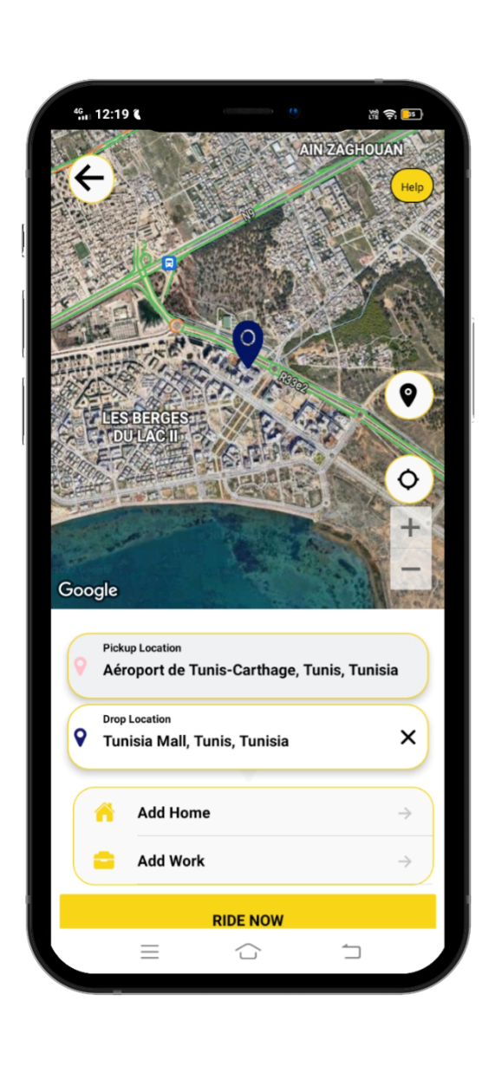
SlideSalad- COPYRIGHT NOTICE
Where to go ?
SlideSalad is #1 online marketplace of premium presentations templates for all needs
Things you can do with the template
Use the free templates for your own presentations and projects without limitations.
Please link back to our website if you like our free designs or write a comment to this template on our website.
All copyright and intellectual property rights, without limitation, are retained by SlideSalad.com. By downloading and using this template, you agree to this statement.
Please contact us if you have any questions about usage: support@slidesalad.com
Things you can’t do with the template
Resell or distribute the templates or backgrounds.
Make these templates available on a website or social network for download.
Edit or modify the downloaded templates and claim / pass off as your own work.
Starting point location
The customer can select the starting point location through Google Map.
Current location
Google Map shows the customer their current location. If the customer needs to refresh the current location or have the current location, he needs to click the current location icon.
Add Residence & Add Office
The customer can save the home & office location for regular trips in the app. Choufli.
More PowerPoint, Google Slides and Keynote templates are available at www.SlideSalad.com

Slide 16
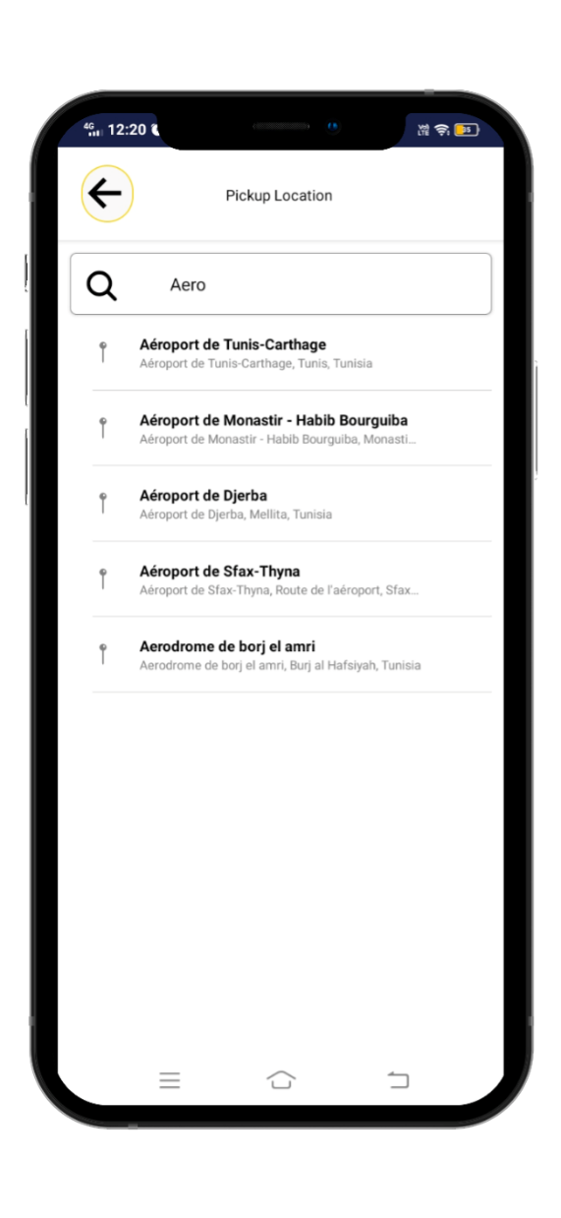
SlideSalad- COPYRIGHT NOTICE
Finding the starting point and ending point location
SlideSalad is #1 online marketplace of premium presentations templates for all needs
Start point and end point location search bar
The customer can search for the location of his departure point and select it in the search bar
Things you can do with the template
Use the free templates for your own presentations and projects without limitations.
Please link back to our website if you like our free designs or write a comment to this template on our website.
All copyright and intellectual property rights, without limitation, are retained by SlideSalad.com. By downloading and using this template, you agree to this statement.
Please contact us if you have any questions about usage: support@slidesalad.com
Things you can’t do with the template
Resell or distribute the templates or backgrounds.
Make these templates available on a website or social network for download.
Edit or modify the downloaded templates and claim / pass off as your own work.
search results
The customer can see their search results in the search bar.
More PowerPoint, Google Slides and Keynote templates are available at www.SlideSalad.com

Slide 17
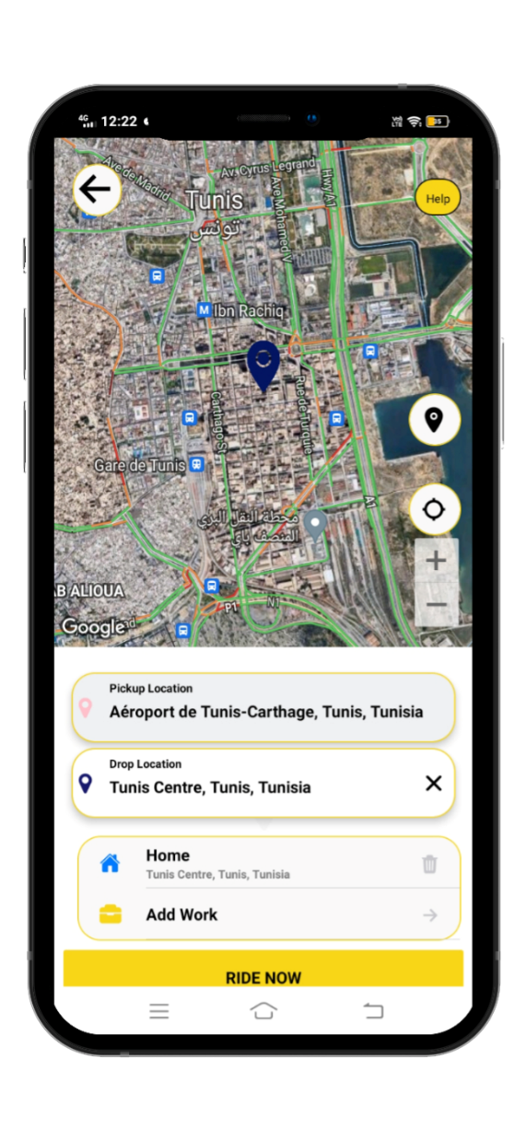
SlideSalad- COPYRIGHT NOTICE
Ride now
SlideSalad is #1 online marketplace of premium presentations templates for all needs
Things you can do with the template
Use the free templates for your own presentations and projects without limitations.
Please link back to our website if you like our free designs or write a comment to this template on our website.
All copyright and intellectual property rights, without limitation, are retained by SlideSalad.com. By downloading and using this template, you agree to this statement.
Please contact us if you have any questions about usage: support@slidesalad.com
Things you can’t do with the template
Resell or distribute the templates or backgrounds.
Make these templates available on a website or social network for download.
Edit or modify the downloaded templates and claim / pass off as your own work.
Current location
Google Map it shows the customer the current location. If the customer needs to refresh the current location or have the current location, he needs to click the icon this current location
Arrival point location
The customer can select the arrival point location through Google Map.
Ride now
After selecting the start point and end point location the customer needs to click the ride now button from the booking
More PowerPoint, Google Slides and Keynote templates are available at www.SlideSalad.com

Slide 18
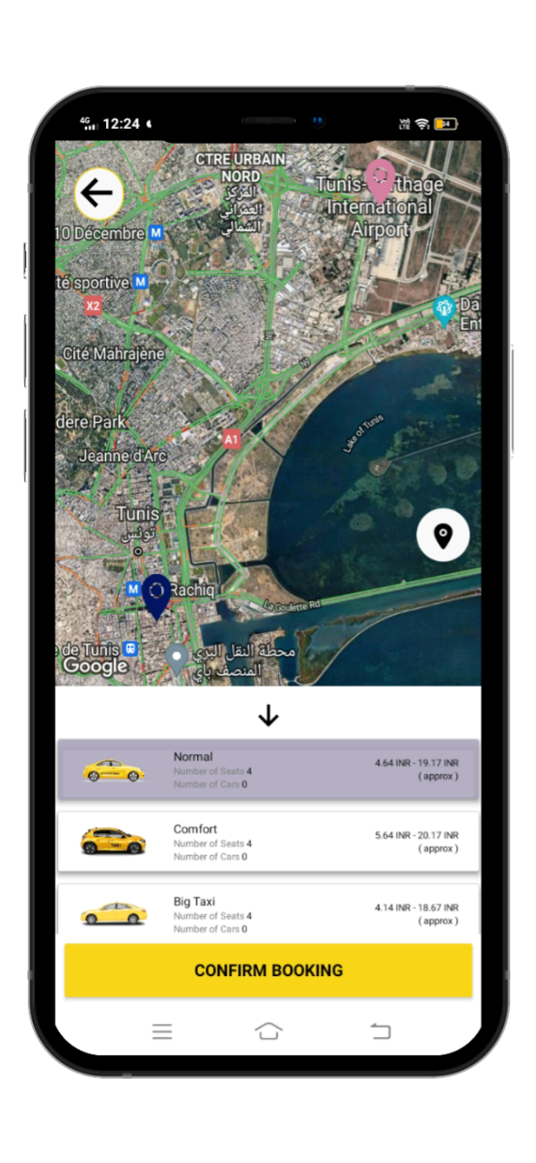
SlideSalad- COPYRIGHT NOTICE
Confirm booking
Back button
If the customer cannot confirm the route or change the start point and end point location, this means the customer can click the back button to navigate to the previous page to check their corrections.
SlideSalad is #1 online marketplace of premium presentations templates for all needs
Things you can do with the template
Use the free templates for your own presentations and projects without limitations.
Please link back to our website if you like our free designs or write a comment to this template on our website.
All copyright and intellectual property rights, without limitation, are retained by SlideSalad.com. By downloading and using this template, you agree to this statement.
Please contact us if you have any questions about usage: support@slidesalad.com
Things you can’t do with the template
Resell or distribute the templates or backgrounds.
Make these templates available on a website or social network for download.
Edit or modify the downloaded templates and claim / pass off as your own work.
Service vehicle type
The customer can type the type of service vehicle he needs, for example:
regular cab
Taxi comfort
Or Motorcycle
Confirm booking
After selecting the type of service vehicle the customer should need to click the confirm booking button for the ride
More PowerPoint, Google Slides and Keynote templates are available at www.SlideSalad.com

Slide 19
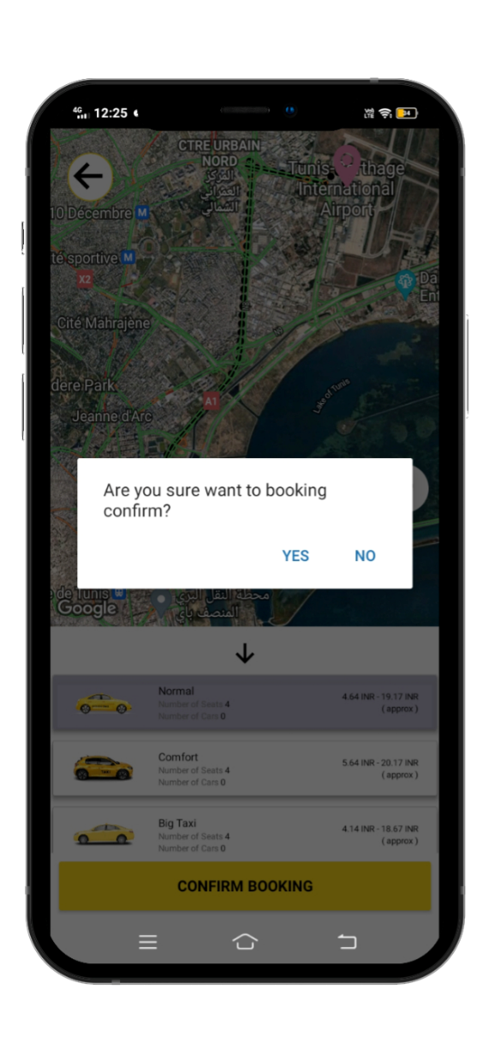
SlideSalad- COPYRIGHT NOTICE
Alert confirm booking
SlideSalad is #1 online marketplace of premium presentations templates for all needs
Things you can do with the template
Use the free templates for your own presentations and projects without limitations.
Please link back to our website if you like our free designs or write a comment to this template on our website.
All copyright and intellectual property rights, without limitation, are retained by SlideSalad.com. By downloading and using this template, you agree to this statement.
Please contact us if you have any questions about usage: support@slidesalad.com
Things you can’t do with the template
Resell or distribute the templates or backgrounds.
Make these templates available on a website or social network for download.
Edit or modify the downloaded templates and claim / pass off as your own work.
Alert – confirm trip
If the customer clicks the confirm the trip button, a popup alert appears (alert contextual window) to start the trip “yes or no”
The customer who should need to start the journey must click "yes"
If the customer clicks "no" the journey cannot begin
More PowerPoint, Google Slides and Keynote templates are available at www.SlideSalad.com

Slide 20
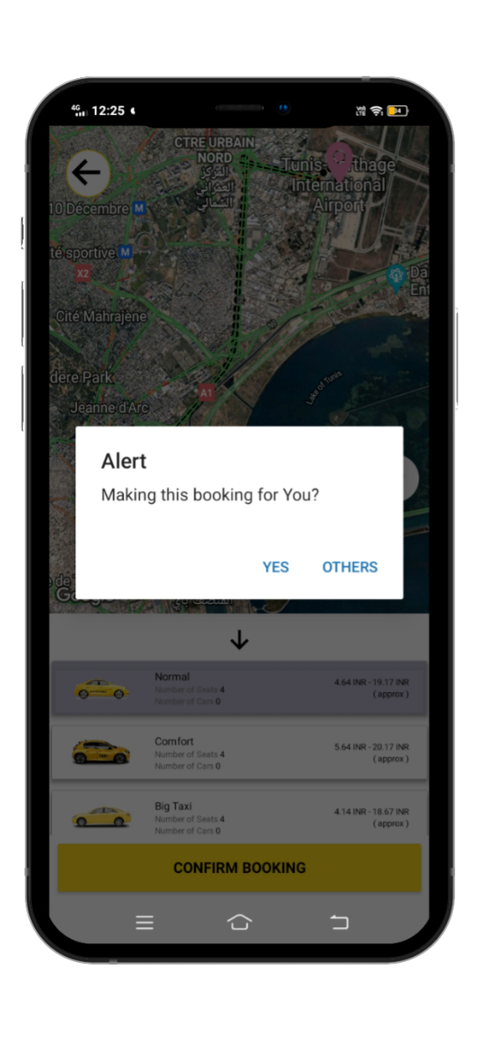
SlideSalad- COPYRIGHT NOTICE
Reservation for
SlideSalad is #1 online marketplace of premium presentations templates for all needs
Things you can do with the template
Use the free templates for your own presentations and projects without limitations.
Please link back to our website if you like our free designs or write a comment to this template on our website.
All copyright and intellectual property rights, without limitation, are retained by SlideSalad.com. By downloading and using this template, you agree to this statement.
Please contact us if you have any questions about usage: support@slidesalad.com
Things you can’t do with the template
Resell or distribute the templates or backgrounds.
Make these templates available on a website or social network for download.
Edit or modify the downloaded templates and claim / pass off as your own work.
Make this reservation for you
The customer must select for whom he is making the reservation for example for himself, he needs to click the "yes" button if he is making the reservation for others he must click the others button.
More PowerPoint, Google Slides and Keynote templates are available at www.SlideSalad.com

Slide 21
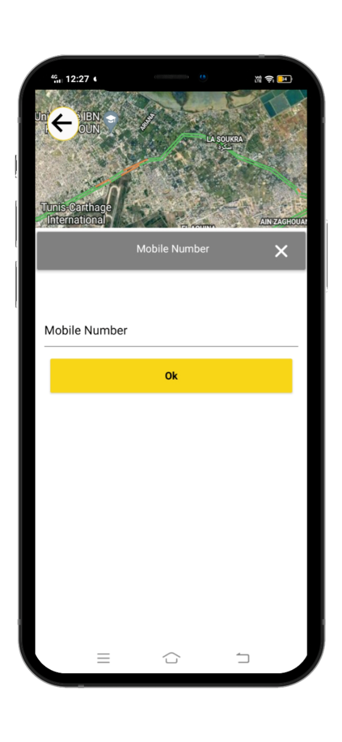
SlideSalad- COPYRIGHT NOTICE
For others
SlideSalad is #1 online marketplace of premium presentations templates for all needs
Things you can do with the template
Use the free templates for your own presentations and projects without limitations.
Please link back to our website if you like our free designs or write a comment to this template on our website.
All copyright and intellectual property rights, without limitation, are retained by SlideSalad.com. By downloading and using this template, you agree to this statement.
Please contact us if you have any questions about usage: support@slidesalad.com
Things you can’t do with the template
Resell or distribute the templates or backgrounds.
Make these templates available on a website or social network for download.
Edit or modify the downloaded templates and claim / pass off as your own work.
Mobile phone number
The customer after selecting the others button, the customer must need to provide the mobile phone number, the contact of others.
More PowerPoint, Google Slides and Keynote templates are available at www.SlideSalad.com

Slide 22
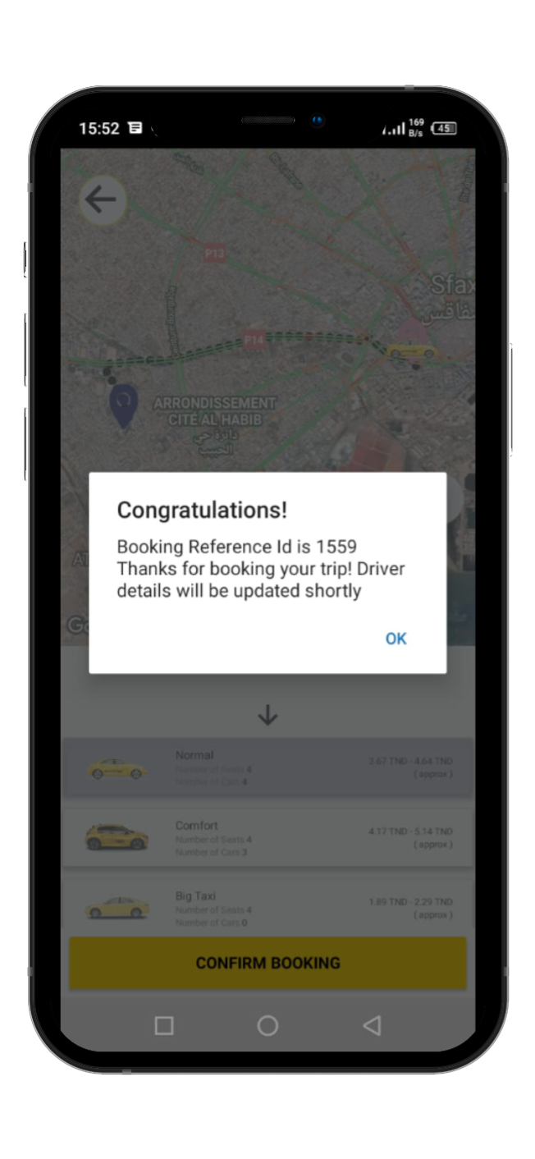
SlideSalad- COPYRIGHT NOTICE
Booking Confirmation Alert
SlideSalad is #1 online marketplace of premium presentations templates for all needs
Things you can do with the template
Use the free templates for your own presentations and projects without limitations.
Please link back to our website if you like our free designs or write a comment to this template on our website.
All copyright and intellectual property rights, without limitation, are retained by SlideSalad.com. By downloading and using this template, you agree to this statement.
Please contact us if you have any questions about usage: support@slidesalad.com
Things you can’t do with the template
Resell or distribute the templates or backgrounds.
Make these templates available on a website or social network for download.
Edit or modify the downloaded templates and claim / pass off as your own work.
Reservation confirmation
After confirming the reservation, the customer receives a confirmation alert with reservation ID
More PowerPoint, Google Slides and Keynote templates are available at www.SlideSalad.com

Slide 23
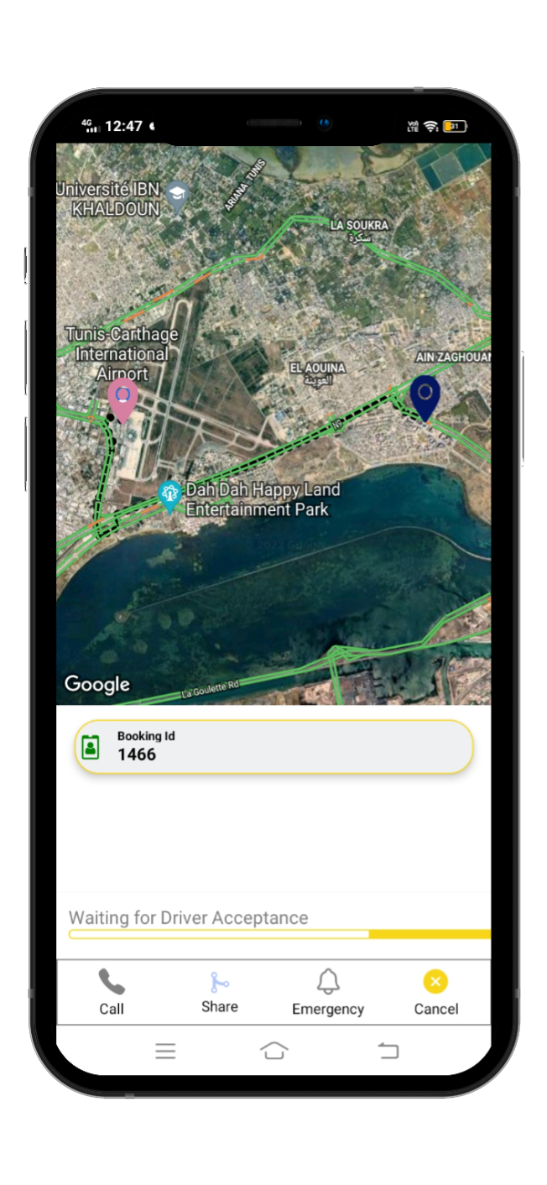
SlideSalad- COPYRIGHT NOTICE
Find a driver
SlideSalad is #1 online marketplace of premium presentations templates for all needs
Things you can do with the template
Use the free templates for your own presentations and projects without limitations.
Please link back to our website if you like our free designs or write a comment to this template on our website.
All copyright and intellectual property rights, without limitation, are retained by SlideSalad.com. By downloading and using this template, you agree to this statement.
Please contact us if you have any questions about usage: support@slidesalad.com
Things you can’t do with the template
Resell or distribute the templates or backgrounds.
Make these templates available on a website or social network for download.
Edit or modify the downloaded templates and claim / pass off as your own work.
Find a driver
After confirming the reservation, the application searches for the online driver closest to the customer.
More PowerPoint, Google Slides and Keynote templates are available at www.SlideSalad.com
Cancel button
During the search for a driver, there is a possibility for the customer to cancel the reservation using the cancel button.

Slide 24
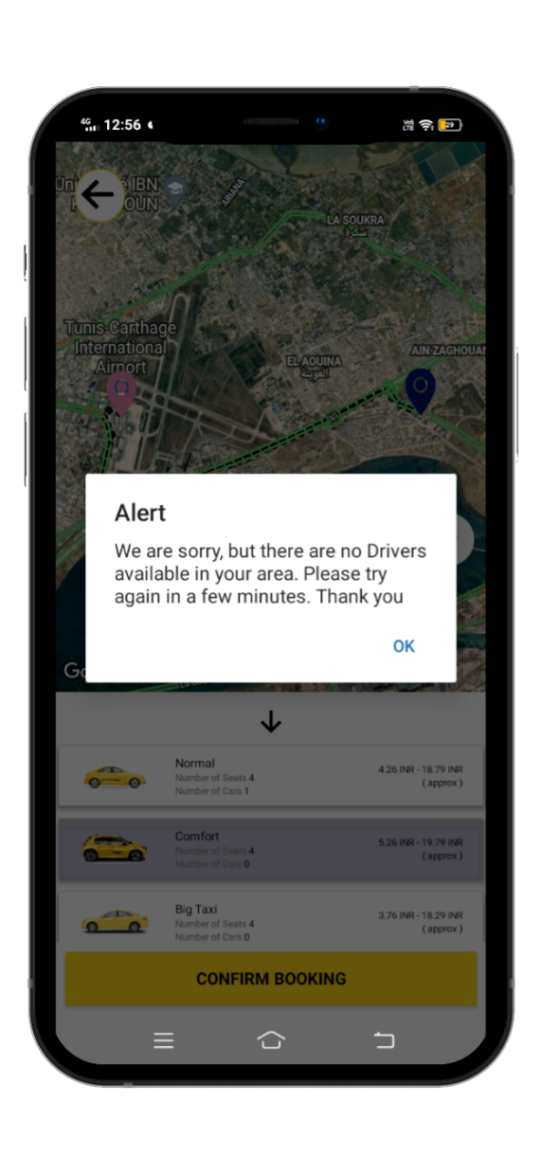
SlideSalad- COPYRIGHT NOTICE
Driver unavailable
SlideSalad is #1 online marketplace of premium presentations templates for all needs
Things you can do with the template
Use the free templates for your own presentations and projects without limitations.
Please link back to our website if you like our free designs or write a comment to this template on our website.
All copyright and intellectual property rights, without limitation, are retained by SlideSalad.com. By downloading and using this template, you agree to this statement.
Please contact us if you have any questions about usage: support@slidesalad.com
Things you can’t do with the template
Resell or distribute the templates or backgrounds.
Make these templates available on a website or social network for download.
Edit or modify the downloaded templates and claim / pass off as your own work.
Driver unavailable
Before confirming the reservation, if all the drivers of the selected service are offline, an alert message is displayed: "sorry unavailable". then the customer can notify that there are no more drivers online for the selected category.
More PowerPoint, Google Slides and Keynote templates are available at www.SlideSalad.com

Slide 25
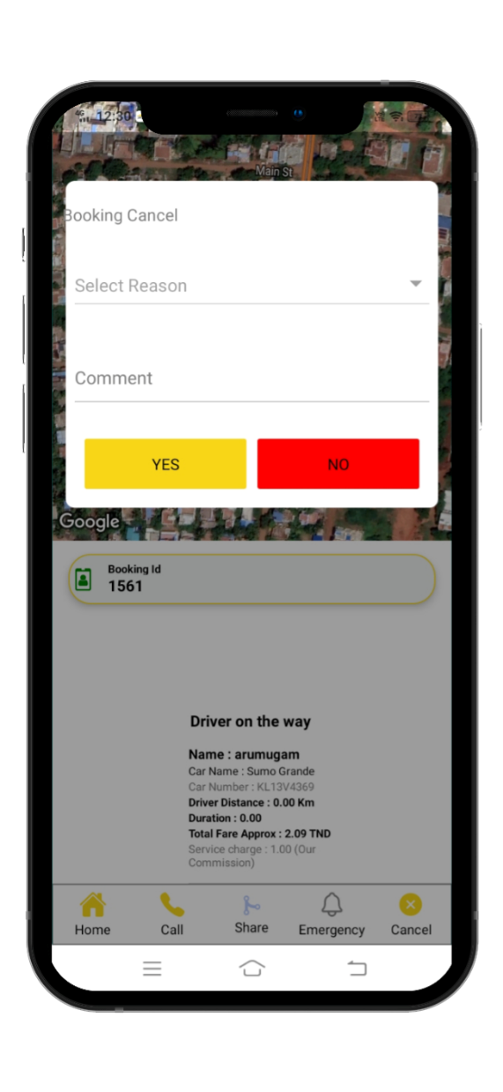
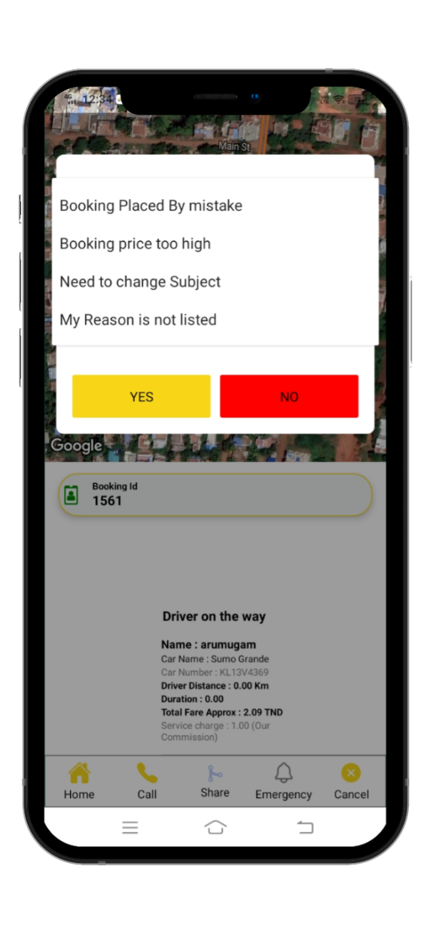
SlideSalad- COPYRIGHT NOTICE
Cancel the reservation
SlideSalad is #1 online marketplace of premium presentations templates for all needs
Things you can do with the template
Use the free templates for your own presentations and projects without limitations.
Please link back to our website if you like our free designs or write a comment to this template on our website.
All copyright and intellectual property rights, without limitation, are retained by SlideSalad.com. By downloading and using this template, you agree to this statement.
Please contact us if you have any questions about usage: support@slidesalad.com
Things you can’t do with the template
Resell or distribute the templates or backgrounds.
Make these templates available on a website or social network for download.
Edit or modify the downloaded templates and claim / pass off as your own work.
Reservation canceled
After clicking the cancel button, the customer needs to select one of the reasons listed in the application and needs to give a comment about the cancellation of the reservation.
More PowerPoint, Google Slides and Keynote templates are available at www.SlideSalad.com

Slide 26
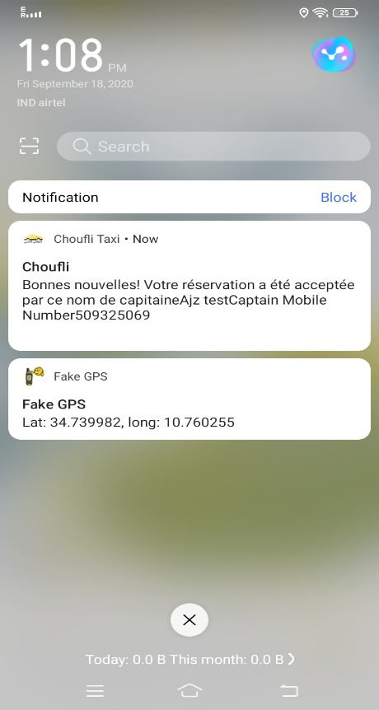
SlideSalad- COPYRIGHT NOTICE
Reservation notification
SlideSalad is #1 online marketplace of premium presentations templates for all needs
Things you can do with the template
Use the free templates for your own presentations and projects without limitations.
Please link back to our website if you like our free designs or write a comment to this template on our website.
All copyright and intellectual property rights, without limitation, are retained by SlideSalad.com. By downloading and using this template, you agree to this statement.
Please contact us if you have any questions about usage: support@slidesalad.com
Things you can’t do with the template
Resell or distribute the templates or backgrounds.
Make these templates available on a website or social network for download.
Edit or modify the downloaded templates and claim / pass off as your own work.
Notification
Once the captain accepts the booking, the client receives notification of the captain's detail and mobile phone number.
More PowerPoint, Google Slides and Keynote templates are available at www.SlideSalad.com

Slide 27
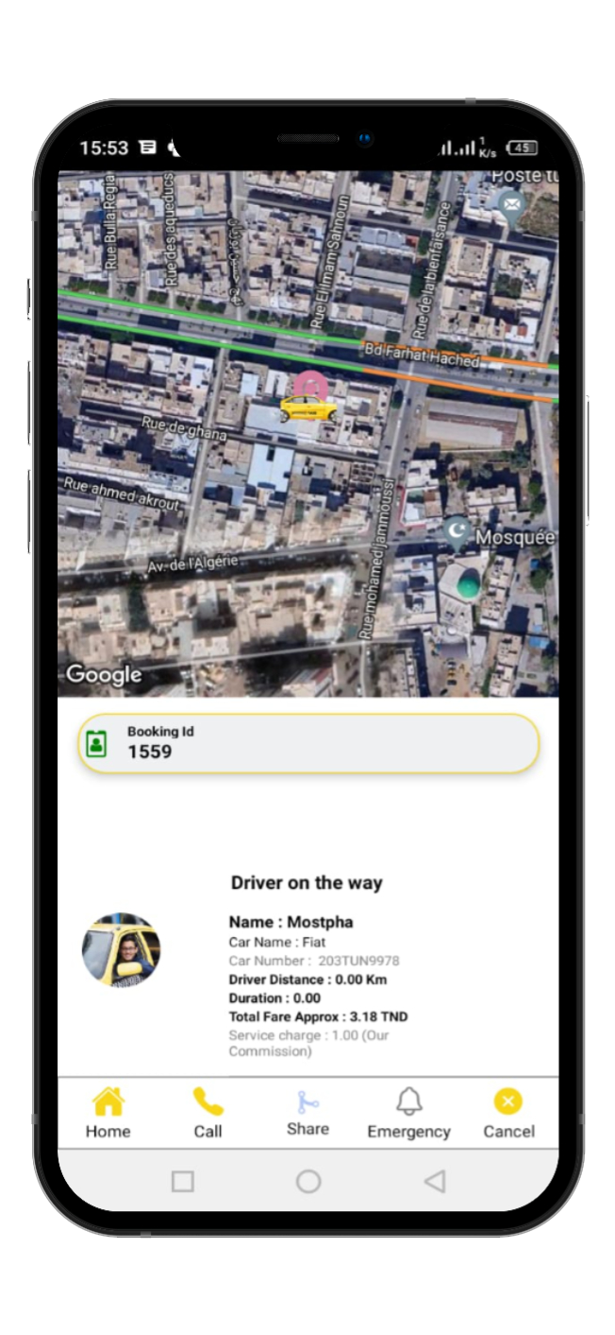
SlideSalad- COPYRIGHT NOTICE
After the driver accepts the booking
SlideSalad is #1 online marketplace of premium presentations templates for all needs
Things you can do with the template
Use the free templates for your own presentations and projects without limitations.
Please link back to our website if you like our free designs or write a comment to this template on our website.
All copyright and intellectual property rights, without limitation, are retained by SlideSalad.com. By downloading and using this template, you agree to this statement.
Please contact us if you have any questions about usage: support@slidesalad.com
Things you can’t do with the template
Resell or distribute the templates or backgrounds.
Make these templates available on a website or social network for download.
Edit or modify the downloaded templates and claim / pass off as your own work.
Notification
After the driver accepts the booking, the customer receives a notification about the captain's details and his mobile phone number.
More PowerPoint, Google Slides and Keynote templates are available at www.SlideSalad.com

Slide 28
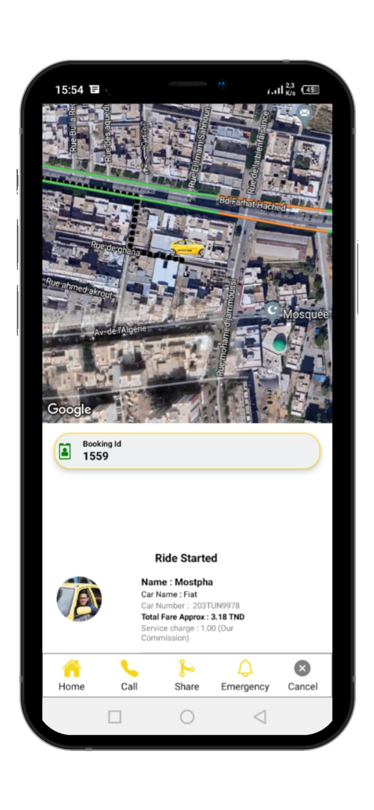
SlideSalad- COPYRIGHT NOTICE
Driver on the way
Last name The customer can see the captain's name in the trip start page.
SlideSalad is #1 online marketplace of premium presentations templates for all needs
Things you can’t do with the template
Resell or distribute the templates or backgrounds.
Make these templates available on a website or social network for download.
Edit or modify the downloaded templates and claim / pass off as your own work.
Vehicle name The customer can see the name of the captain's vehicle on the start trip page.
Vehicle number The customer can see the vehicle number in the start trip page.
Start ride
Driver distance The customer can see the driver distance in the trip start page
Duration The client can see the duration of the arrival of the captain at the starting point
Total Price Approx. The customer can see the total fare approx. for the total trip.
More PowerPoint, Google Slides and Keynote templates are available at www.SlideSalad.com
duty charge The customer can see the total service charge for the company

Slide 29
SlideSalad- COPYRIGHT NOTICE
Driver on the way
SlideSalad is #1 online marketplace of premium presentations templates for all needs
Homepage If the customer needs to go to the homepage During the ride he needs to click the home button.
Things you can’t do with the template
Resell or distribute the templates or backgrounds.
Make these templates available on a website or social network for download.
Edit or modify the downloaded templates and claim / pass off as your own work.
To call If you click the call button a call will be made to the driver.
To share After starting the customer journey, if the customer wants to share their live location with their friends or family, they need to click the share button.
Start ride
Emergency Once the journey begins, the customer needs an emergency, he must click the emergency button and enter the number of the parents or others who must be notified of the emergency.
To cancel The customer can cancel the reservation before the start of the trip while the driver is on the way, he needs to click the cancel button.
More PowerPoint, Google Slides and Keynote templates are available at www.SlideSalad.com

Slide 30
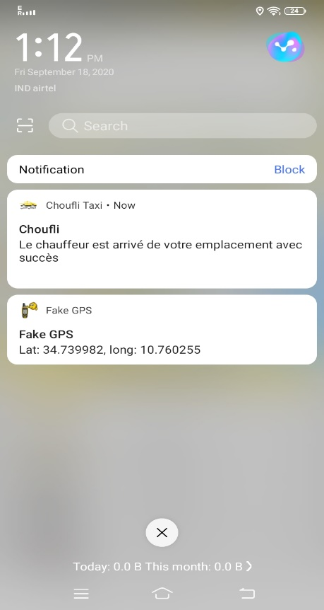
SlideSalad- COPYRIGHT NOTICE
Notification of arrival at the starting point location
SlideSalad is #1 online marketplace of premium presentations templates for all needs
Things you can do with the template
Use the free templates for your own presentations and projects without limitations.
Please link back to our website if you like our free designs or write a comment to this template on our website.
All copyright and intellectual property rights, without limitation, are retained by SlideSalad.com. By downloading and using this template, you agree to this statement.
Please contact us if you have any questions about usage: support@slidesalad.com
Things you can’t do with the template
Resell or distribute the templates or backgrounds.
Make these templates available on a website or social network for download.
Edit or modify the downloaded templates and claim / pass off as your own work.
Notify
Once the captain reaches the client's starting point location, the captain sends a notification to the client.
The client may receive a notification from the captain that he has arrived at the starting point location.
More PowerPoint, Google Slides and Keynote templates are available at www.SlideSalad.com

Slide 31
SlideSalad- COPYRIGHT NOTICE
Beginning of journey
SlideSalad is #1 online marketplace of premium presentations templates for all needs
Things you can do with the template
Use the free templates for your own presentations and projects without limitations.
Please link back to our website if you like our free designs or write a comment to this template on our website.
All copyright and intellectual property rights, without limitation, are retained by SlideSalad.com. By downloading and using this template, you agree to this statement.
Please contact us if you have any questions about usage: support@slidesalad.com
Things you can’t do with the template
Resell or distribute the templates or backgrounds.
Make these templates available on a website or social network for download.
Edit or modify the downloaded templates and claim / pass off as your own work.
Beginning of journey
After the captain arrives at the customer's starting point location, the captain begins a journey to drop off the customer at their end point location. The customer can see in the app. Choufli the start route and arrival point location page.
More PowerPoint, Google Slides and Keynote templates are available at www.SlideSalad.com

Slide 32
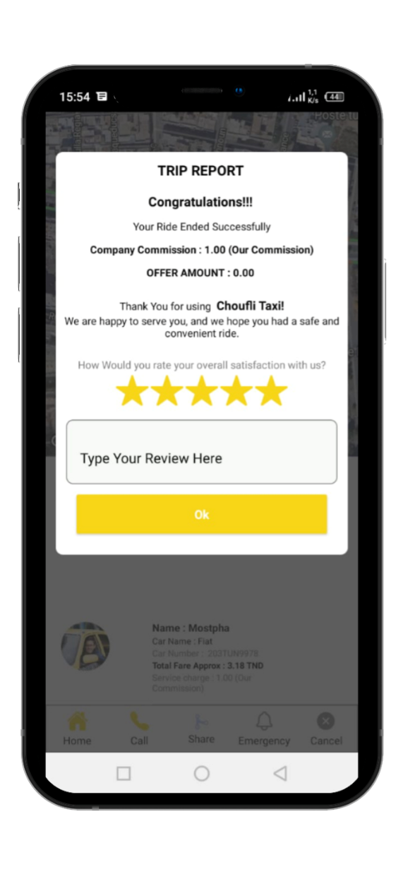
SlideSalad- COPYRIGHT NOTICE
End of journey
SlideSalad is #1 online marketplace of premium presentations templates for all needs
Things you can do with the template
Use the free templates for your own presentations and projects without limitations.
Please link back to our website if you like our free designs or write a comment to this template on our website.
All copyright and intellectual property rights, without limitation, are retained by SlideSalad.com. By downloading and using this template, you agree to this statement.
Please contact us if you have any questions about usage: support@slidesalad.com
Things you can’t do with the template
Resell or distribute the templates or backgrounds.
Make these templates available on a website or social network for download.
Edit or modify the downloaded templates and claim / pass off as your own work.
End of journey
Once the customer arrives at his location point of arrival the captain finishes the trip at its end, the customer receives the trip report once the trip is finished.
More PowerPoint, Google Slides and Keynote templates are available at www.SlideSalad.com

Slide 33
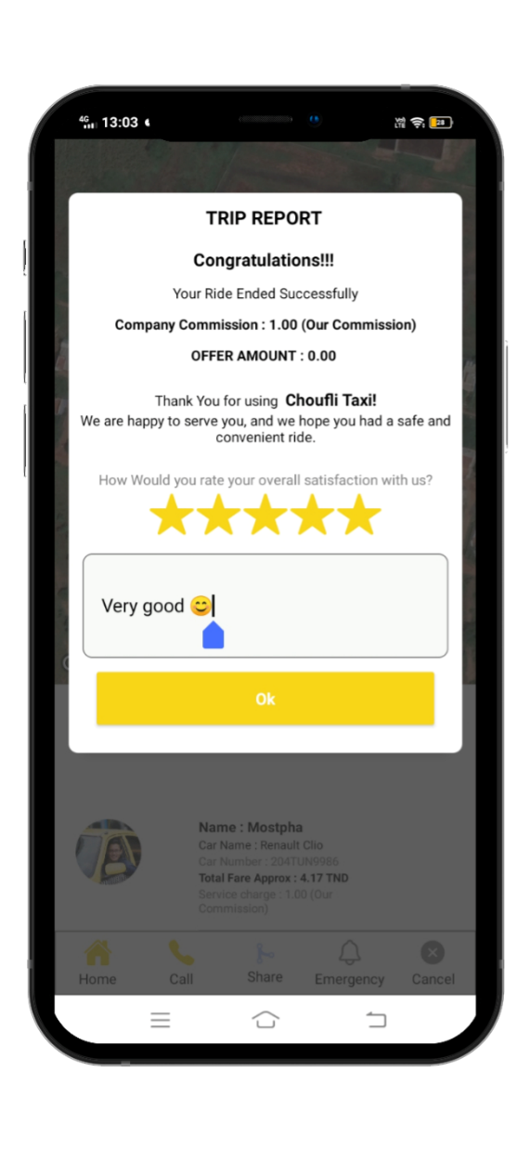
SlideSalad- COPYRIGHT NOTICE
Trip report
SlideSalad is #1 online marketplace of premium presentations templates for all needs
Trip report
The customer can receive congratulatory messages in the trip report from Choufli Taxi for each trip completed
Things you can do with the template
Use the free templates for your own presentations and projects without limitations.
Please link back to our website if you like our free designs or write a comment to this template on our website.
All copyright and intellectual property rights, without limitation, are retained by SlideSalad.com. By downloading and using this template, you agree to this statement.
Please contact us if you have any questions about usage: support@slidesalad.com
Things you can’t do with the template
Resell or distribute the templates or backgrounds.
Make these templates available on a website or social network for download.
Edit or modify the downloaded templates and claim / pass off as your own work.
Company Commission
The customer can see the company commission in the trip report.
Ratings
The customer should need to give ratings regarding the app. Choufli Taxi.
Bid amount
The customer can see the company's offers in the trip report.
Ratings
If the customer has a revision, he can type in the revision box.
More PowerPoint, Google Slides and Keynote templates are available at www.SlideSalad.com

Slide 34
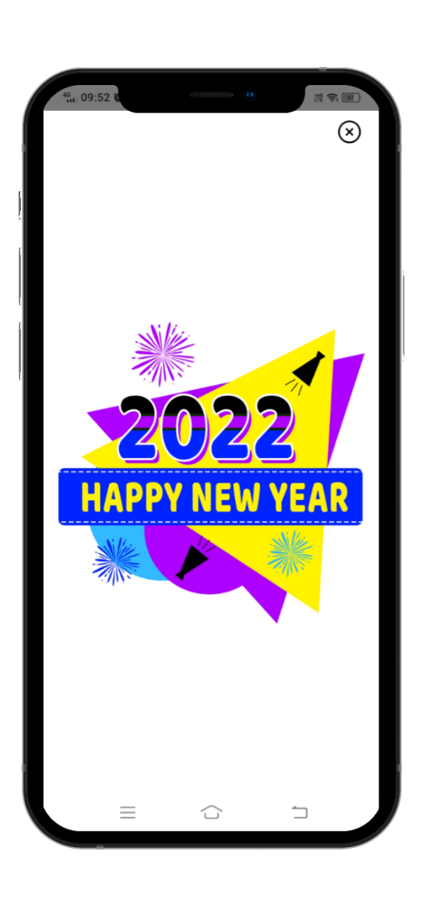
SlideSalad- COPYRIGHT NOTICE
To add
SlideSalad is #1 online marketplace of premium presentations templates for all needs
Things you can do with the template
Use the free templates for your own presentations and projects without limitations.
Please link back to our website if you like our free designs or write a comment to this template on our website.
All copyright and intellectual property rights, without limitation, are retained by SlideSalad.com. By downloading and using this template, you agree to this statement.
Please contact us if you have any questions about usage: support@slidesalad.com
Things you can’t do with the template
Resell or distribute the templates or backgrounds.
Make these templates available on a website or social network for download.
Edit or modify the downloaded templates and claim / pass off as your own work.
To add
After the trip report the customer can see advertisement on Choufli app.
More PowerPoint, Google Slides and Keynote templates are available at www.SlideSalad.com

Slide 35
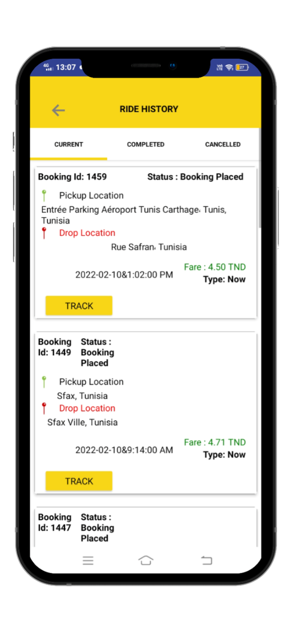
SlideSalad- COPYRIGHT NOTICE
Trip History
SlideSalad is #1 online marketplace of premium presentations templates for all needs
Things you can do with the template
Use the free templates for your own presentations and projects without limitations.
Please link back to our website if you like our free designs or write a comment to this template on our website.
All copyright and intellectual property rights, without limitation, are retained by SlideSalad.com. By downloading and using this template, you agree to this statement.
Please contact us if you have any questions about usage: support@slidesalad.com
Things you can’t do with the template
Resell or distribute the templates or backgrounds.
Make these templates available on a website or social network for download.
Edit or modify the downloaded templates and claim / pass off as your own work.
Current trip
The customer can see the current trip
The location of the customer's departure point and arrival point
Status
Captain's name
The type of reservation
Date hour
Vehicle name.
Trip completed
The customer can see the completed trip
The location of the customer's departure point and arrival point
Captain's name
Reservation type
Date hour
Vehicle name
Rate
Trip canceled
The customer can see trip canceled
The location of the customer's departure point and arrival point
Date hour
Reason for cancellation
More PowerPoint, Google Slides and Keynote templates are available at www.SlideSalad.com

Slide 36
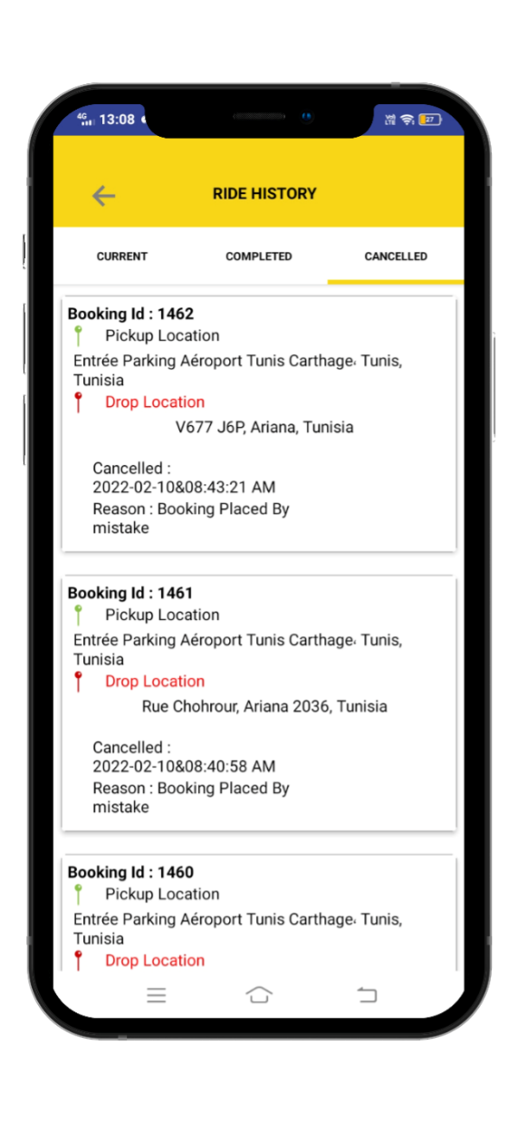
SlideSalad- COPYRIGHT NOTICE
Trip History
SlideSalad is #1 online marketplace of premium presentations templates for all needs
Things you can do with the template
Use the free templates for your own presentations and projects without limitations.
Please link back to our website if you like our free designs or write a comment to this template on our website.
All copyright and intellectual property rights, without limitation, are retained by SlideSalad.com. By downloading and using this template, you agree to this statement.
Please contact us if you have any questions about usage: support@slidesalad.com
Things you can’t do with the template
Resell or distribute the templates or backgrounds.
Make these templates available on a website or social network for download.
Edit or modify the downloaded templates and claim / pass off as your own work.
Current trip
The customer can see the current trip
The location of the customer's departure point and arrival point
Status.
Captain's name.
The type of reservation.
Date hour.
Vehicle name.
Trip completed
The customer can see the completed trip.
The location of the customer's departure point and arrival point.
Captain's name.
Type of reservation.
Date hour.
Vehicle name.
Rate.
Trip canceled
The customer can see trip canceled.
The point location. customer departure and arrival point.
Date hour.
Reason for cancellation.
track ride
Customer can track the booking if click track ride button.
More PowerPoint, Google Slides and Keynote templates are available at www.SlideSalad.com

Slide 37
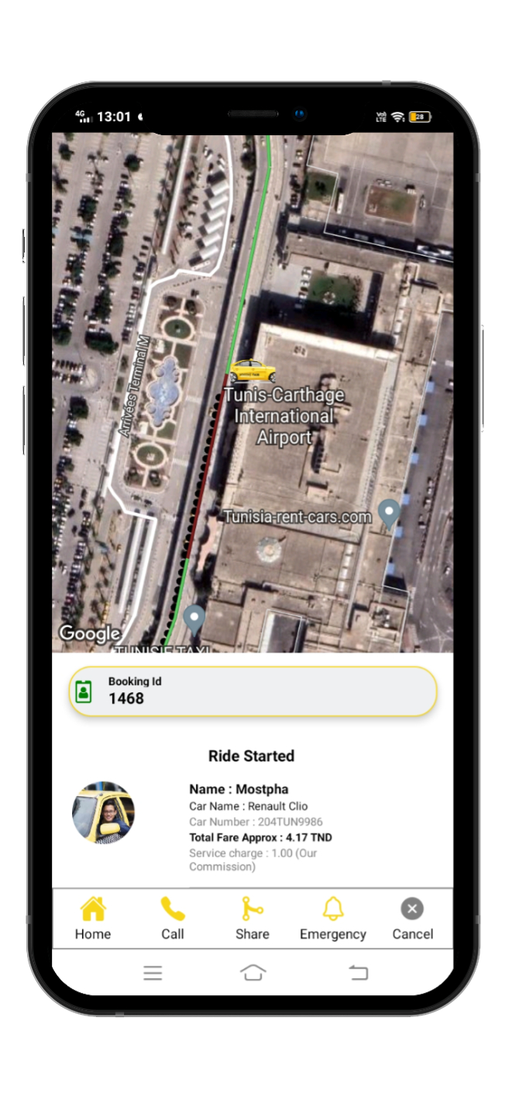
SlideSalad- COPYRIGHT NOTICE
Follow the route
SlideSalad is #1 online marketplace of premium presentations templates for all needs
Things you can do with the template
Use the free templates for your own presentations and projects without limitations.
Please link back to our website if you like our free designs or write a comment to this template on our website.
All copyright and intellectual property rights, without limitation, are retained by SlideSalad.com. By downloading and using this template, you agree to this statement.
Please contact us if you have any questions about usage: support@slidesalad.com
Things you can’t do with the template
Resell or distribute the templates or backgrounds.
Make these templates available on a website or social network for download.
Edit or modify the downloaded templates and claim / pass off as your own work.
Follow the route
The customer can follow the reservation if he clicks the button follow the reservation
More PowerPoint, Google Slides and Keynote templates are available at www.SlideSalad.com

Slide 38
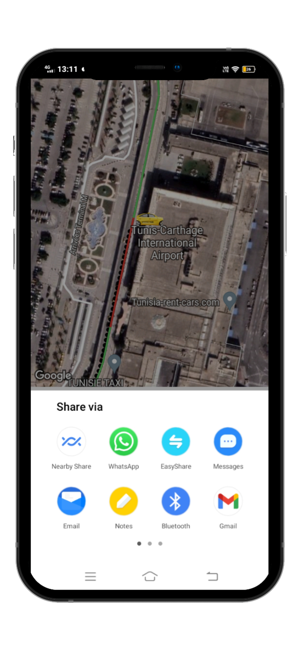
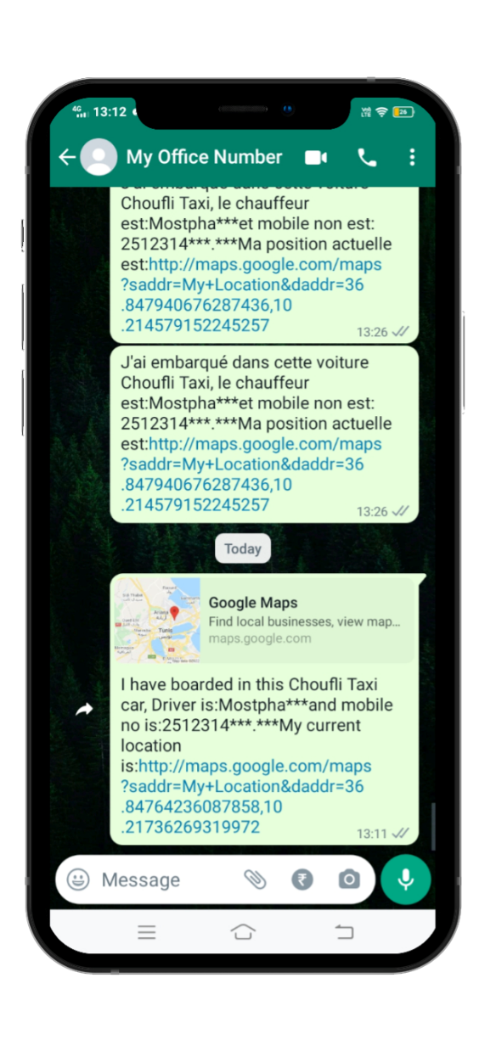
SlideSalad- COPYRIGHT NOTICE
Share location
SlideSalad is #1 online marketplace of premium presentations templates for all needs
Things you can do with the template
Use the free templates for your own presentations and projects without limitations.
Please link back to our website if you like our free designs or write a comment to this template on our website.
All copyright and intellectual property rights, without limitation, are retained by SlideSalad.com. By downloading and using this template, you agree to this statement.
Please contact us if you have any questions about usage: support@slidesalad.com
Things you can’t do with the template
Resell or distribute the templates or backgrounds.
Make these templates available on a website or social network for download.
Edit or modify the downloaded templates and claim / pass off as your own work.
Share location
After starting the ride, if the customer wants to share his current location with his friends or family, he needs to click the share button and he can share through what's app, email and some other platforms.
More PowerPoint, Google Slides and Keynote templates are available at www.SlideSalad.com

Slide 39
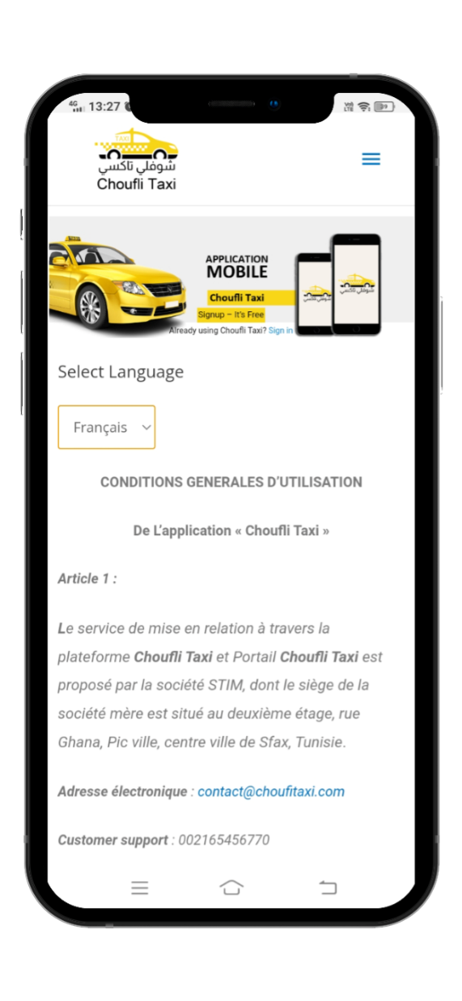
SlideSalad- COPYRIGHT NOTICE
Terms & Conditions
SlideSalad is #1 online marketplace of premium presentations templates for all needs
Things you can do with the template
Use the free templates for your own presentations and projects without limitations.
Please link back to our website if you like our free designs or write a comment to this template on our website.
All copyright and intellectual property rights, without limitation, are retained by SlideSalad.com. By downloading and using this template, you agree to this statement.
Please contact us if you have any questions about usage: support@slidesalad.com
Things you can’t do with the template
Resell or distribute the templates or backgrounds.
Make these templates available on a website or social network for download.
Edit or modify the downloaded templates and claim / pass off as your own work.
Terms & Conditions
U Terms & Conditions for customer he can read at any time from Choufli app portal.
More PowerPoint, Google Slides and Keynote templates are available at www.SlideSalad.com

Slide 40
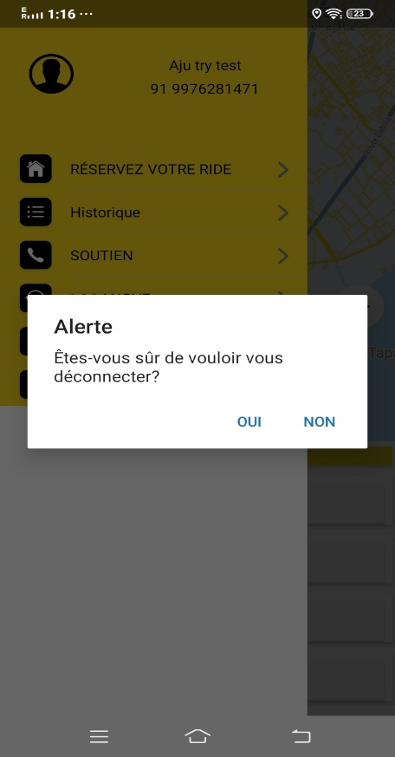
SlideSalad- COPYRIGHT NOTICE
Sign out
SlideSalad is #1 online marketplace of premium presentations templates for all needs
Things you can do with the template
Use the free templates for your own presentations and projects without limitations.
Please link back to our website if you like our free designs or write a comment to this template on our website.
All copyright and intellectual property rights, without limitation, are retained by SlideSalad.com. By downloading and using this template, you agree to this statement.
Please contact us if you have any questions about usage: support@slidesalad.com
Things you can’t do with the template
Resell or distribute the templates or backgrounds.
Make these templates available on a website or social network for download.
Edit or modify the downloaded templates and claim / pass off as your own work.
Sign out
Logout option for the customer when he needs a long break or other personal issues, he can log out of the app. At any time.
More PowerPoint, Google Slides and Keynote templates are available at www.SlideSalad.com

Slide 41
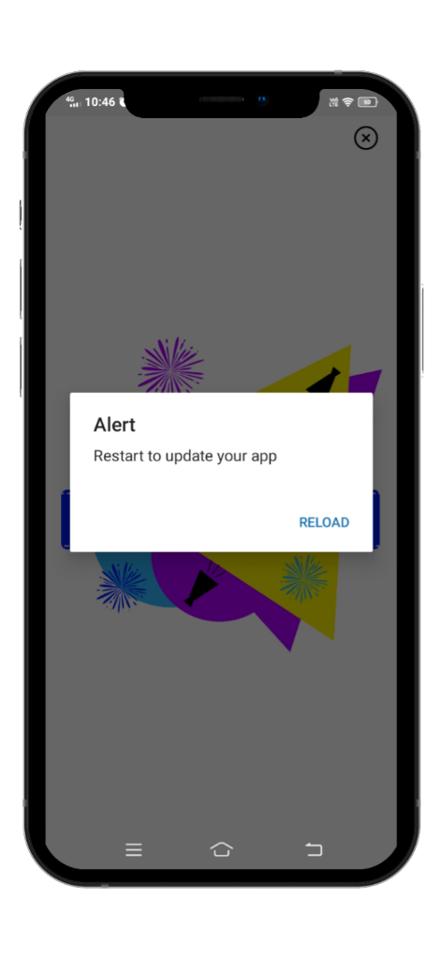
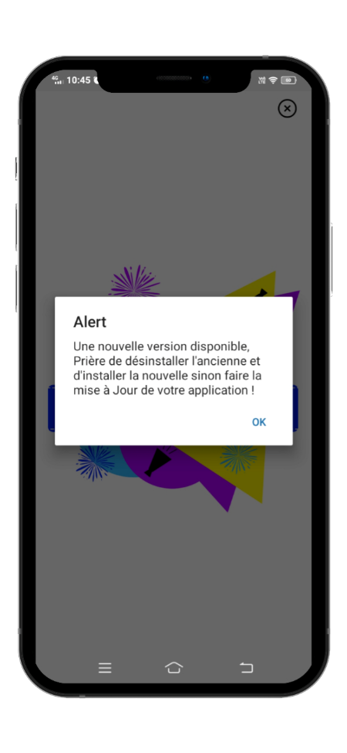
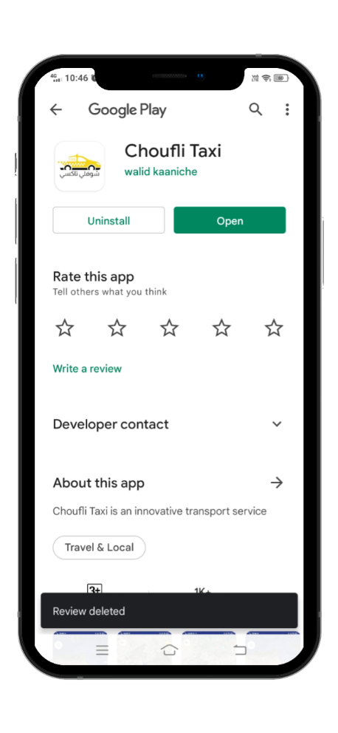
SlideSalad- COPYRIGHT NOTICE
New version
SlideSalad is #1 online marketplace of premium presentations templates for all needs
Things you can do with the template
Use the free templates for your own presentations and projects without limitations.
Please link back to our website if you like our free designs or write a comment to this template on our website.
All copyright and intellectual property rights, without limitation, are retained by SlideSalad.com. By downloading and using this template, you agree to this statement.
Please contact us if you have any questions about usage: support@slidesalad.com
Things you can’t do with the template
Resell or distribute the templates or backgrounds.
Make these templates available on a website or social network for download.
Edit or modify the downloaded templates and claim / pass off as your own work.
Alert
If the Choufli Taxi company updates the app portal. With new features it means the customer's existing application must need to be updated.
Then the client opens the application and it asks to be updated. Customer must need to click "yes" button for update
Play store & App store
After clicking “OK” it is redirected to play store for update, customer needs to click update option in play store to update.
Play store and App store
After updating the app, the customer needs to click re-download to open the app with new updated features in Choufli Taxi.
More PowerPoint, Google Slides and Keynote templates are available at www.SlideSalad.com

